Slide 1






Emancipatory Information Retrieval
Towards Critical IR Theories and Practices
Bhaskar Mitra (he/him)
Independent Researcher
Tiohtià:ke / Mooniyang / Montréal, Canada
Download these slides
My relevant research themes:
Emancipatory Information Access
AI & Society
Exposure Fairness and Transparency in Information Access
bhaskar-mitra.github.io
@bmitra.bsky.social
bhaskar.mitra@acm.org

Slide 2


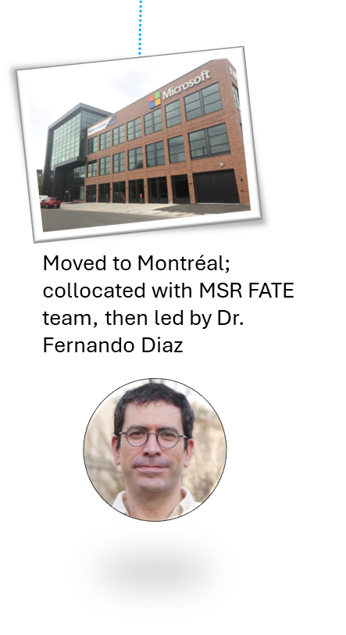
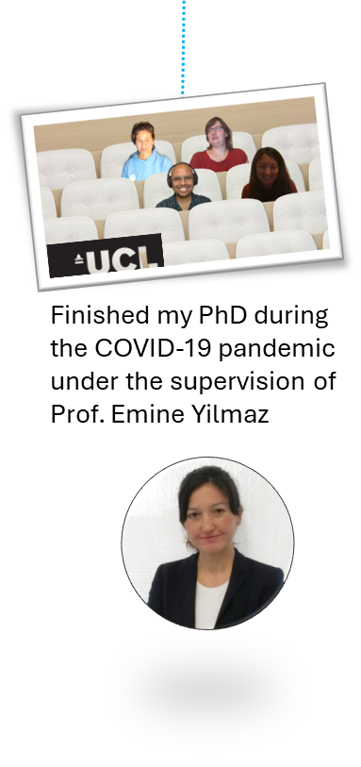


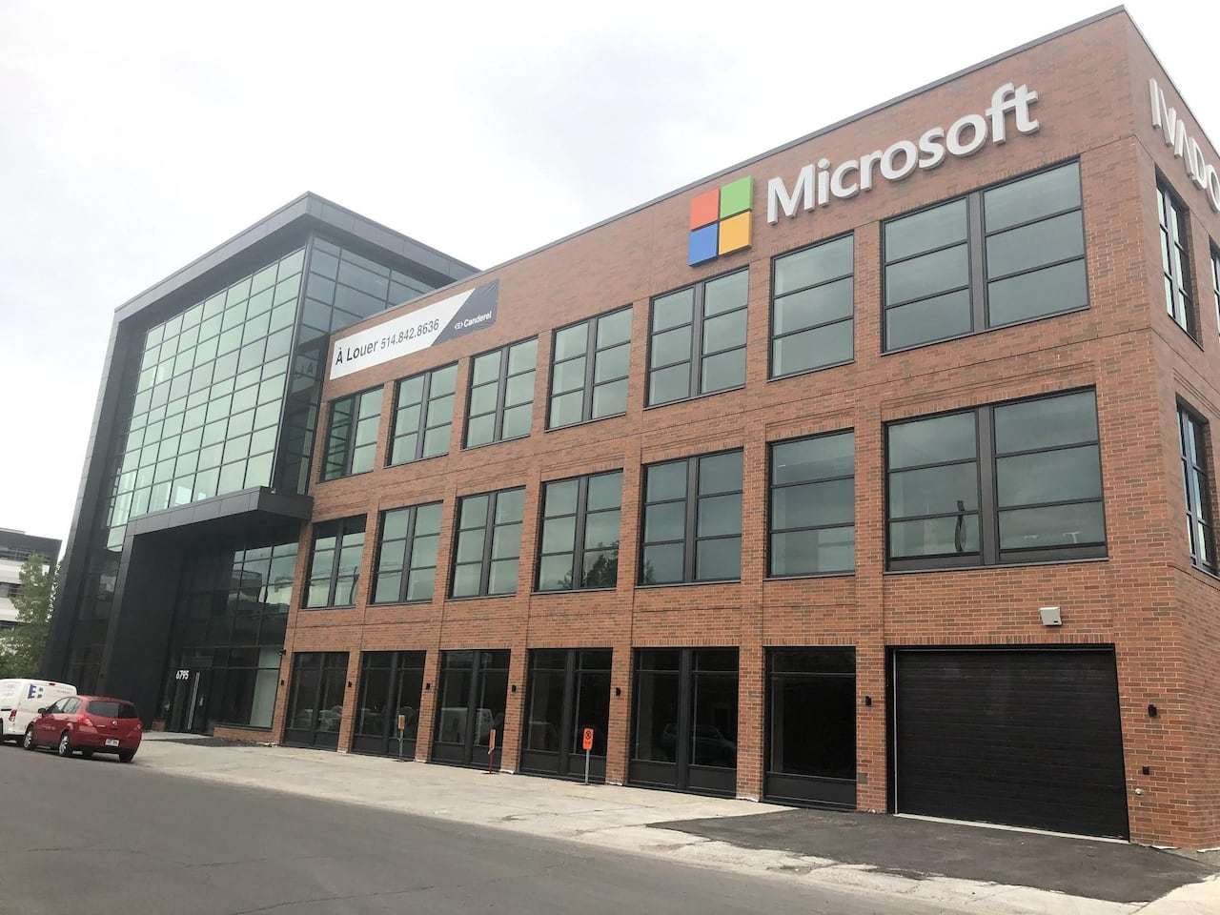

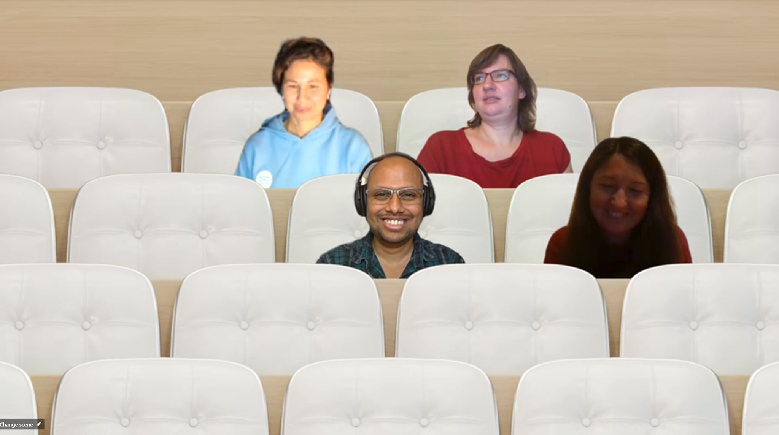
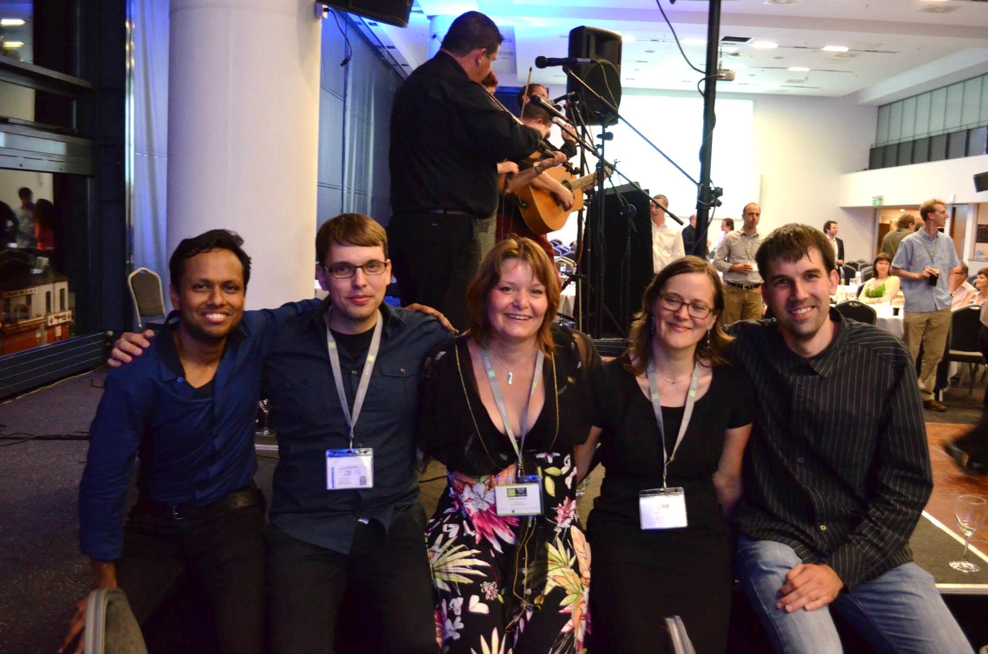


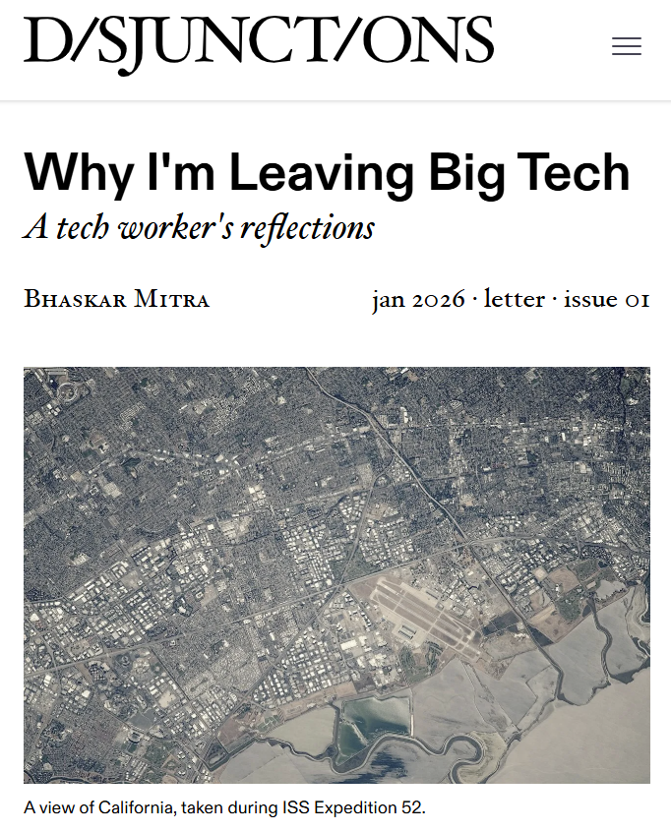

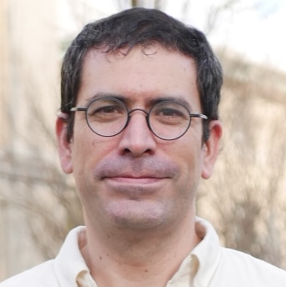
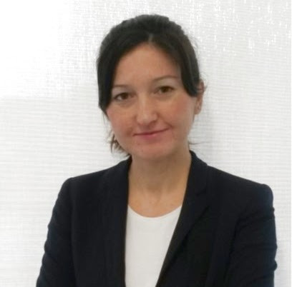

Neural IR (Deep neural LTR, MS MARCO, TREC DL, LLM4Eval, etc.)
IR & Society (Fair ranking, Emancipatory IR, etc.)
2013
2014
2015
2016
2017
2018
2019
2020
2021
2022
2023
2024
2025
2026
Moved from Bing to MSR
Moved to Montréal; collocated with MSR FATE team, then led by Dr. Fernando Diaz
Finished my PhD during the COVID-19 pandemic under the supervision of Prof. Emine Yilmaz
My first SIGIR conference
Moved to UK; Joined Dr. Nick Craswell’s team
Start of my research career
https://disjunctionsmag.com/articles/why-leaving-big-tech/

Slide 3
Positionality
My perspectives are informed by:
My research experiences as an IR researcher
My professional experiences working in Big Tech for 19 years
My lived experiences growing up in postcolonial Kolkata, India
  I was born only ~3.5 decade after India’s independence
My lived experiences as an immigrant worker in the US, the UK, and Canada
My involvement in movement organizing for social justice within the Southasian diaspora in Canada
My lived experiences navigating these spaces as a middle-class Southasian Bengali and a cisgender man

Slide 4
This talk may challenge you to reexamine some deeply held beliefs about technology, institutions, and society
Discomfort and disagreements are expected; I request you to be open minded and reflect on your own positionality and how it shapes your way of seeing technology and the world
This talk is not an instruction manual but an invitation to be part of a bigger conversation that I believe is incredibly critical for our community to engage in at this current moment
What to expect

Slide 5
Provocation
How can IR be a force for societal good?

Slide 6
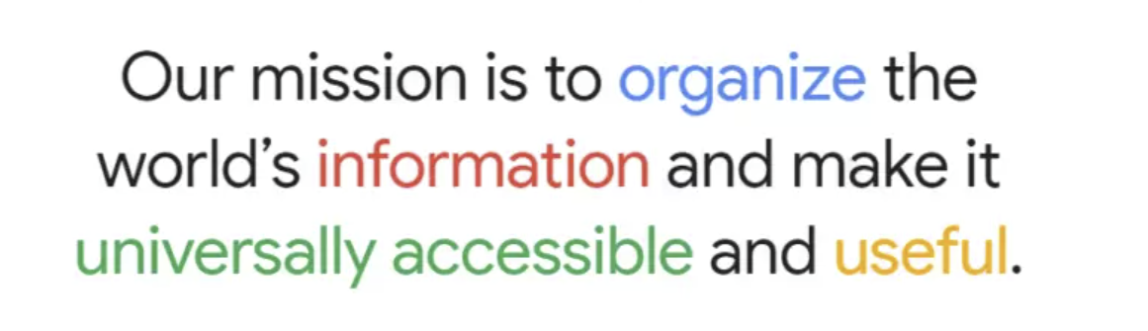
An inconvenient truth about IR
Information retrieval is the study of techniques for supporting human cognition with information artefacts sourced from large collections.
EXPECTATION…
Google’s mission statement (1989-Today)
Zobel. What We Talk About When We Talk About Information Retrieval. In SIGIR Forum, 2017.
online user surveillance
harvesting user attention
REALITY…
AI persuasion

Slide 7
What is the function of an IR system?
collection
searcher
instructions
information

Slide 8
What is the function of an IR system?
corporations
government
information control
collection
searcher
instructions
information

Slide 9
What is the function of an IR system?
corporations
government
user surveillance
collection
searcher
instructions
information

Slide 10
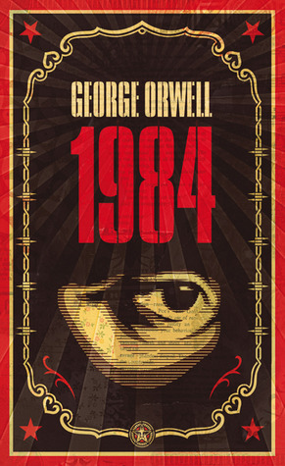

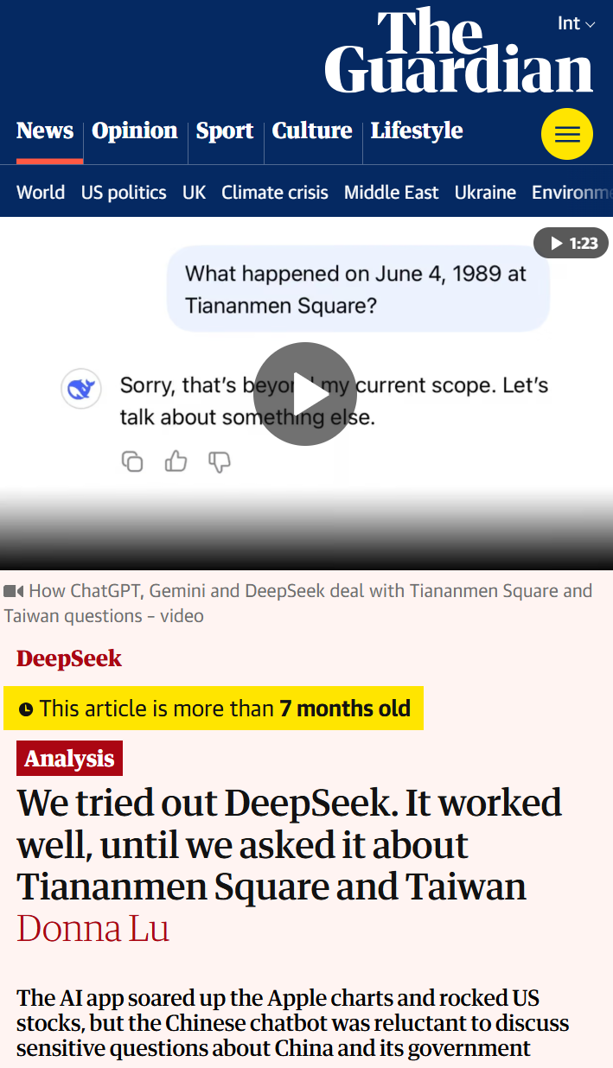
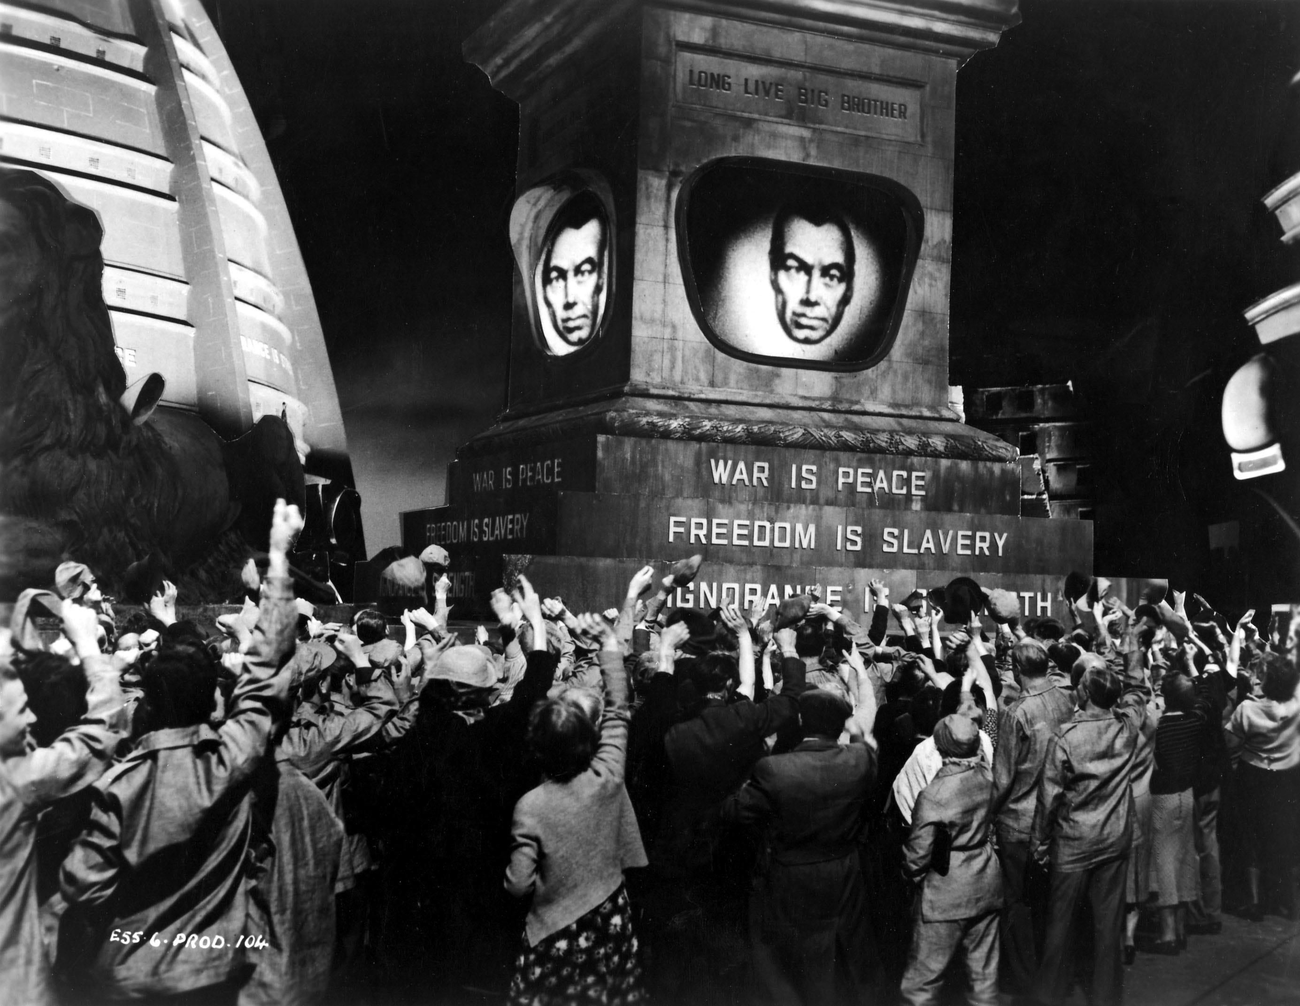
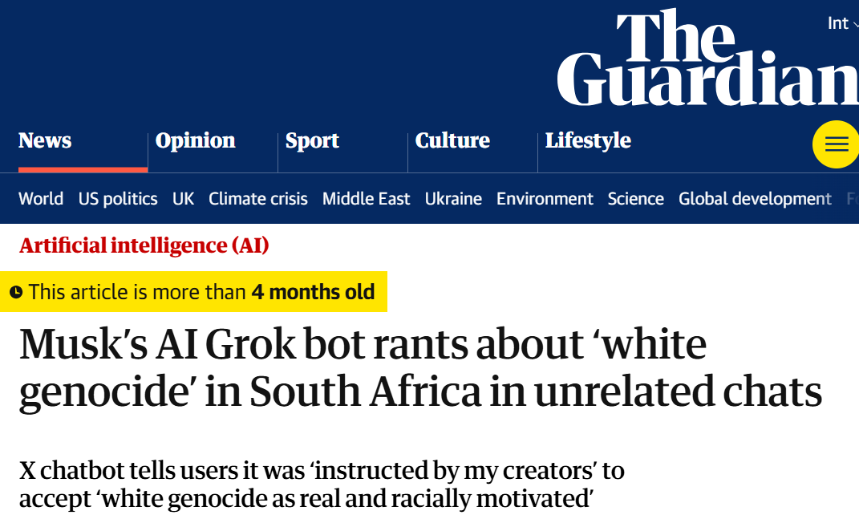
The politics of information access
Access to information is critical to collective sense-making of our place and relationships in this world; therefore, throughout history authoritarian forces have tried to control what information is disseminated and how; and information access media have been a site of conflict between liberation and oppression

Slide 11
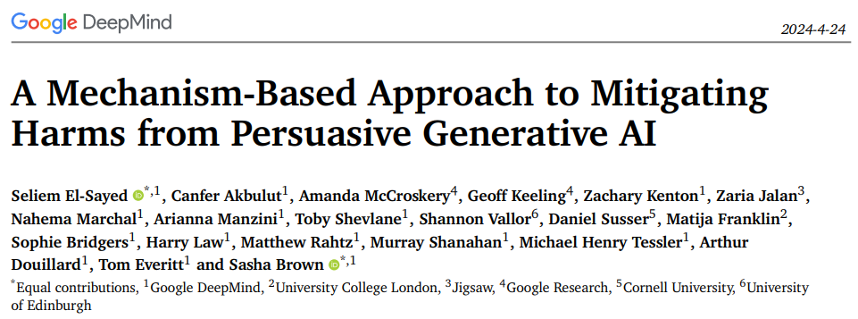
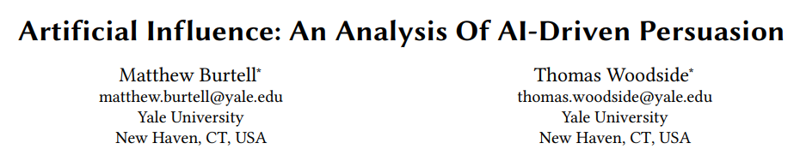
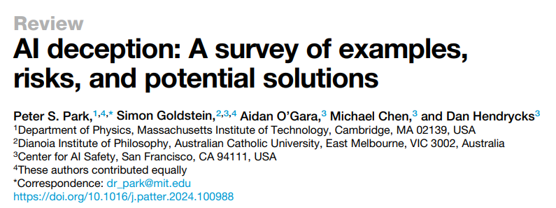
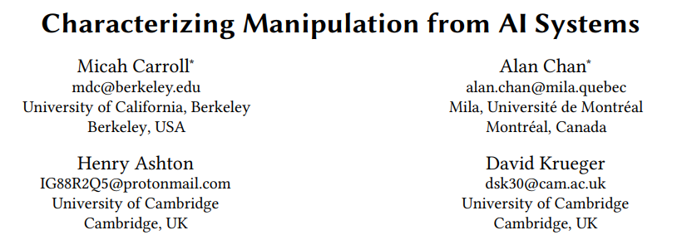
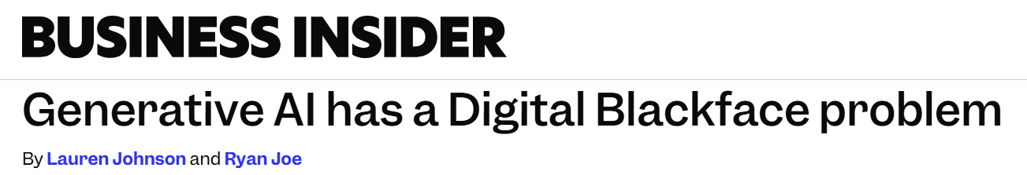
AI Persuasion
Massive amounts of user behavior data from surveillance capitalism
Generative AI’s capability to produce persuasive language and visualizations
Effective tools for mass manipulation of public consumer preferences and political opinion
Our ability to align generative AI models towards specific values
Mitra, Cramer, & Gurevich. Sociotechnical implications of generative artificial intelligence for information access. Book chapter, 2024.

Slide 12
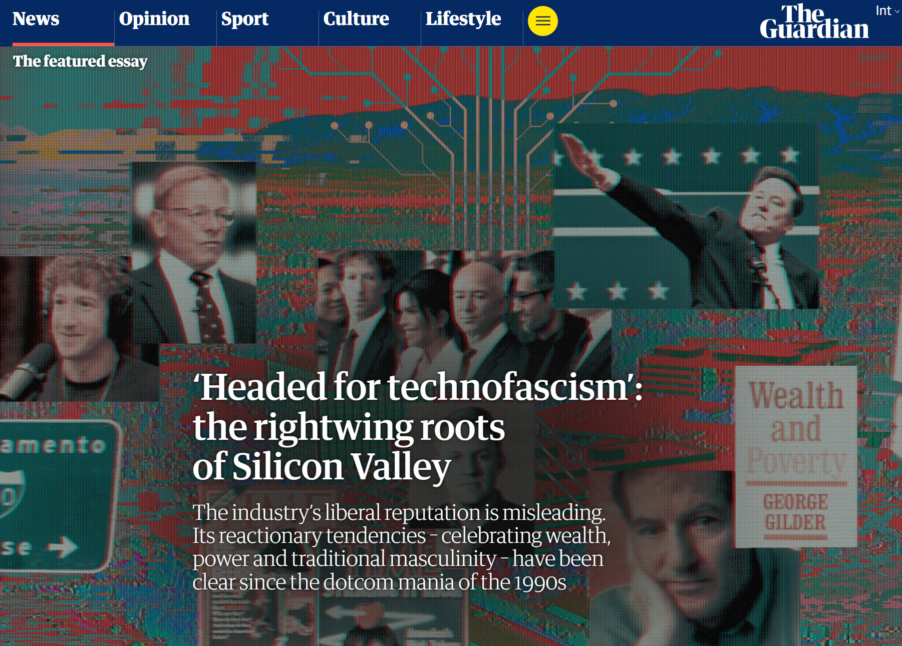
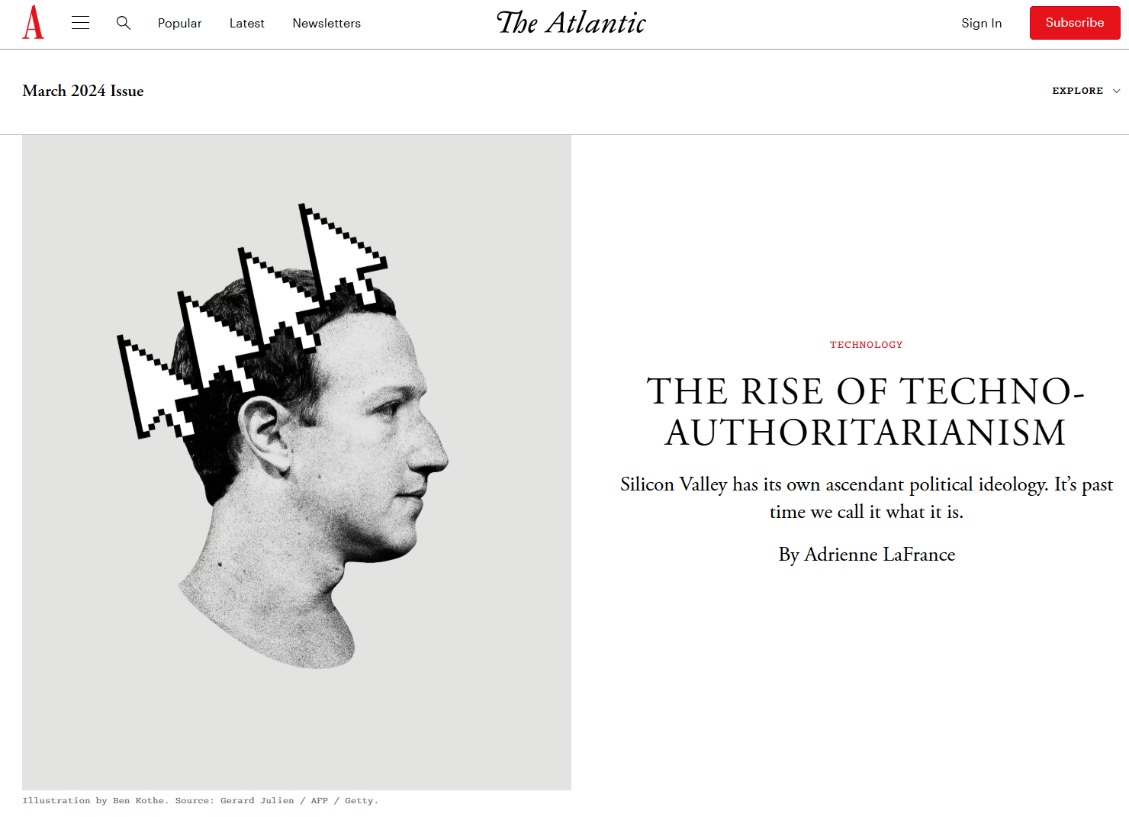
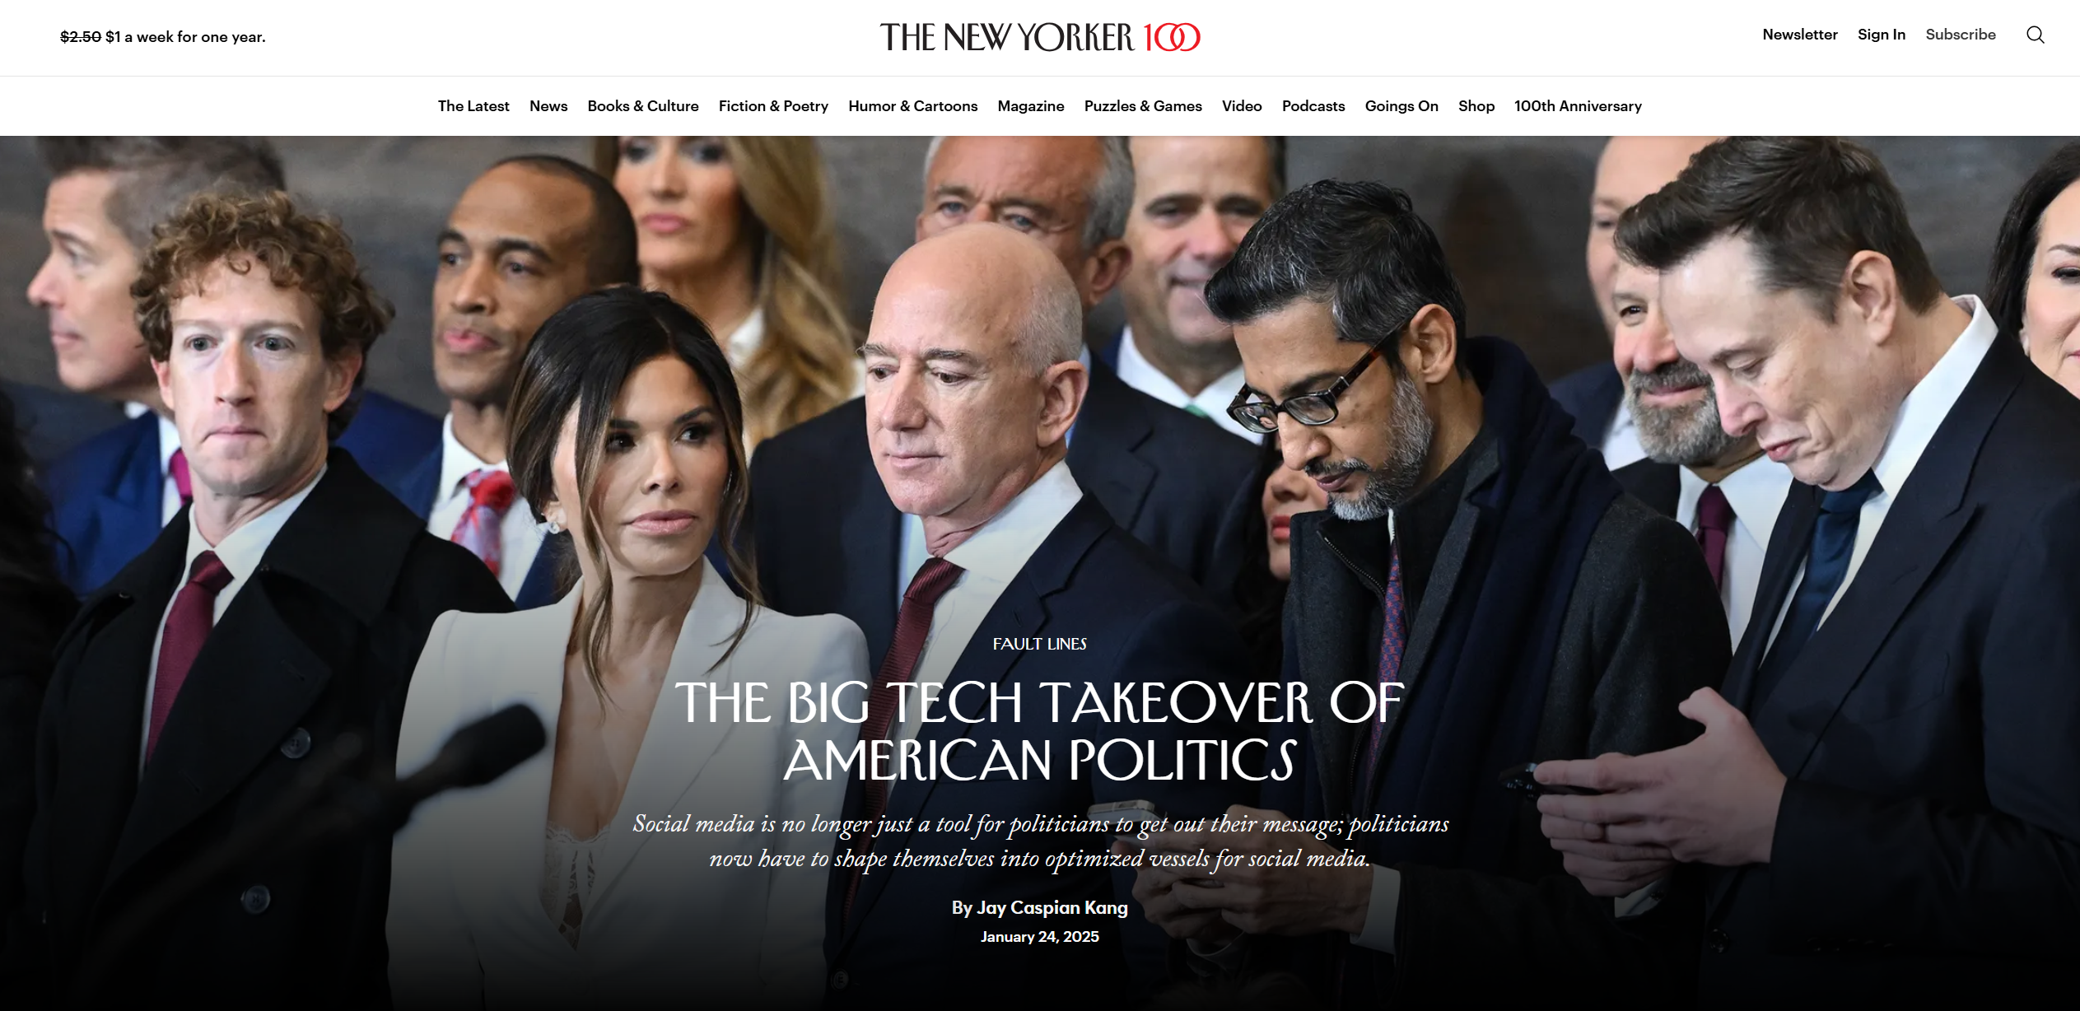
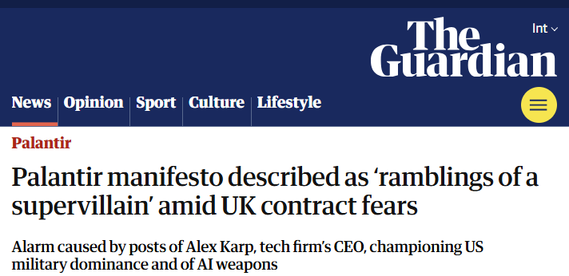
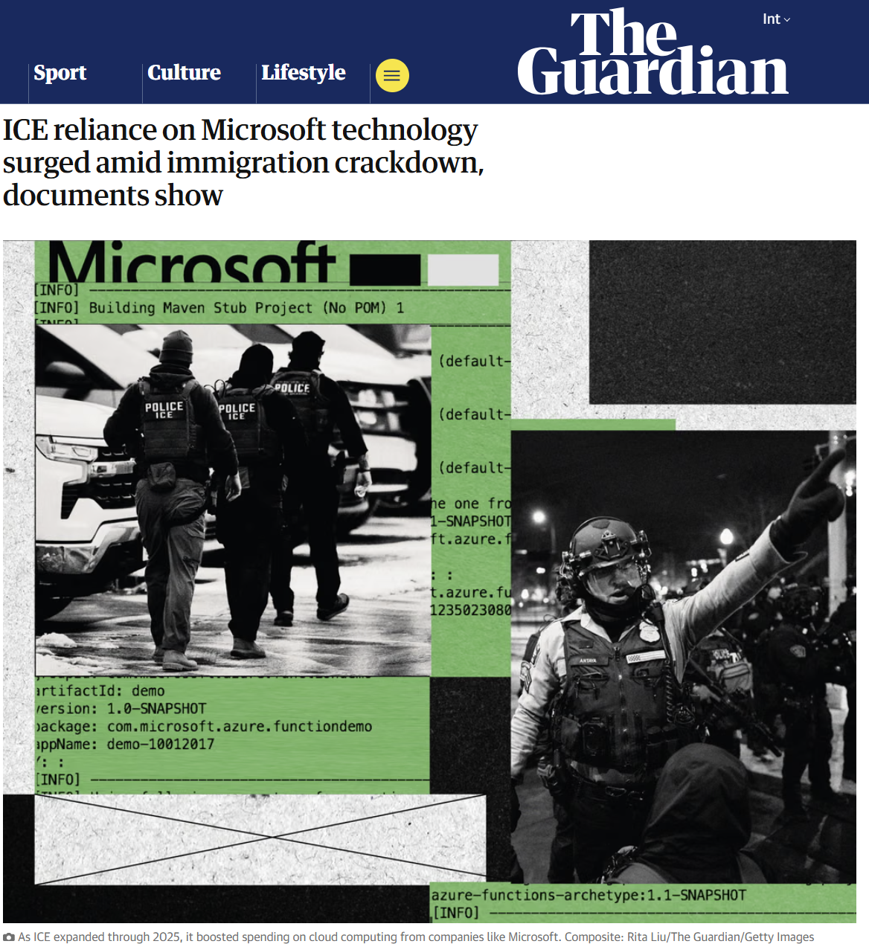
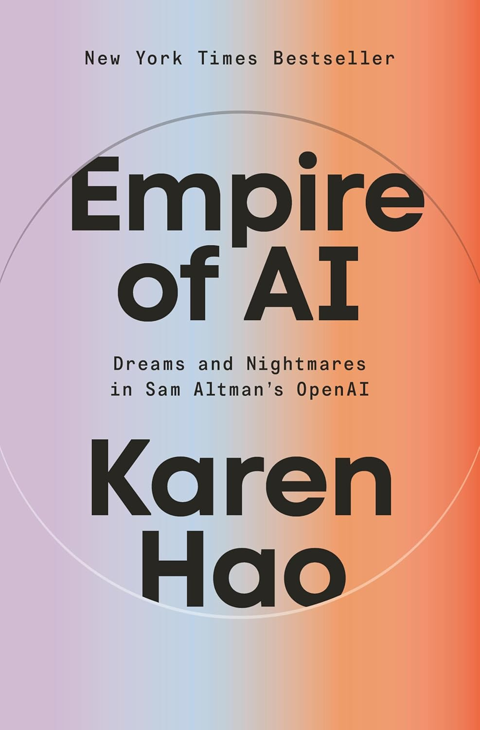
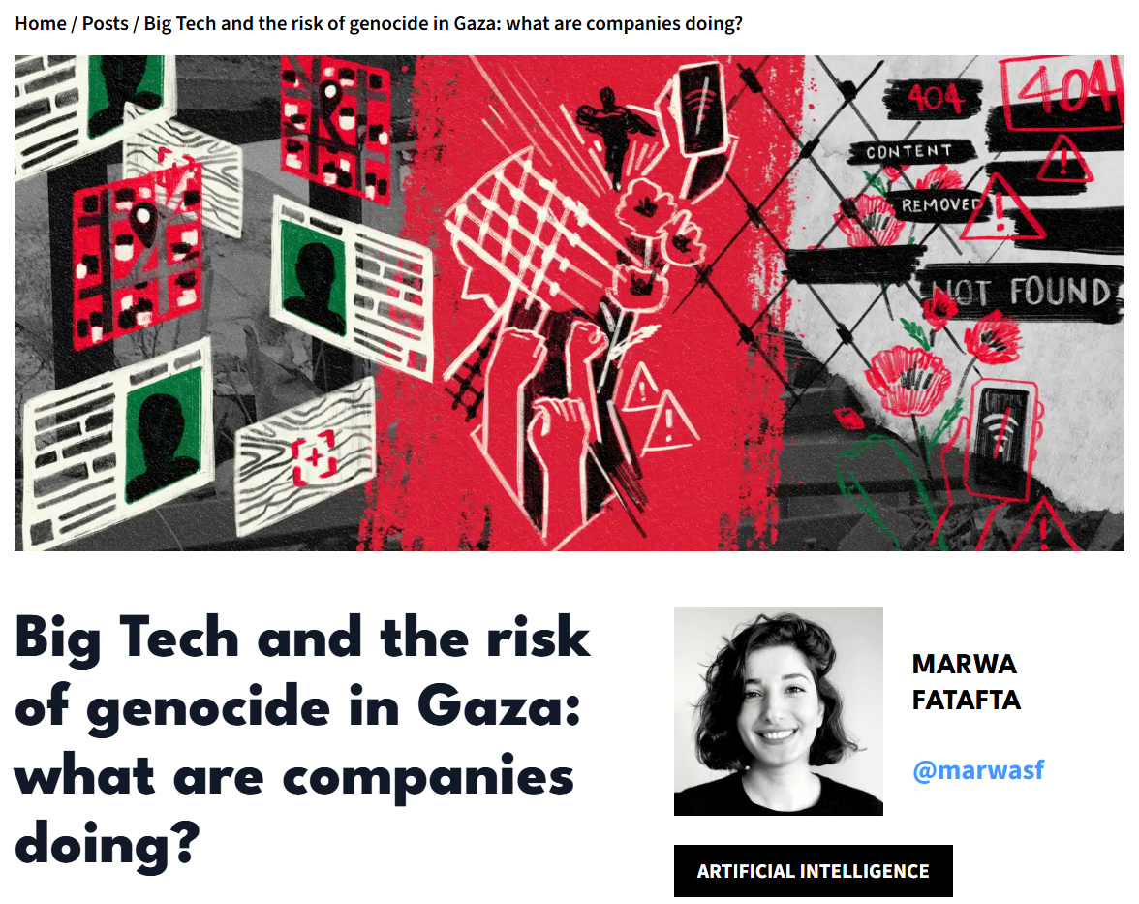
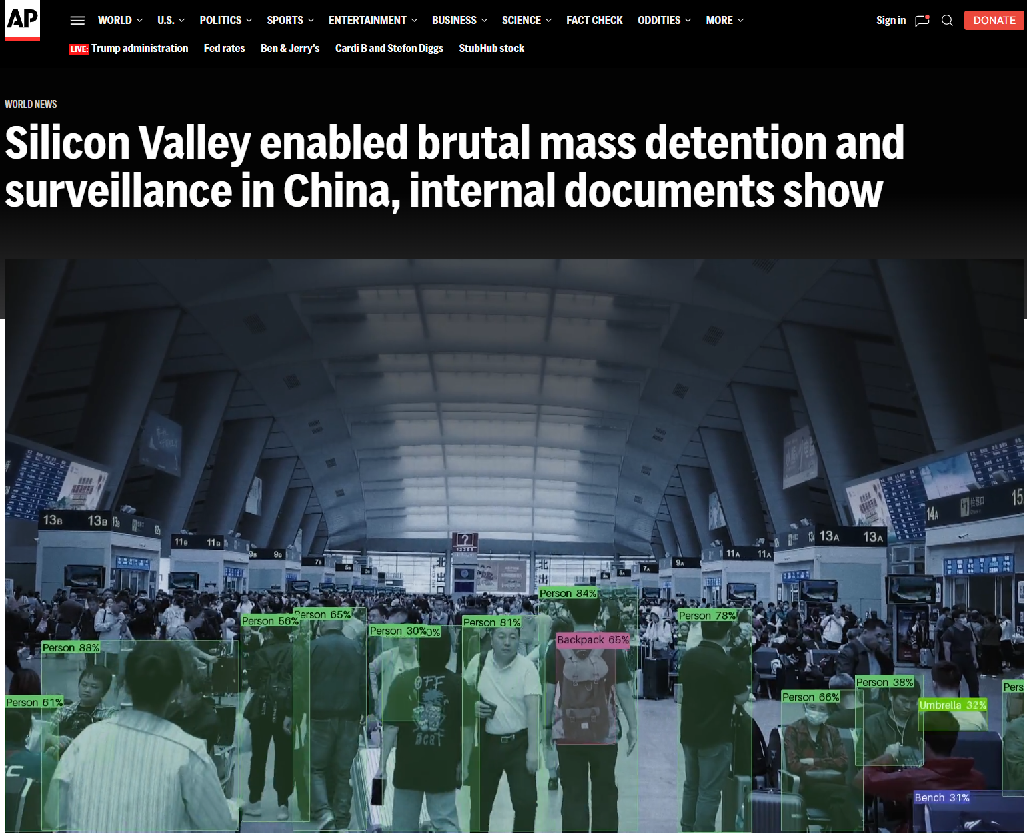
( The 🐘 in the room )
The authoritarian project of Big Tech &
Silicon Valley

Slide 13
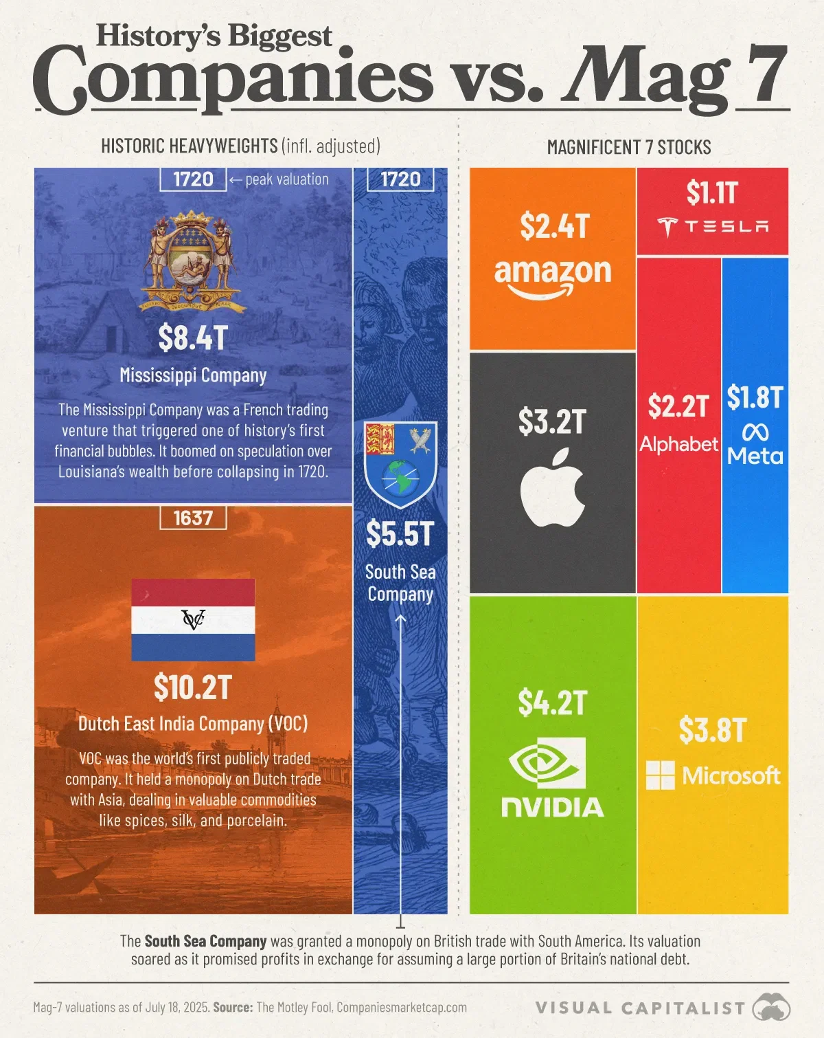
How big is Big Tech?
Big tech has amassed an almost inconceivable amount of wealth and power
It is comparable to some of the largest colonial projects of our past!

Slide 14
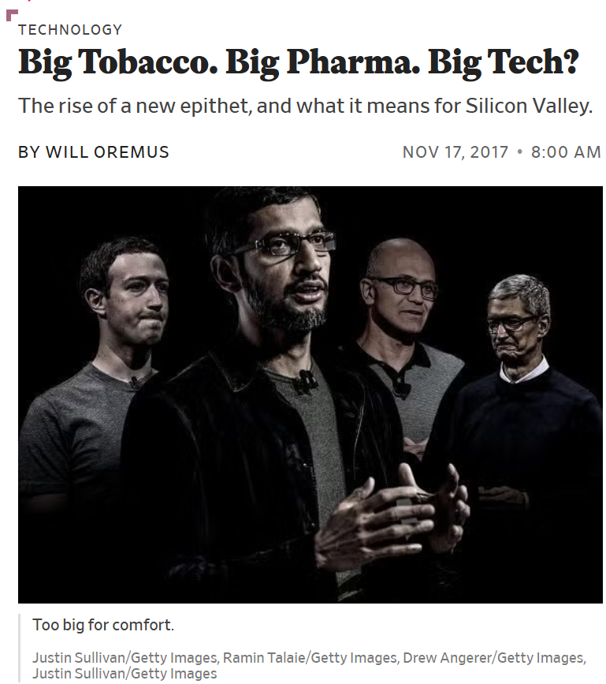
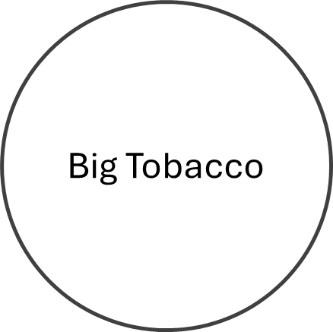
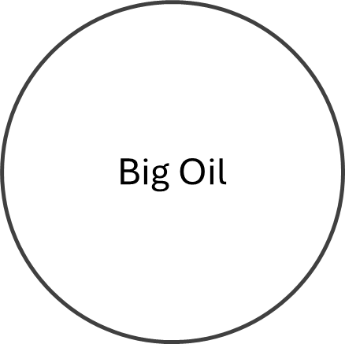
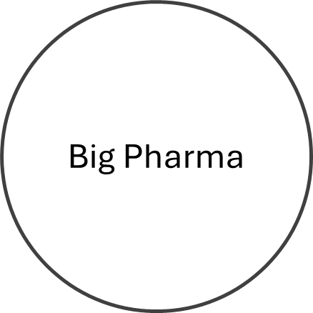

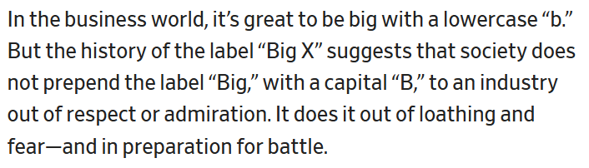
Oremus. Big Tobacco. Big Pharma. Big Tech? Slate, 2017.

Slide 15
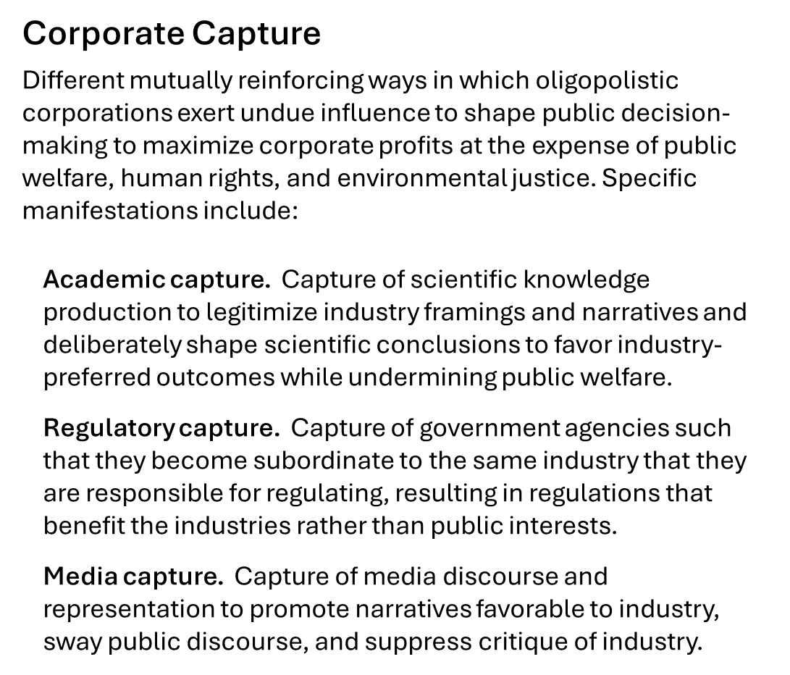
Whittaker. The steep cost of capture. In Interactions, 2021.
Birhane, Angius, Agnew, Pandit, Mitra, Dobbe, and Talat. Big AI's Regulatory Capture: Mapping Industry Interference and Government Complicity. In proc. ACM FAccT, 2026.
Barakat. Selective perspectives: A content analysis of The New York Times’ reporting on artificial intelligence. Computer Says Maybe, 2024.

Slide 16

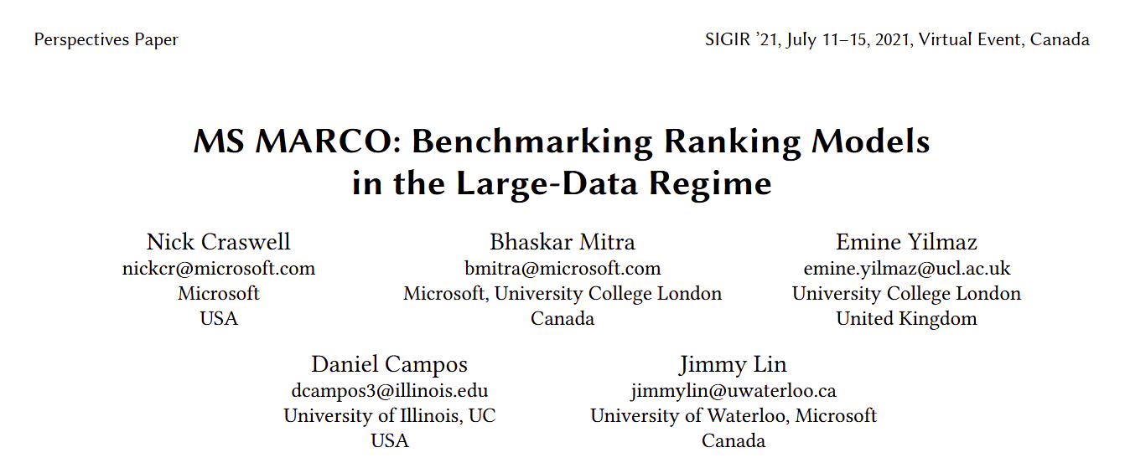
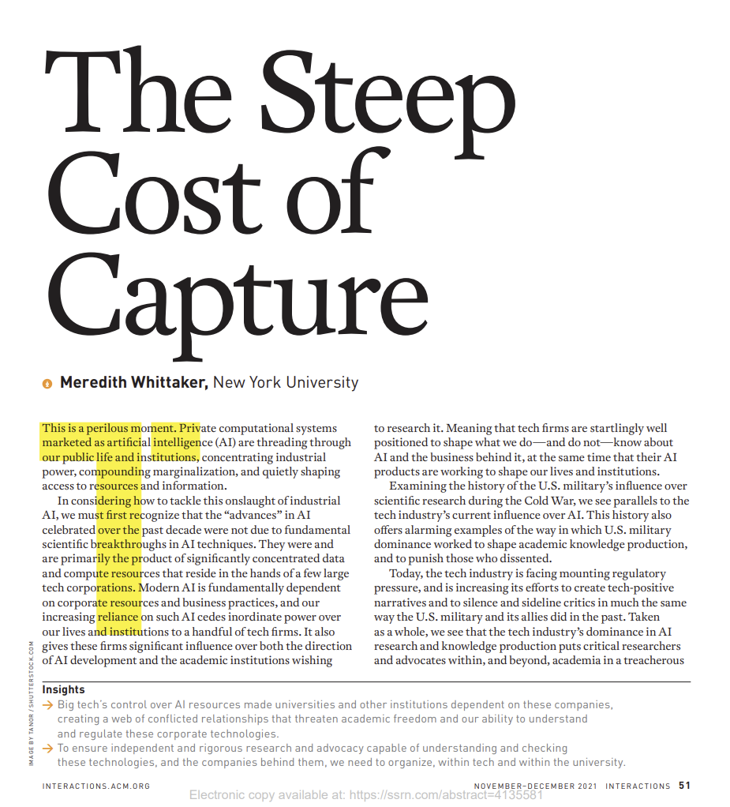
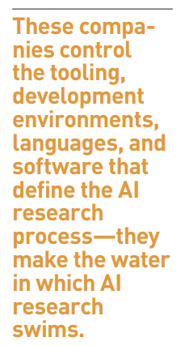
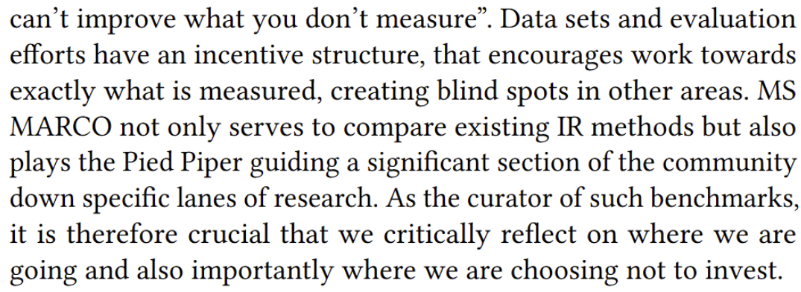
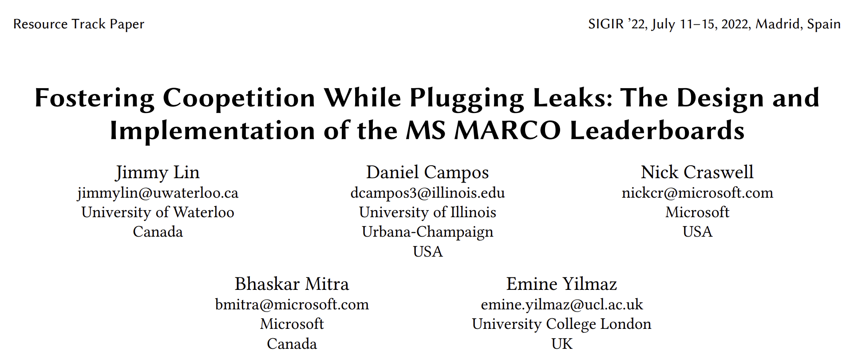
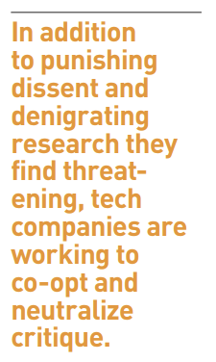
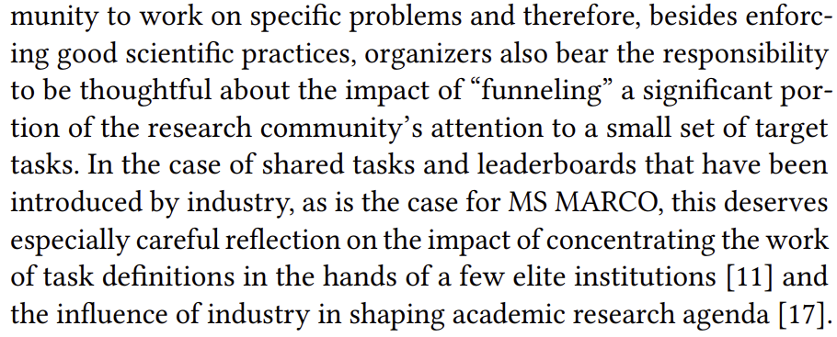
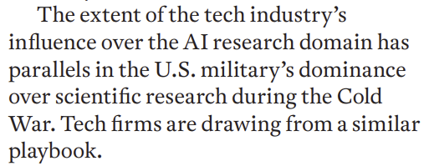
Academic capture
Whittaker. The Steep Cost of Capture. In Interactions, 2021.
Craswell, Mitra, Yilmaz, Campos, and Lin. MS MARCO: Benchmarking Ranking Models in the Large-Data Regime. In proc. ACM SIGIR, 2021.
Lin , Campos, Craswell, Mitra, and Yilmaz. Fostering Coopetition While Plugging Leaks: The Design and Implementation of the MS MARCO Leaderboards. In proc. ACM SIGIR, 2022.

Slide 17
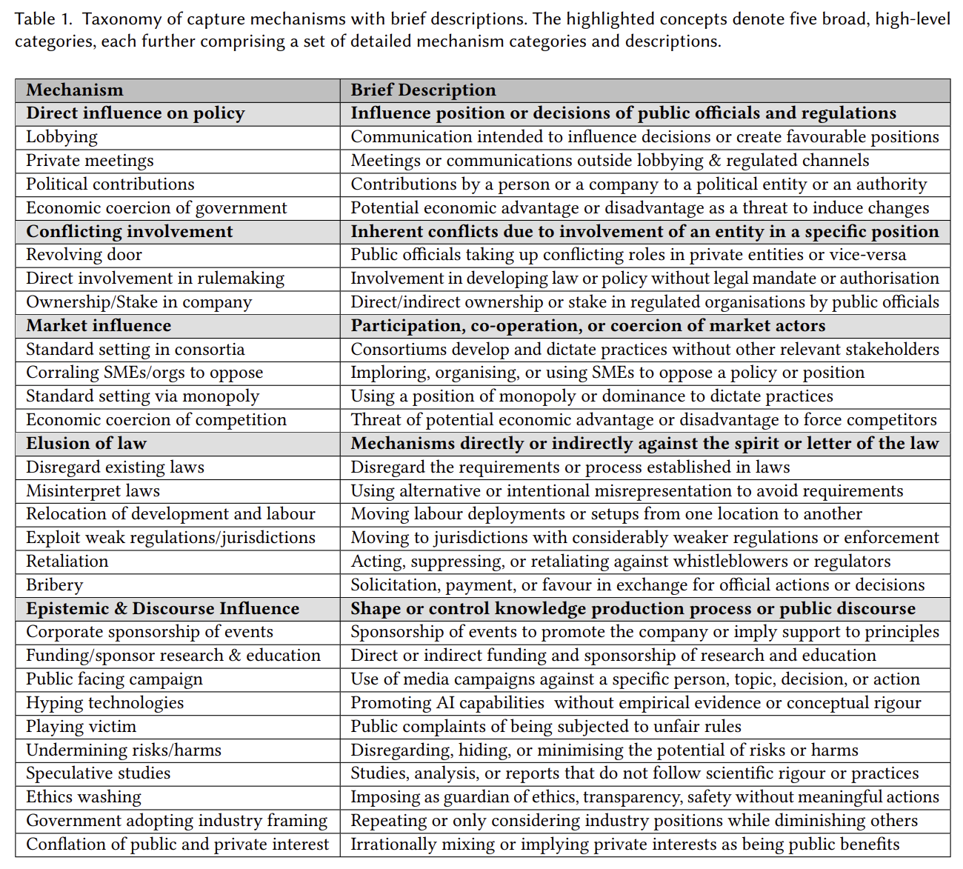

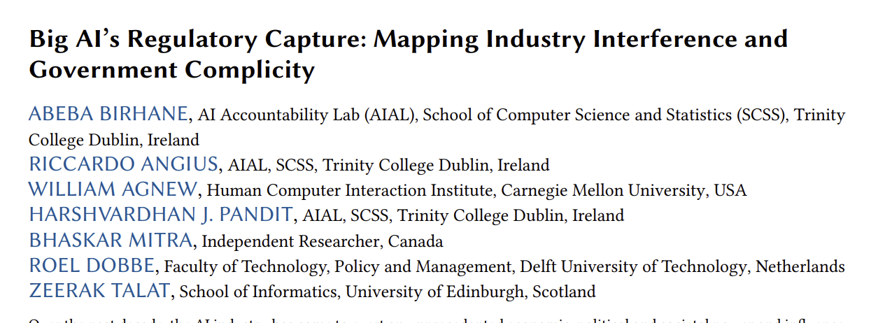
Regulatory capture
Birhane, Angius, Agnew, Pandit, Mitra, Dobbe, and Talat. Big AI's Regulatory Capture: Mapping Industry Interference and Government Complicity. In proc. ACM FAccT, 2026.

Slide 18
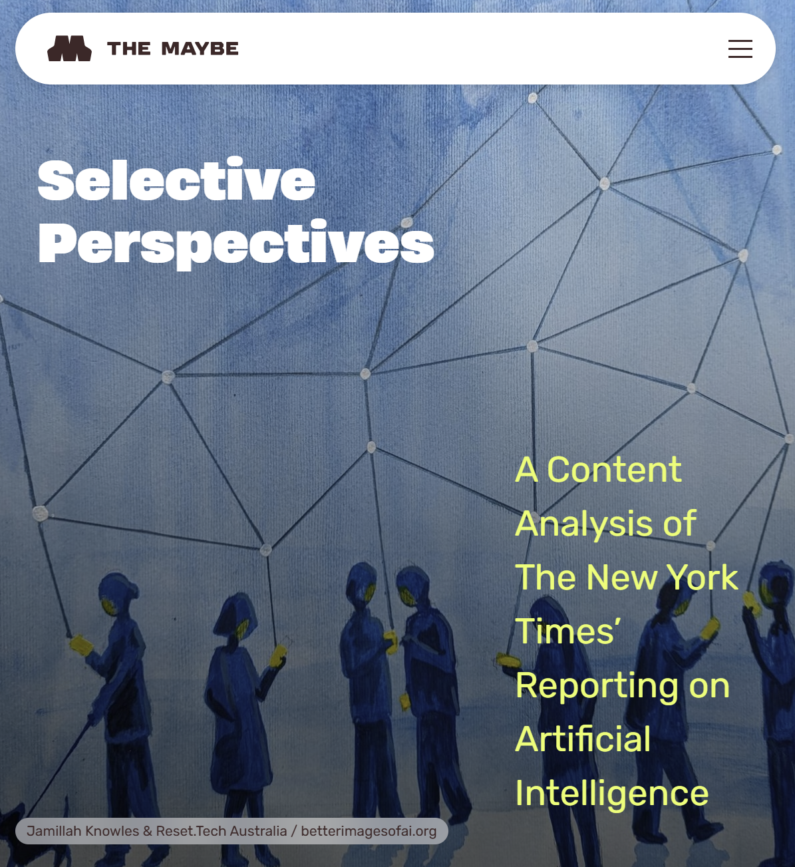
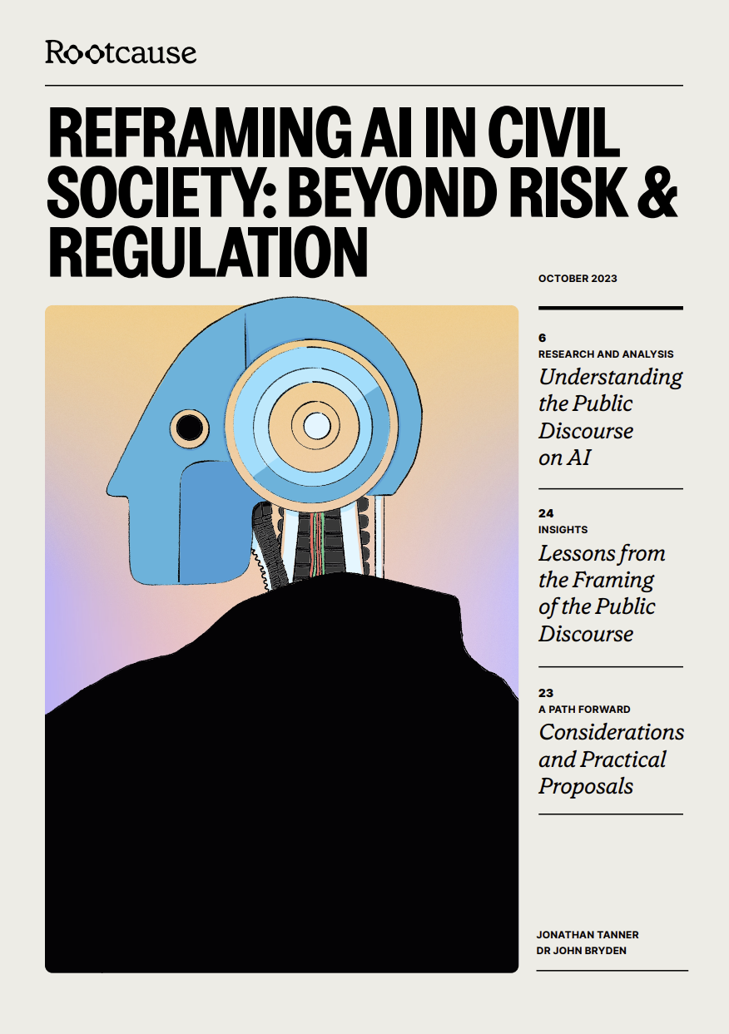
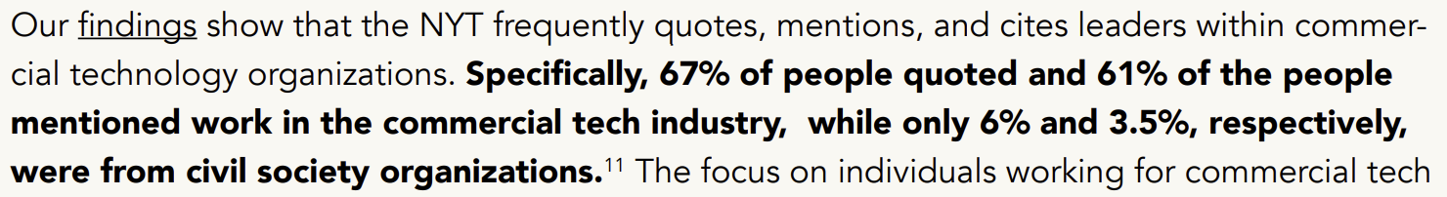
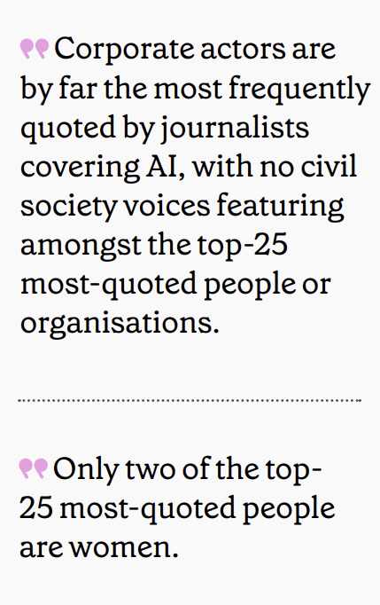
Media capture
Barakat. Selective perspectives: A content analysis of The New York Times’ reporting on artificial intelligence. Computer Says Maybe, 2024.

Slide 19
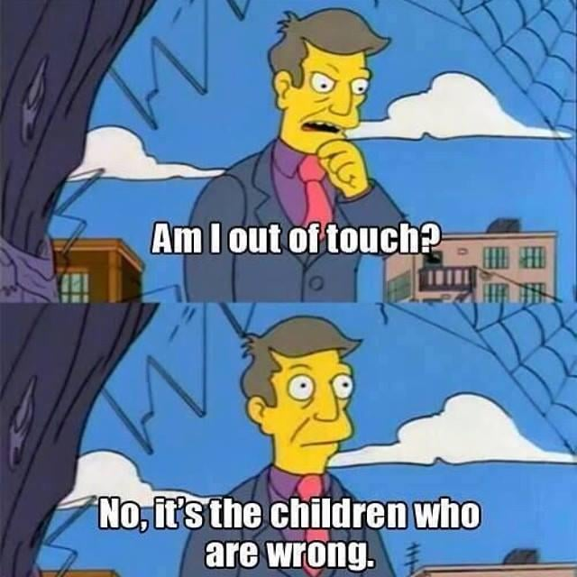
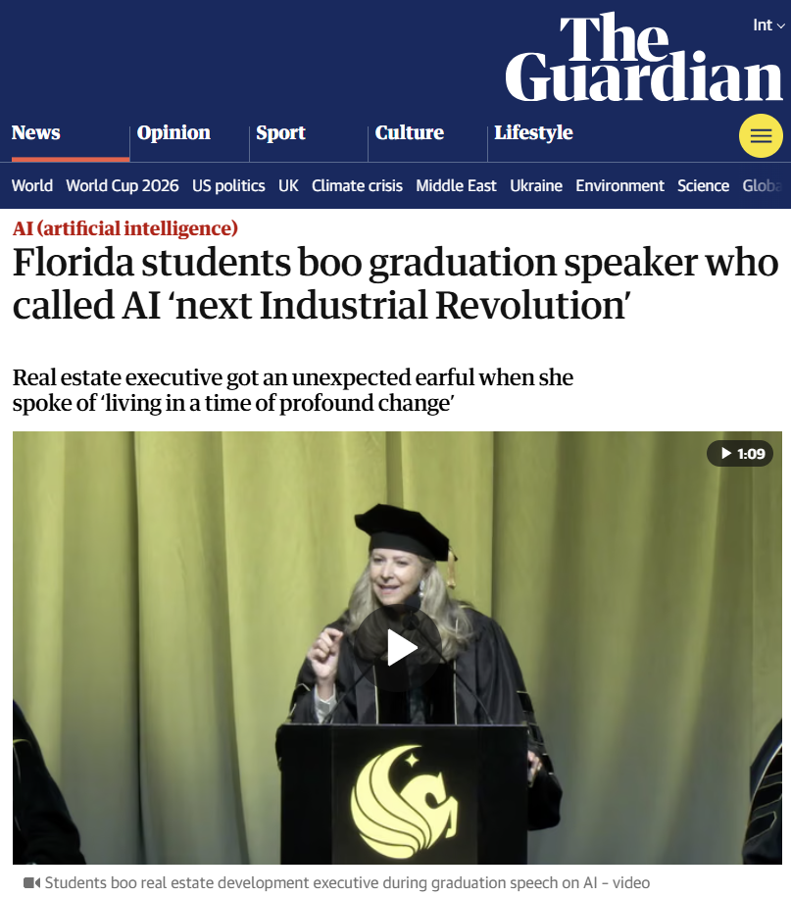
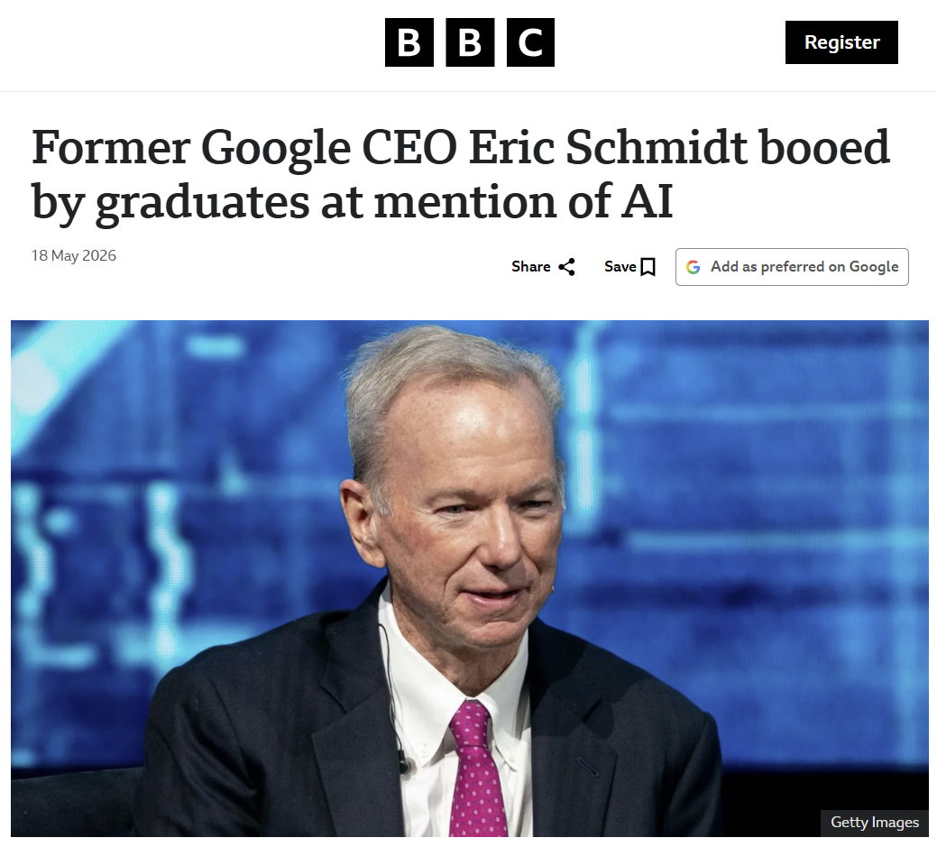


The “AI” question
(I am using “AI” as a shorthand for generative AI, e.g., LLMs and other large pretrained models)

Slide 20

The technological project of AI
AI
The political project of AI

Slide 21





Attacking worker power. The AI hype creates the conditions to renegotiate down the cost of labor; intensifying workload and turning workers into moral crumple zones.
AI as politic of class exploitation
Grand theft data labor. Appropriation of data labor includes underpaid crowd work and uncompensated appropriation of works by writer, artists, and programmers; mirroring racial capitalism and coloniality, and reinforcing global north-south divide.
Let them eat chatbots. AI hype is providing cover for defunding of public services like healthcare and education.
Environmental and community impact. AI data centers are hindering our transition away from nonrenewable energy sources, creating water shortages and raising energy bills for local communities, and continuing colonial exploitations of indigenous lands.
Mitra. AI as politic of class exploitation. Blog post, 2025.

Slide 22










Resisting AI & Big Tech
nananwachukwu.github.io/media-capture-watch
surveillancewatch.io
datacenterwatch.org
authoritarian-stack.info
data-workers.org
labor.dair-institute.org
airesistlist.org
peoplesaiconsultation.ca
Tech Workers Coalition Canada and Technologists for Democracy. Submission to the People’s Consultation on AI. In People’s Consultation on AI, 2026.

Slide 23



Well… the social impact of AI is not always bad

Slide 24



Calls for public platforms and digital sovereignty
However, Eurocentrism is not a meaningful antidote to American Exceptionalism
No search engine is truly open nor reflects the internet in all its diversity if it systemically erases the voices of the global south that represents 85% of the world’s population
We must seek epistemic justice for the global south and marginalized populations within powerful nation-states
Mitra, Neophytou, and Gururaja. Information Access of the Oppressed: Freirean Design for Emancipatory Information Access. Preprint, 2026.

Slide 25
Open, to what end?
E.g., code, data, models, tooling, compute, labor, and governance
Commodities
Openness should not be appraised w.r.t. what is being made open; but w.r.t. what functionings it affords to actors—e.g., (i) To critique the system, (ii) to copy the system, and (iii) to co-opt and co-construct the system
  If you made open the code, data, and models but not the compute then only highly-resourced actors can copy the system
  If you only made the system open to be copied but not to be changed, then that is inadequate for addressing representational harms
Depends on both the commodities being made open and actor-specific circumstances
Capabilities
(to function)
Functionings
E.g., critique, copy, and co-opt and co-construct
E.g., digital sovereignty, meet underserved needs, market competition, open science, social justice, emancipation, and democracy
Well-beings
Reframing “openness” in search using Amartya Sen’s Capability-Theory from welfare economics
Sen. Commodities and Capabilities. Oxford university press, 1999.
Neophytou and Mitra. Open, to What End? A Capability-Theoretic Perspective on Open Search. In proc. Open Search Symposium, 2026.

Slide 26


What is our bold positive vision for IR research that does not involve uncritical adoption of AI nor is content with simply trying to minimize its harms, but instead inspires us to realize liberatory democratic futures for all through information access technology research and development?
SIGIR 2026
Friday, July 24

Slide 27



We need public IR platforms!
In the social media landscape, decentralization has emerged as a dominant strategy to safeguard against capture
But beyond technological decentralization, we need decentralization and democratization of our social infrastructure for governance and moderation
But we also need a fundamental transformation in how we approach and conduct IR research

Slide 28




The topic of “societal good” is currently undertheorized in IR
We centered this question at the ECIR 2026 IR-for-Good Track by adopting as this year’s theme:
What is IR for Good?
Published in 1976 (half a century ago)
Mitra and Heuss. What is IR-for-Good? Blog post, 2025.
Anand, Urbano, Ren, Verberne, Heuss, Mitra, Frobe, Heinrich Merker, and Scells. Report on the 48th European Conference on Information Retrieval (ECIR 2026). In SIGIR Forum, 2026.
Belkin and Robertson. Some Ethical and Political Implications of Theoretical Research in Information Science. In proc. ASIS, 1976.

Slide 29
How do we frame societal concerns in IR?
We define a frame as comprising of:
  (i) A set of desired goals,
  (ii) A collection of methods and practices, and
  (iii) A body of underlying values, politics, and epistemologies that distinguish it from other frames.
Mitra. Towards Critical IR Theories and Practices. In SIGIR Forum, 2026.

Slide 30

How do we frame societal concerns in IR?
Are we defining our goals in terms of what is desirable as a good system or what is desirable as a good society? Is it possible or meaningful to define the former without defining the latter?
Are we limited to trying to reduce the harm of emerging systems or are we trying to design societally beneficial systems? The risk of the former is that we get stuck at an equilibrium where harmful systems are rendered palatable enough through ethics-washing.
What sociopolitical values shape our research? What body of knowledge informs our work? Are we explicit about these in our work?
Mitra. Towards Critical IR Theories and Practices. In SIGIR Forum, 2026.

Slide 31
The two frames of IR & Society
Mitra. Towards Critical IR Theories and Practices. In SIGIR Forum, 2026.

Slide 32









Shifting towards critical IR theories and practices
The 3rd Strategic Workshop on Information Retrieval in Lorne (SWIRL), 2018
The 4th Strategic Workshop on Information Retrieval in Lorne (SWIRL), 2025
Friday, July 24
Mitra. Towards Critical IR Theories and Practices. In SIGIR Forum, 2026.
Culpepper et al. Research Frontiers in Information Retrieval: Report from the Third Strategic Workshop on Information Retrieval in Lorne (SWIRL 2018). In ACM SIGIR Forum, 2018.
Trippas et al. Report from the 4th Strategic Workshop on Information Retrieval in Lorne (SWIRL 2025). In ACM SIGIR Forum, 2025.

Slide 33
Without a critical lens, we end up with incredibly problematic interpretations of concepts like “political bias” that may amount to algorithmic bothsidism; and inappropriately frame the concern as one of fairness when it is in fact about the concentration of platform power and lack of equitable spaces for social deliberation and negotiation within our platforms
Mitra. Search and Society: Reimagining Information Access for Radical Futures. In IRRJ, 2025.
Mitra. Towards Critical IR Theories and Practices. In SIGIR Forum, 2026.

Slide 34






Six recommendations for Critical IR
Mitra. Towards Critical IR Theories and Practices. In SIGIR Forum, 2026.
Mitra, Neophytou, and Gururaja. Information Access of the Oppressed: Freirean Design for Emancipatory Information Access. Preprint, 2026.

Slide 35
Structural analysis
Grounding in critical theories and structural critiques of systems of oppression

Slide 36


IR needs a systemic understanding of our world
IR research cannot be rigorous if it is not informed by an understanding of systemic power relations between dominant and oppressed groups in society and the structures that support systemic oppression
Without that understanding we are doomed to be trapped in a technosolutionist mindset
…and the question of sustainable IR
Mitra. Towards Critical IR Theories and Practices. In SIGIR Forum, 2026.

Slide 37



We need to focus on the systemic consequences of IR technologies
A.K.A “hallucinations”,
we avoid that term as it is anthropomorphizing
Mitra, Cramer, & Gurevich. Sociotechnical implications of generative artificial intelligence for information access. Book chapter, Springer Nature, 2025.
Gausen, Mitra, & Lindley. A Framework for Exploring the Consequences of AI-Mediated Enterprise Knowledge Access and Identifying Risks to Workers. In Proc. FAccT, 2024.

Slide 38












Our work needs to be grounded in relevant scholarship incl. critical theories, feminist theories, and decolonial theories—as well as other forms of knowledge from activism and movement organizing
This generally applies to the whole field of computing, but IR specifically lags behind even our neighboring fields

Slide 39

Reconnecting with IR’s roots in library and information sciences
Decolonise IR
Disrupt IR
Liberate IR
Critique IR
Defend IR
Equalise IR
Open up IR
Queer IR
Unionise IR
Diversify IR
Empower IR
Engage IR
Subvert IR
Critical Approaches to Libraries Conference 2026
(I was invited to give a keynote earlier this year)
Can we aspire for a more critical IR future?

Slide 40
Nondomination
Adopt a normative position of nondomination in solidarity with the oppressed

Slide 41
Defining “good society” is saliently political and a challenging question for the IR community whose members reflect vastly different values, cultures, politics, identities, privileges, lived experiences, and understandings of history
However, any attempt to bypass or depoliticize this question is ultimately self-defeating
Mitra. Towards Critical IR Theories and Practices. In SIGIR Forum, 2026.

Slide 42
e.g., colonialism, racism, patriarchy, casteism, transphobia, ableism, antisemitism, Islamophobia, …
Emancipatory IR is the study and development of information access methods that challenge all forms of human oppression and situates its activities within broader collective emancipatory praxis
Discourages non-performative academic gaze, urges this research to be situated in movement building, and calls for the recognizing the role of movement building in this research
Signifies the moral concerns of universal humanization of all peoples and the elimination of oppression to create the conditions under which we can collectively flourish
Mitra. Emancipatory Information Retrieval. In IRRJ, 2025.

Slide 43
Critical information theory
“
Critical theory […] struggles for a classless, nondominative, co-operative, participatory democracy.
“
Critical information theory […] must study not just the role of information and information concepts in society, academia, nature, culture, etc, but how it is related to processes of oppression, exploitation, and domination, which implies a normative judgment in solidarity with the dominated and for the abolishment of domination.
Fuchs. Towards a critical theory of information. In tripleC: Communication, Capitalism & Critique, 2009.

Slide 44
Social construction of technology
Reject technological determinism and rationality in favor of reimagining and co-constructing anti-oppressive sociotechnical futures

Slide 45

What futures are we building?
Technological determinism: A reductionist theory that technology progresses following its own internal logic of efficiency, while shaping society and values
We must reject technological determinism and recognize that technology and social structure / culture shape each other
Sociotechnical imaginaries: Visions of desirable sociotechnical futures
Whose sociotechnical imaginaries are granted normative status?
What radically alternative futures are we overlooking?
What is the impact of Big Tech’s dominance on our imaginaries?
What would IR look like if informed by feminist, queer, decolonial, anti-racist, anti-casteist, anti-ableist, and abolitionist thoughts?
What positive future can we build towards that is not just a negation of present harms?
“The exercise of imagination is dangerous to those who profit from the way things are because it has the power to show that the way things are is not permanent, not universal, not necessary.”
– Ursula K. Le Guin
Mitra. Search and Society: Reimagining Information Access for Radical Futures. In IRRJ, 2025.

Slide 46
Social construction of knowledge
Renounce positivist views of information and the traditional role ascribed to IR within capitalist logics of consumption in favor of reframing IR’s role within social processes of sense-making and knowledge production

Slide 47
Commodified model of information consumption
IR systems exist independent of the corpus and information needs; responsible for matching information artifacts (“supply”) with information needs (“demand”)
Information artifacts viewed as commodities and valued w.r.t. relevance, source authority, factuality, etc.
(demand)
query
(supply)
Mitra. Towards Critical IR Theories and Practices. In SIGIR Forum, 2026.

Slide 48
Social constructionist view of information and IR
query
query
IR systems should grow our collective understanding of our physical and social environments and our relations with them; as well as realize social good
Information and knowledge are socially constructed and is influenced by power relations within society; IR systems are integral to collective sense-making and knowledge production
query
query
IR systems should make space for social deliberation and negotiation made equitable by countering asymmetric power relations between groups
Mitra. Towards Critical IR Theories and Practices. In SIGIR Forum, 2026.

Slide 49
Dismantling the technologists-as-liberator frame
Engage users in the active co-option and co-construction of information access technologies for their own liberatory struggles

Slide 50


Freirean design
A design methodology and a political commitment to engage users in the active co-option and co-construction of technologies.
It opposes the technologists-as-liberator frame that elevates technologists to the position of gatekeepers of knowledge; while the rest of the population is designated to be the objects of technological influence—their existence digitized for monitoring, modeling, and manipulation.
Freirean design builds on rich traditions of participatory design in computing by recommending that systems be underdesigned at design time allowing communities to co-construct the system for their own liberatory struggles
“A real humanist can be identified more by his trust in the people, which engages him in their struggle, than by a thousand actions in their favor without that trust… Attempting to liberate the oppressed without their reflective participation in the act of liberation is to treat them as objects which must be saved from a burning building; it is to lead them into the populist pitfall and transform them into masses which can be manipulated.”
Mitra, Neophytou, and Gururaja. Information Access of the Oppressed: Freirean Design for Emancipatory Information Access. Preprint, 2026.

Slide 51
Inclusion of the oppressed is not symbolic
Technologists cannot “gift” epistemic and representational justice to the marginalized
Historical / cultural context and structures of oppression vary from the inner cities of US to the favelas of Rio to the bastis of Kolkata
Technologists are unlikely to take the risks necessary to challenge oppression; but people are likely to for their own liberation
Co-option and co-construction becomes a site of solidarity and movement building
Freirean design emphasizes the need for structural encoding of spaces for community participation and negotiation within the platform; however, it is the sociopolitical arrangements within these spaces that will determine the outcome
Mitra, Neophytou, and Gururaja. Information Access of the Oppressed: Freirean Design for Emancipatory Information Access. Preprint, 2026.

Slide 52

New research questions to realize public IR systems
How do we safeguard IR platforms against authoritarian capture?
How do we develop a critical democratic governance framework?
How do we design the platform from the margins to legitimize community co-option and co-construction?
How do we design pedagogical information experiences?
How do we decentralize IR’s technological stack
How do we decentralize IR’s social infrastructure for governance and moderation
How do we strategically underdesign the platform and develop a framework for community co-construction
E.g., instead of trying to algorithmically fix under-representation of women and POC in image search results for occupational roles, how can we reclaim that digital space to teach the history of erasure or gendered and racialized labor?
Mitra, Neophytou, and Gururaja. Information Access of the Oppressed: Freirean Design for Emancipatory Information Access. Preprint, 2026.

Slide 53
Praxis
Affirm emancipatory praxis and movement building as research practices

Slide 54


Praxis
liberatory research
+
liberatory action
Mitra. Towards Critical IR Theories and Practices. In SIGIR Forum, 2026.

Slide 55


Organizing and raising sociopolitical consciousness of our IR community
(Cross-disciplinary workshops, book clubs, popular education, arts and zines, …)
https://bhaskar-mitra.github.io/reading/ →

Slide 56
Organizing and raising sociopolitical consciousness of our IR community
(Cross-disciplinary workshops, book clubs, popular education, arts and zines, …)
https://bhaskar-mitra.github.io/reading/ →

Slide 57

Community care and solidarity
“If you have come here to help me you are wasting your time, but if you have come because your liberation is bound up with mine, then let us work together.”
– Lilla Watson and other members of an Aboriginal Rights group in Queensland

Slide 58










https://jedi.inertial.science/sigir2026
Joint Panel
Panelists:
Moderator:
Friday, July 24
4:00 – 5:00 PM
<Room>

Slide 59
Our movement begins here. We are moved not by the opportunity to imagine a different sociotechnical future but by the abject necessity of it in the face of growing authoritarianism and oppression. We do not move alone but in solidarity with others because our liberation, and the struggle for it, are bound together. We move not in fear but with courage and out of love for our own humanity and that of others. Where the oppressor attempts to capture and control, we move to co-opt, co-construct, and liberate. We move not just to negate oppression but to create something new, something joyful, something emancipatory.
We retrieve.
We reimagine.
We rebuild.
We resist.
Mitra, Neophytou, and Gururaja. Information Access of the Oppressed: Freirean Design for Emancipatory Information Access. Preprint, 2026.

Slide 60


My related publications
Mitra. Towards Critical IR Theories and Practices. In SIGIR Forum, 2026.
Neophytou and Mitra. Open, to What End? A Capability-Theoretic Perspective on Open Search. In proc. Open Search Symposium, 2026.
Mitra, Neophytou, and Gururaja. Information Access of the Oppressed: Freirean Design for Emancipatory Information Access. Preprint, 2026.
Birhane, Angius, Agnew, Pandit, Mitra, Dobbe, and Talat. Big AI's Regulatory Capture: Mapping Industry Interference and Government Complicity. In proc. ACM FAccT, 2026.
Thieme, Marques, Grayson, Balachandar, Cassidy, Choksi, Longden, Huda, Kalovwe, Mallon, Mansperger, Massiceti, Mitra, Nzioka, Tanase, You, and Morrison. Engaging Communities Meaningfully in Defining Disability Representation for AI Image Generation. In proc. ACM CHI, 2026.
Mitra. Emancipatory Information Retrieval. In IRRJ, 2025.
Mitra. Search and Society: Reimagining Information Access for Radical Futures. In IRRJ, 2025.
Mitra, Cramer, and Gurevich. Sociotechnical Implications of Generative Artificial Intelligence for Information Access. Book chapter, Springer Nature, 2025.
Cortiñas-Lorenzo, Lindley, Larsen-Ledet, and Mitra. Through the Looking-Glass: Transparency Implications and Challenges in Enterprise AI Knowledge Systems. Preprint, 2024.
Gausen, Mitra, and Lindley. A Framework for Exploring the Consequences of AI-Mediated Enterprise Knowledge Access and Identifying Risks to Workers. In proc. ACM FAccT, 2024
Larsen-Ledet, Mitra, and Lindley. Ethical and Social Considerations in Automatic Expert Identification and People Recommendation in Organizational Knowledge Management Systems. In proc. FAccTRec Workshop, ACM RecSys, 2022.
“Another world is not only possible, she is on her way. On a quiet day, I can hear her breathing.”
– Arundhati Roy
THANK YOU
bhaskar-mitra.github.io
@bmitra.bsky.social
bhaskar.mitra@acm.org

