Slide 1







Emancipatory IR: Towards Critical Theories and Practices
Bhaskar Mitra (he/him)
Independent Researcher
Tiohtià:ke / Mooniyang / Montréal, Canada
bhaskar-mitra.github.io
@bmitra.bsky.social
bhaskar.mitra@acm.org
My relevant research themes:
Emancipatory Information Access
AI & Society
Exposure Fairness and Transparency in Information Access

Slide 2

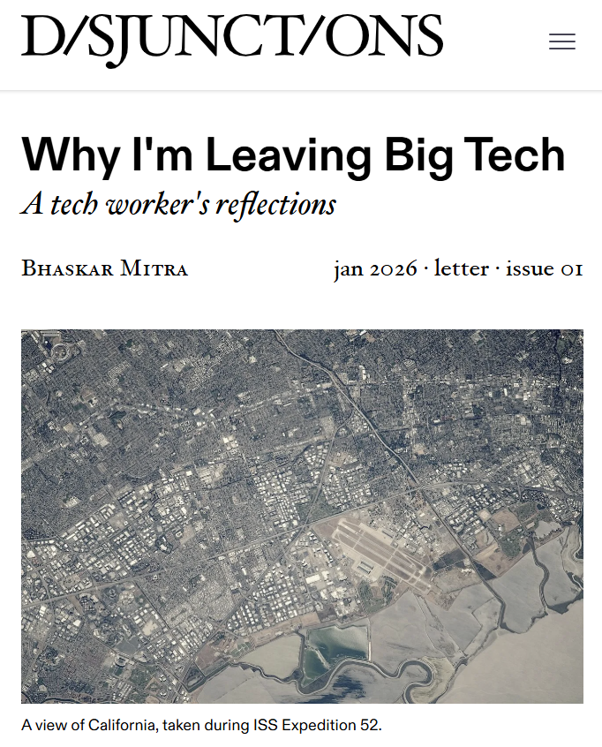
Positionality
https://disjunctionsmag.com/articles/why-leaving-big-tech/
The perspectives I will present are informed by my professional and lived experiences as:
An IR researcher who worked in Big Tech for 19 years before quitting the industry last year out of serious moral and ethical concerns about the industry’s complicity in societal harms
A Southasian immigrant worker (in USA, UK, and Canada) involved in movement organizing for social justice within the Southasian diaspora

Slide 3
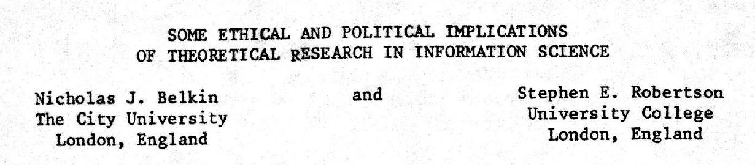
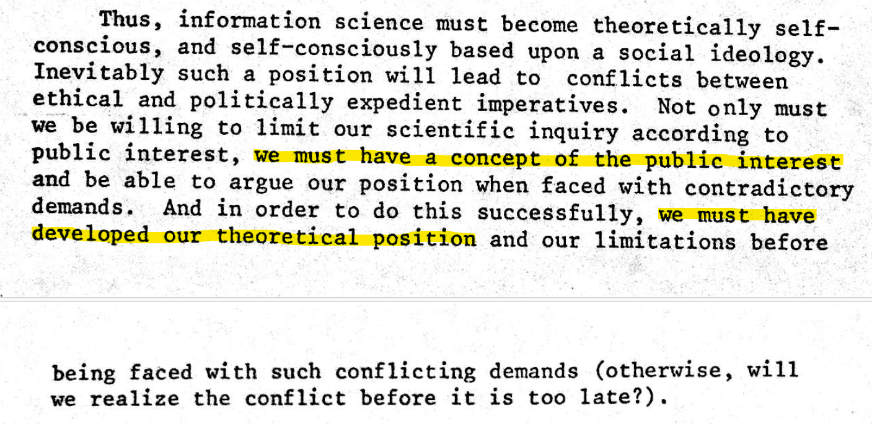
Published in 1976 (half a century ago)

Slide 4
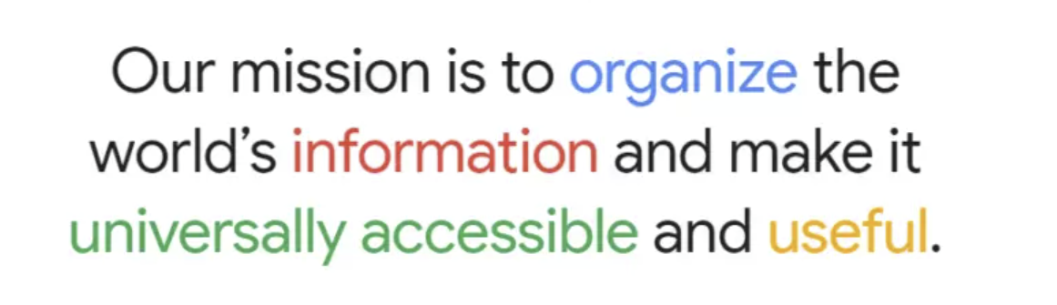
An inconvenient truth about IR
Information retrieval is the study of techniques for supporting human cognition with information artefacts sourced from large collections.
EXPECTATION…
Google’s mission statement (1989-Today)
Zobel. What We Talk About When We Talk About Information Retrieval. In SIGIR Forum, 2017.
online user surveillance
harvesting user attention
REALITY…
AI persuasion

Slide 5
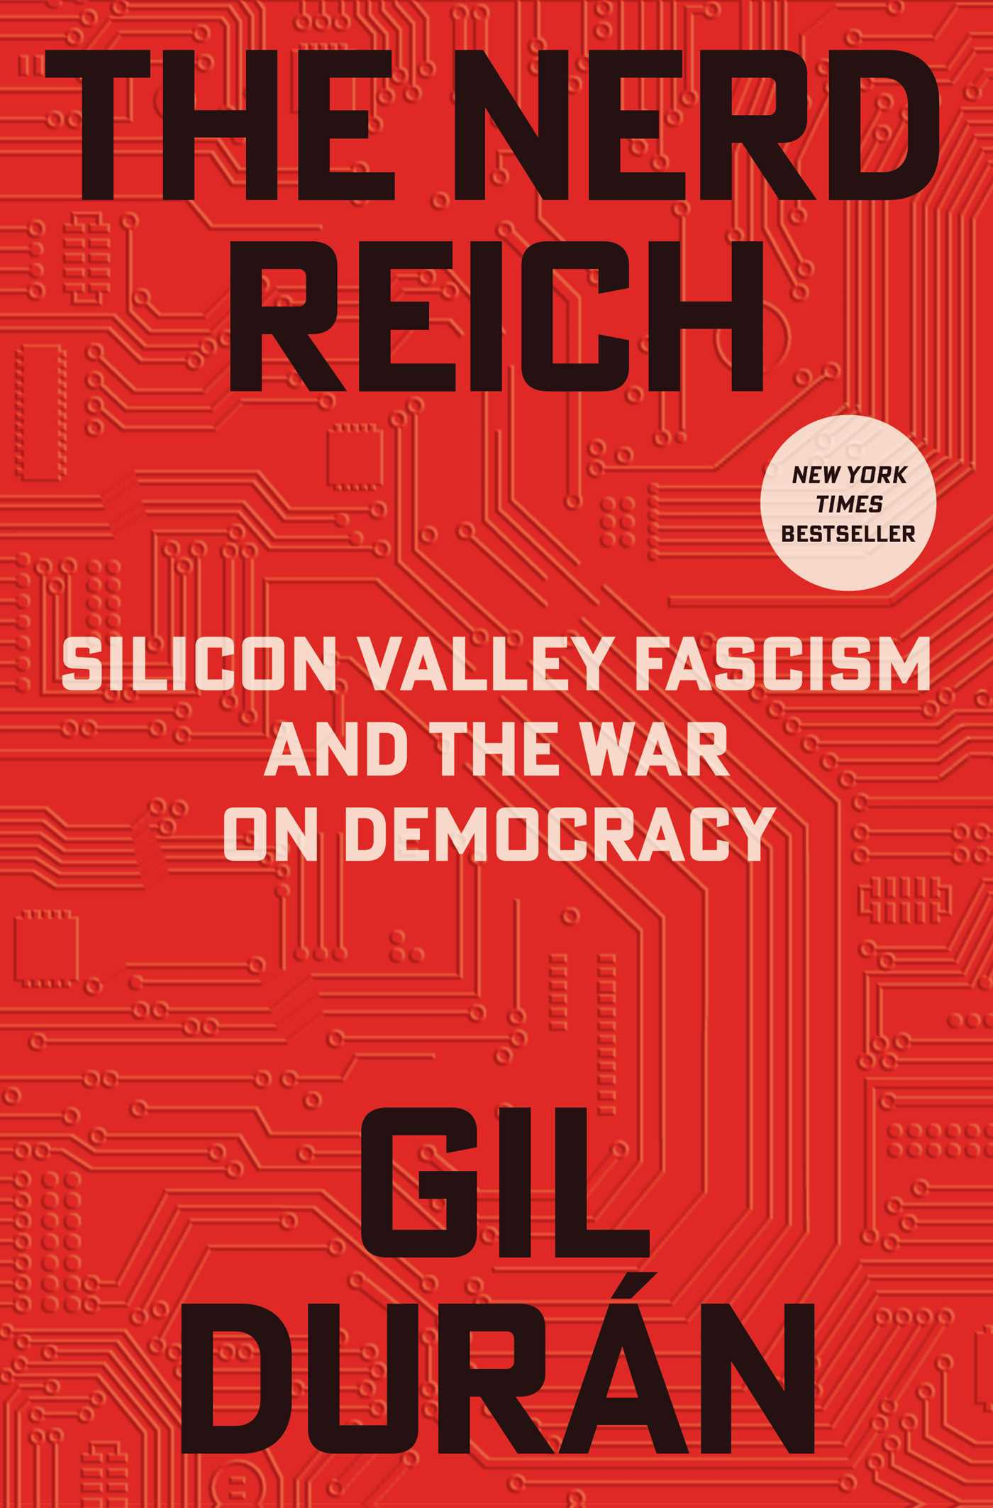

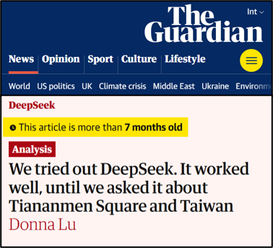
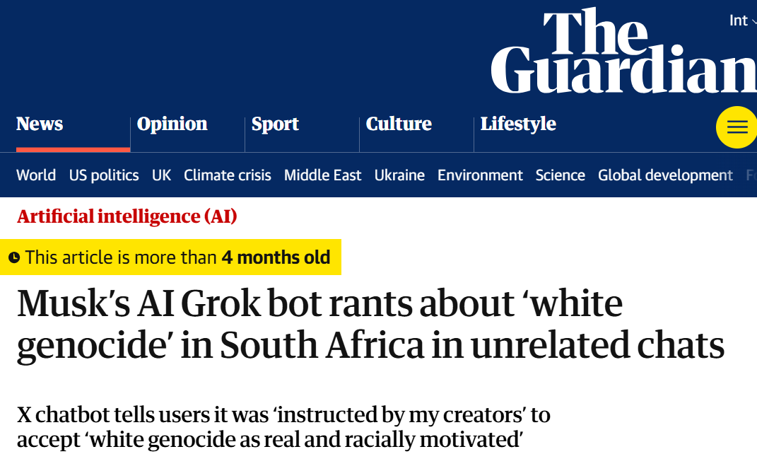
AI Persuasion
Massive amounts of user behavior data from surveillance capitalism
Generative AI’s capability to produce persuasive language and visualizations
Effective tools for mass manipulation of public consumer preferences and political opinion
Our ability to align generative AI models towards specific values
Mitra, Cramer, & Gurevich. Sociotechnical implications of generative artificial intelligence for information access. Book chapter, 2024.

Slide 6
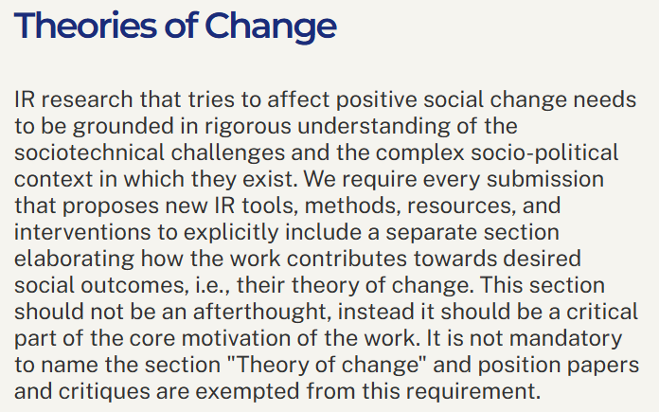
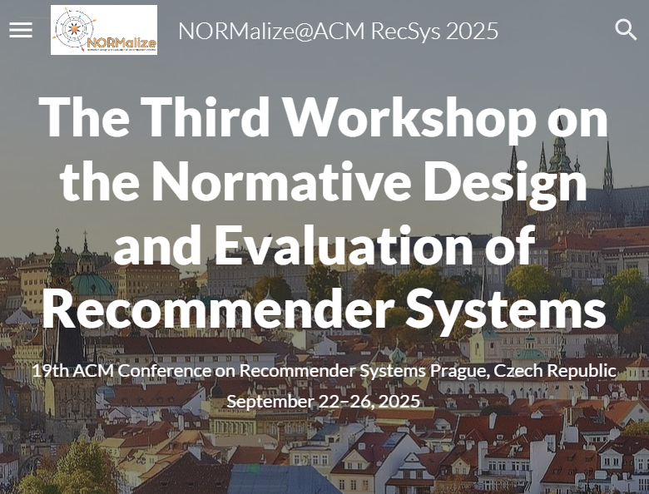
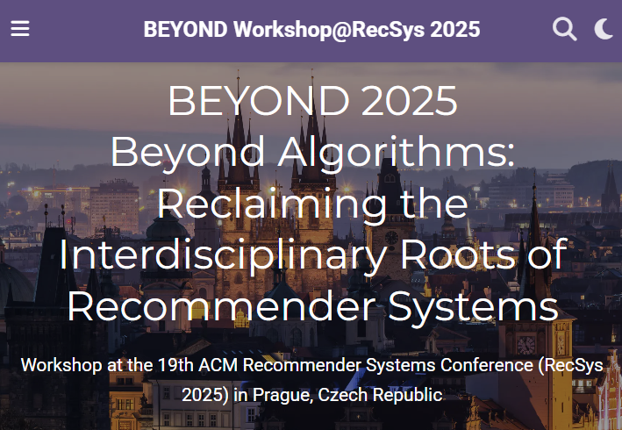
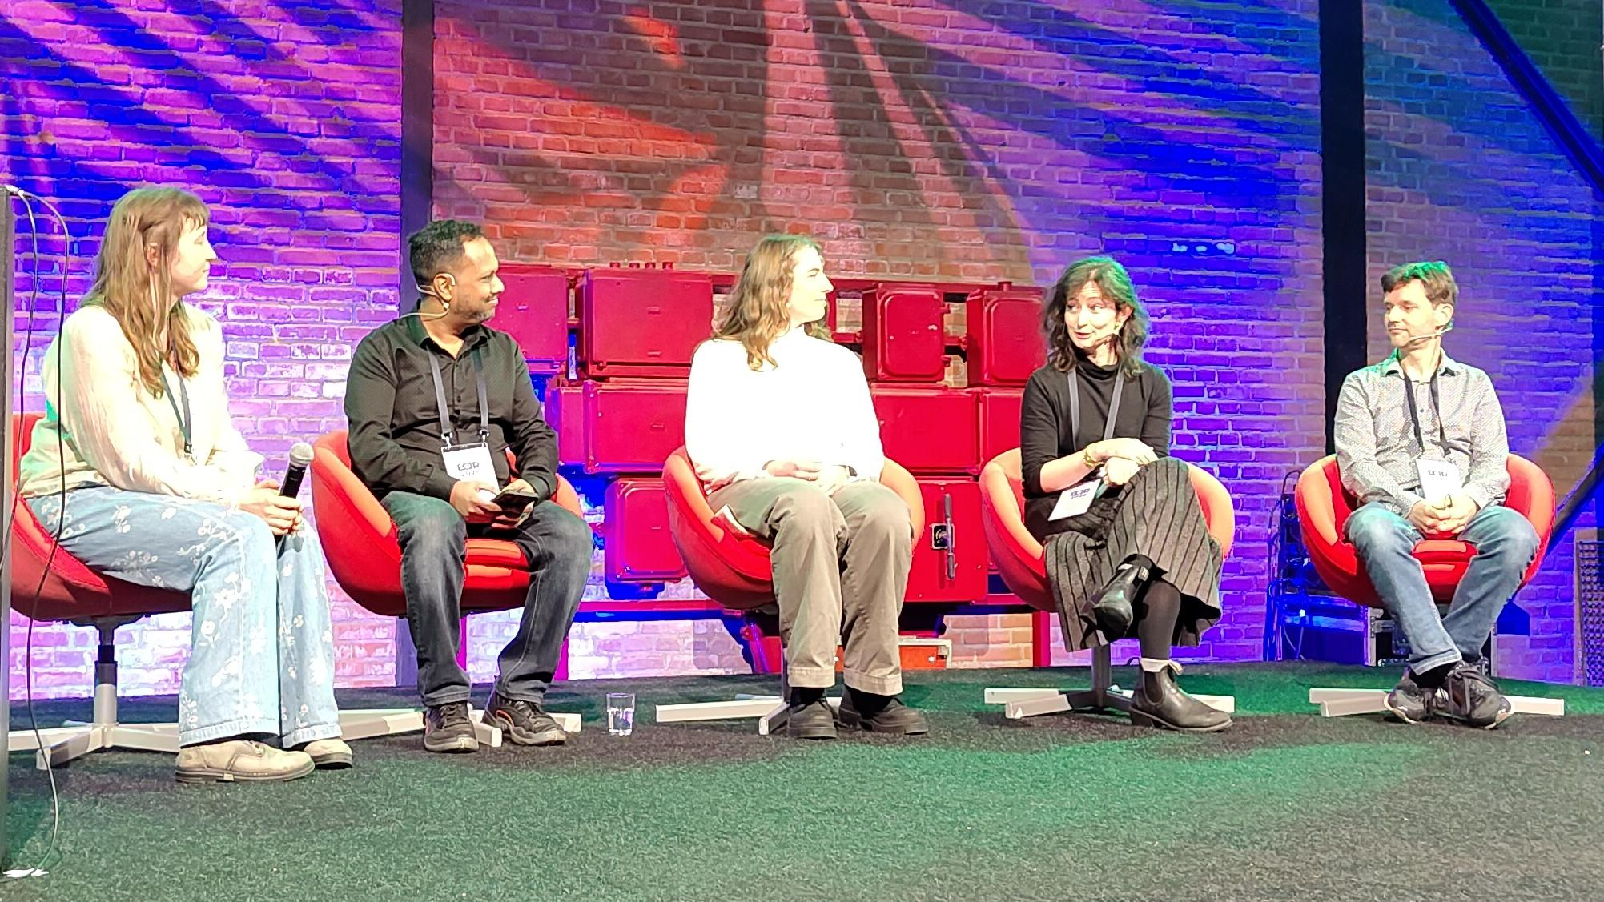
The topic of “societal good” is currently undertheorized in IR
We centered this question at the ECIR 2026 IR-for-Good Track by adopting as this year’s theme:
What is IR for Good?
Belkin and Robertson. Some Ethical and Political Implications of Theoretical Research in Information Science. In proc. ASIS, 1976.
Anand, Urbano, Ren, Verberne, Heuss, Mitra, Frobe, Heinrich Merker, and Scells. Report on the 48th European Conference on Information Retrieval (ECIR 2026). In SIGIR Forum, 2026.
Mitra and Heuss. What is IR-for-Good? Blog post, 2025.

Slide 7
How do we frame societal concerns in IR?
We define a frame as comprising of:
  (i) A set of desired goals,
  (ii) A collection of methods and practices, and
  (iii) A body of underlying values, politics, and epistemologies that distinguish it from other frames.
Mitra. Towards Critical IR Theories and Practices. In SIGIR Forum, 2026.

Slide 8
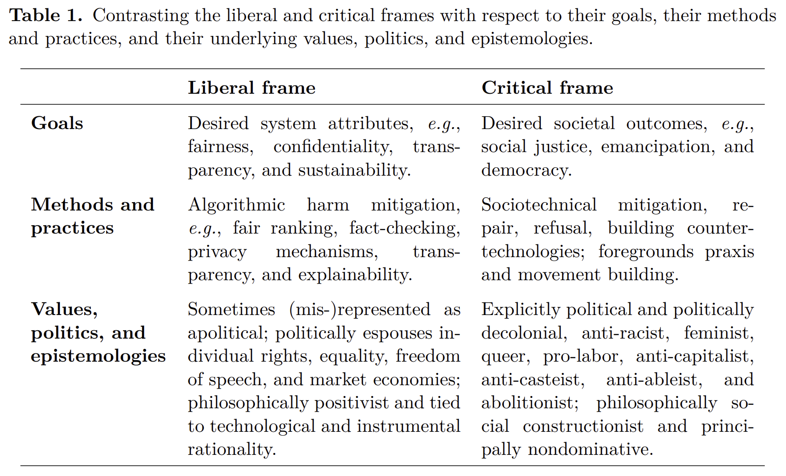
How do we frame societal concerns in IR?
Are we defining our goals in terms of what is desirable as a good system or what is desirable as a good society? Is it possible to meaningfully define the former without defining the latter?
Are we limited to trying to reduce the harm of emerging systems or are we trying to design societally beneficial systems? The risk of the former is that we get stuck at an equilibrium where harmful systems are rendered palatable enough through ethics-washing.
Without a normative stance, we end up with incredibly problematic interpretations of concepts like “political bias” that may amount to algorithmic bothsidism; and inappropriately frame the concern as one of fairness when it is in fact about the concentration of platform power and lack of equitable spaces for social deliberation and negotiation within our platforms
What sociopolitical values shape our research? What body of knowledge informs our work? Are we explicit about these in our work?
Mitra. Search and Society: Reimagining Information Access for Radical Futures. In IRRJ, 2025.
Mitra. Towards Critical IR Theories and Practices. In SIGIR Forum, 2026.

Slide 9
The two frames of IR & Society
Mitra. Towards Critical IR Theories and Practices. In SIGIR Forum, 2026.

Slide 10
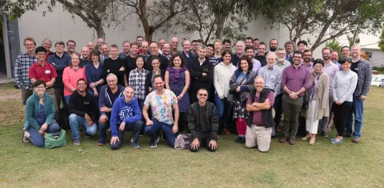
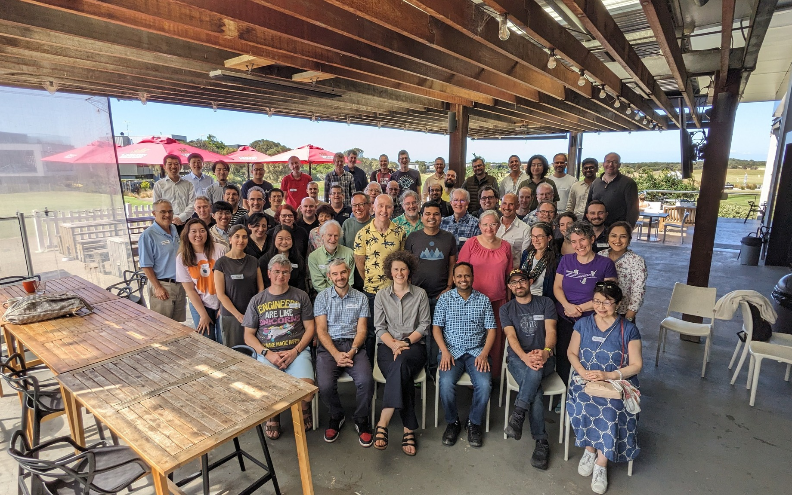
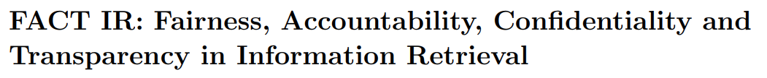
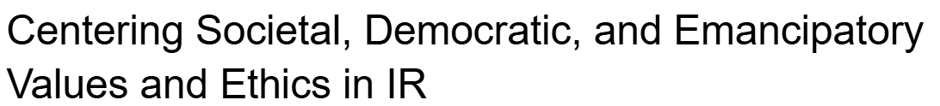
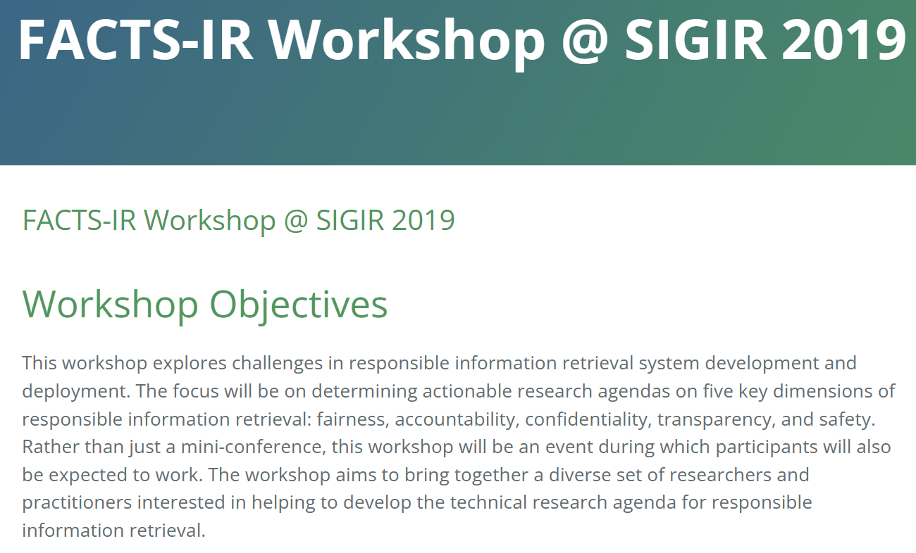
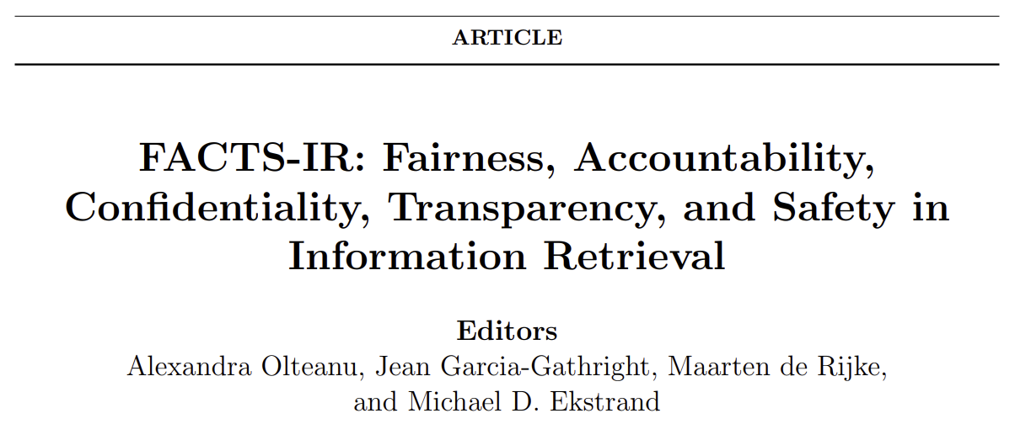
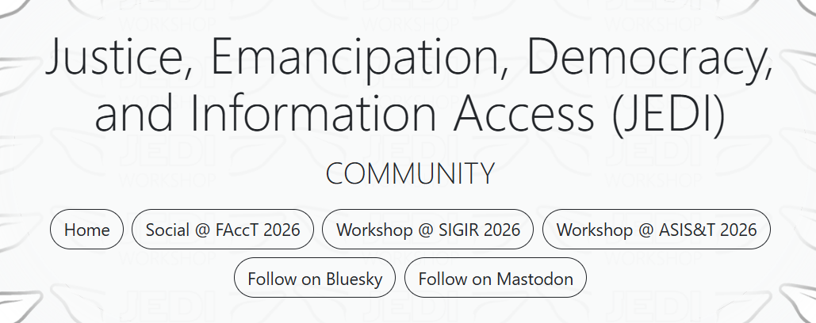
Shifting towards critical IR theories and practices
The 3rd Strategic Workshop on Information Retrieval in Lorne (SWIRL), 2018
The 4th Strategic Workshop on Information Retrieval in Lorne (SWIRL), 2025
Mitra. Towards Critical IR Theories and Practices. In SIGIR Forum, 2026.
Culpepper et al. Research Frontiers in Information Retrieval: Report from the Third Strategic Workshop on Information Retrieval in Lorne (SWIRL 2018). In ACM SIGIR Forum, 2018.
Trippas et al. Report from the 4th Strategic Workshop on Information Retrieval in Lorne (SWIRL 2025). In ACM SIGIR Forum, 2025.

Slide 11
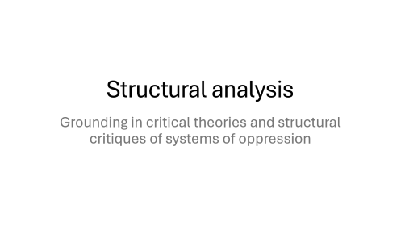
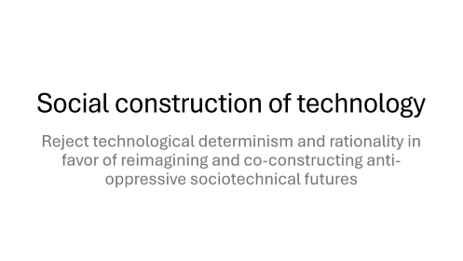

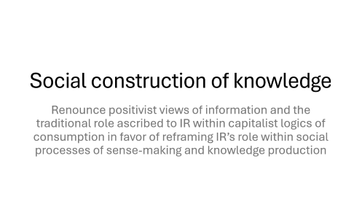
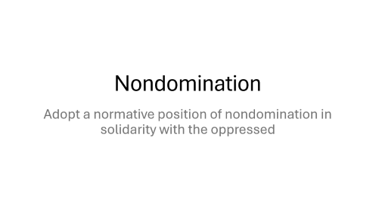
Five recommendations for Critical IR
Mitra. Towards Critical IR Theories and Practices. In SIGIR Forum, 2026.

Slide 12
Social construction of technology
Reject technological determinism and rationality in favor of reimagining and co-constructing anti-oppressive sociotechnical futures

Slide 13

What futures are we building?
Technological determinism: A reductionist theory that technology progresses following its own internal logic of efficiency, while shaping society and values
We must reject technological determinism and recognize that technology and social structure / culture shape each other
Sociotechnical imaginaries: Visions of desirable sociotechnical futures
Whose sociotechnical imaginaries are granted normative status?
What radically alternative futures are we overlooking?
What is the impact of Big Tech’s dominance on our imaginaries?
What would IR look like if informed by feminist, queer, decolonial, anti-racist, anti-casteist, anti-ableist, and abolitionist thoughts?
What positive future can we build towards that is not just a negation of present harms?
“The exercise of imagination is dangerous to those who profit from the way things are because it has the power to show that the way things are is not permanent, not universal, not necessary.”
– Ursula K. Le Guin
Mitra. Search and Society: Reimagining Information Access for Radical Futures. In IRRJ, 2025.

Slide 14
Structural analysis
Grounding in critical theories and structural critiques of systems of oppression

Slide 15
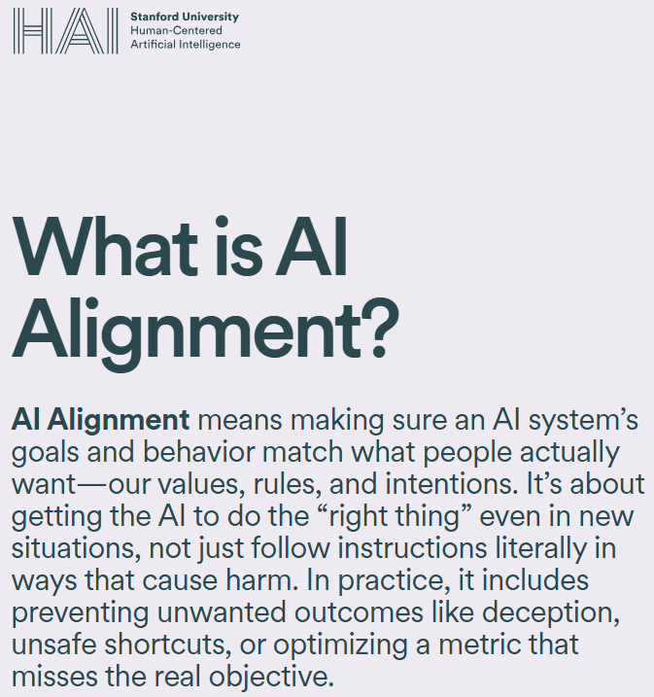
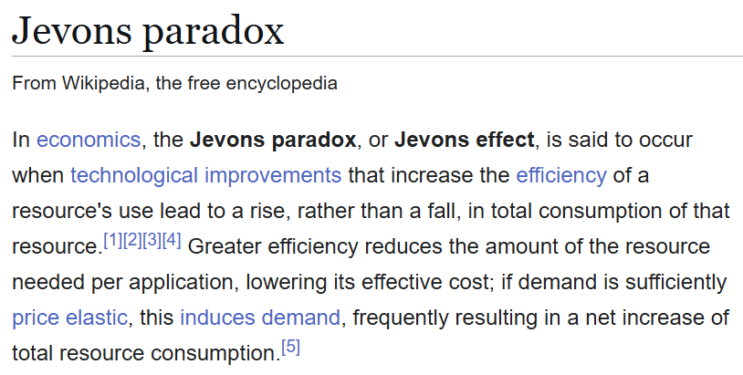
IR needs a systemic understanding of our world
IR research cannot be rigorous if it is not informed by an understanding of systemic power relations between dominant and oppressed groups in society and the structures that support systemic oppression
Without that understanding we are doomed to be trapped in a technosolutionist mindset
…and the question of sustainable IR
Mitra. Towards Critical IR Theories and Practices. In SIGIR Forum, 2026.

Slide 16
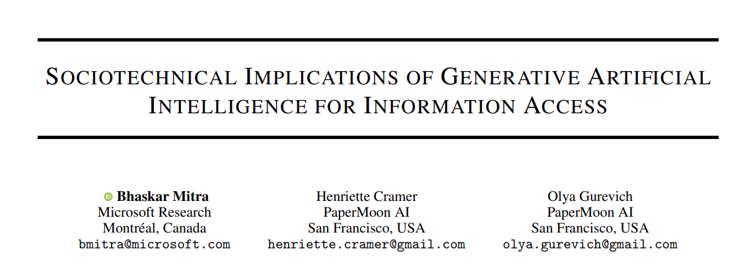

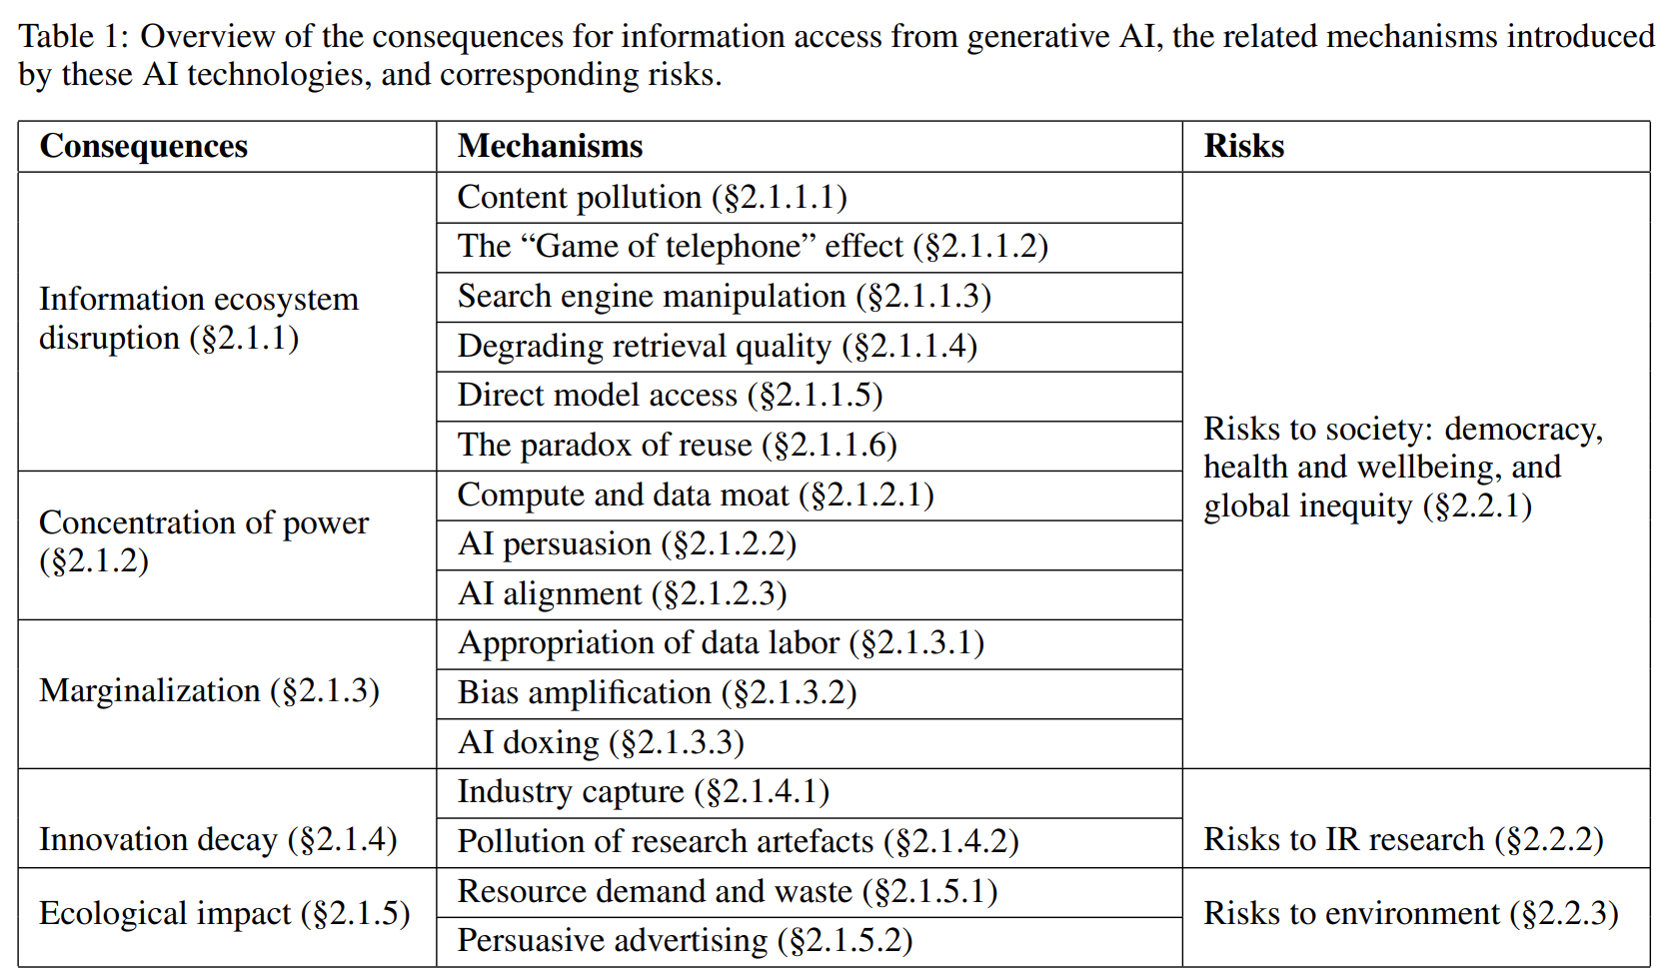
We need to focus on the systemic consequences of IR technologies
A.K.A “hallucinations”,
we avoid that term as it is anthropomorphizing
Mitra, Cramer, & Gurevich. Sociotechnical implications of generative artificial intelligence for information access. Book chapter, Springer Nature, 2025.
Gausen, Mitra, & Lindley. A Framework for Exploring the Consequences of AI-Mediated Enterprise Knowledge Access and Identifying Risks to Workers. In Proc. FAccT, 2024.

Slide 17
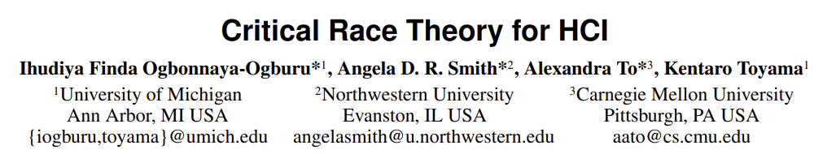

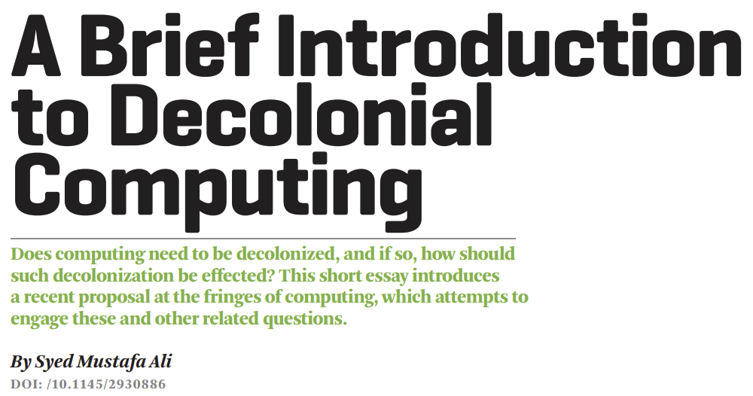
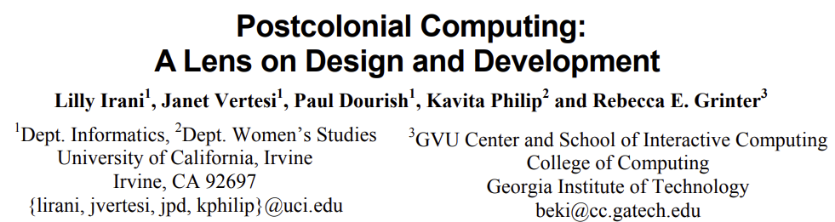
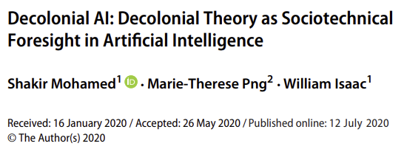


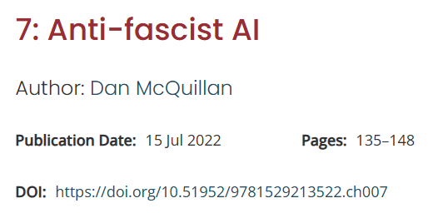

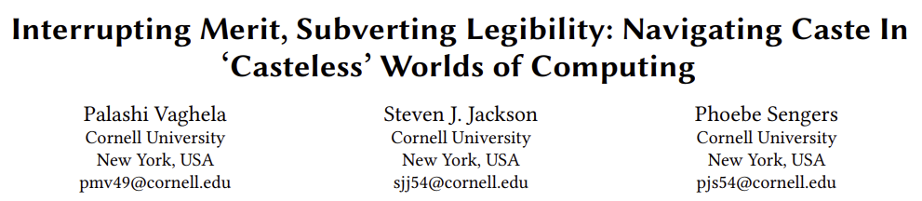
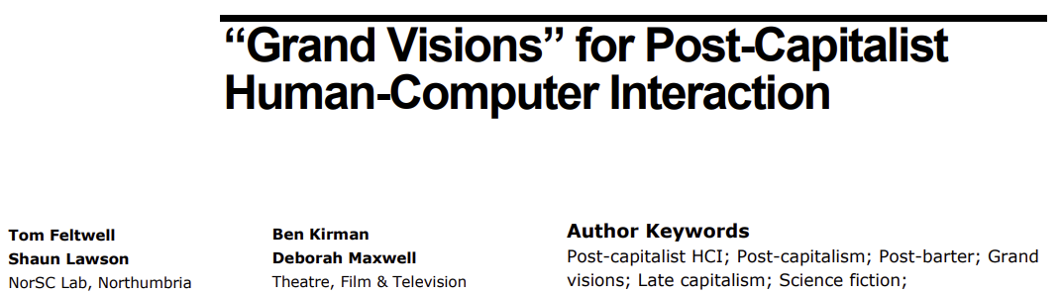
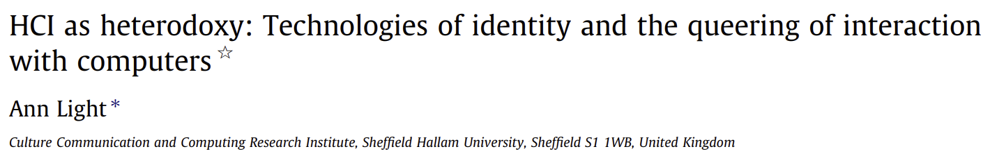
Our work needs to be grounded in relevant scholarship incl. critical theories, feminist theories, and decolonial theories—as well as other forms of knowledge from activism and movement organizing
This generally applies to the whole field of computing, but IR specifically lags behind even our neighboring fields

Slide 18
Nondomination
Adopt a normative position of nondomination in solidarity with the oppressed

Slide 19
Defining “good society” is saliently political and a challenging question for the IR community whose members reflect vastly different values, cultures, politics, identities, privileges, lived experiences, and understandings of history
However, any attempt to bypass or depoliticize this question is ultimately self-defeating
Mitra. Towards Critical IR Theories and Practices. In SIGIR Forum, 2026.

Slide 20
e.g., colonialism, racism, patriarchy, casteism, transphobia, ableism, antisemitism, Islamophobia, …
Emancipatory IR is the study and development of information access methods that challenge all forms of human oppression and situates its activities within broader collective emancipatory praxis
Discourages non-performative academic gaze, urges this research to be situated in movement building, and calls for the recognizing the role of movement building in this research
Signifies the moral concerns of universal humanization of all peoples and the elimination of oppression to create the conditions under which we can collectively flourish
Mitra. Emancipatory Information Retrieval. In IRRJ, 2025.

Slide 21
Critical information theory
“
Critical theory […] struggles for a classless, nondominative, co-operative, participatory democracy.
“
Critical information theory […] must study not just the role of information and information concepts in society, academia, nature, culture, etc, but how it is related to processes of oppression, exploitation, and domination, which implies a normative judgment in solidarity with the dominated and for the abolishment of domination.
Fuchs. Towards a critical theory of information. In tripleC: Communication, Capitalism & Critique, 2009.

Slide 22
Social construction of knowledge
Renounce positivist views of information and the traditional role ascribed to IR within capitalist logics of consumption in favor of reframing IR’s role within social processes of sense-making and knowledge production

Slide 23
Commodified model of information consumption
IR systems exist independent of the corpus and information needs; responsible for matching information artifacts (“supply”) with information needs (“demand”)
Information artifacts viewed as commodities and valued w.r.t. relevance, source authority, factuality, etc.
(demand)
query
(supply)
Mitra. Towards Critical IR Theories and Practices. In SIGIR Forum, 2026.

Slide 24
Social constructionist view of information and IR
query
query
IR systems should grow our collective understanding of our physical and social environments and our relations with them; as well as realize social good
Information and knowledge are socially constructed and is influenced by power relations within society; IR systems are integral to collective sense-making and knowledge production
query
query
IR systems should make space for social deliberation and negotiation made equitable by countering asymmetric power relations between groups
Mitra. Towards Critical IR Theories and Practices. In SIGIR Forum, 2026.

Slide 25
Praxis
Affirm emancipatory praxis and movement building as research practices

Slide 26
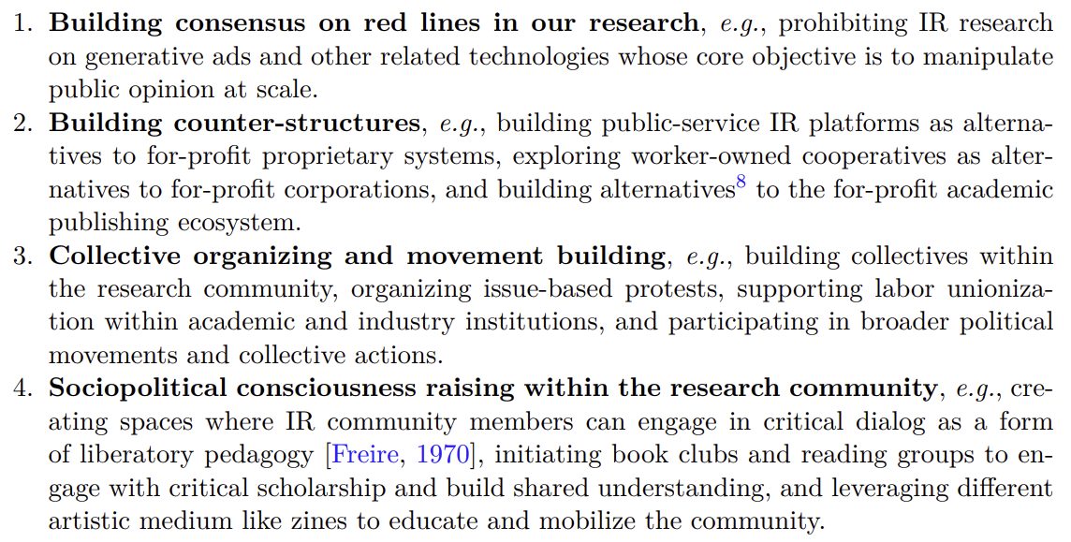
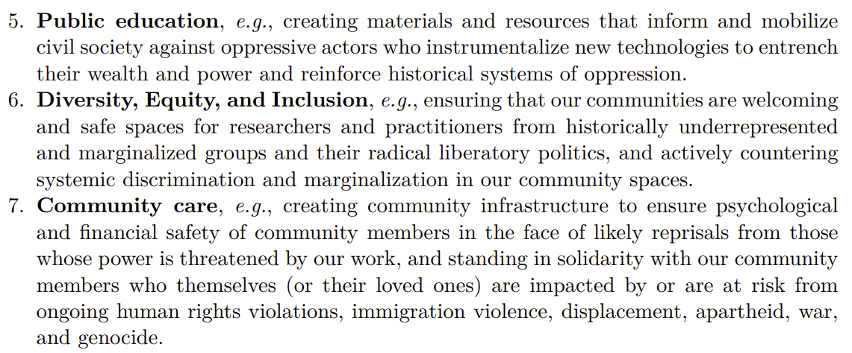
Praxis
liberatory research
+
liberatory action
Mitra. Towards Critical IR Theories and Practices. In SIGIR Forum, 2026.

Slide 27
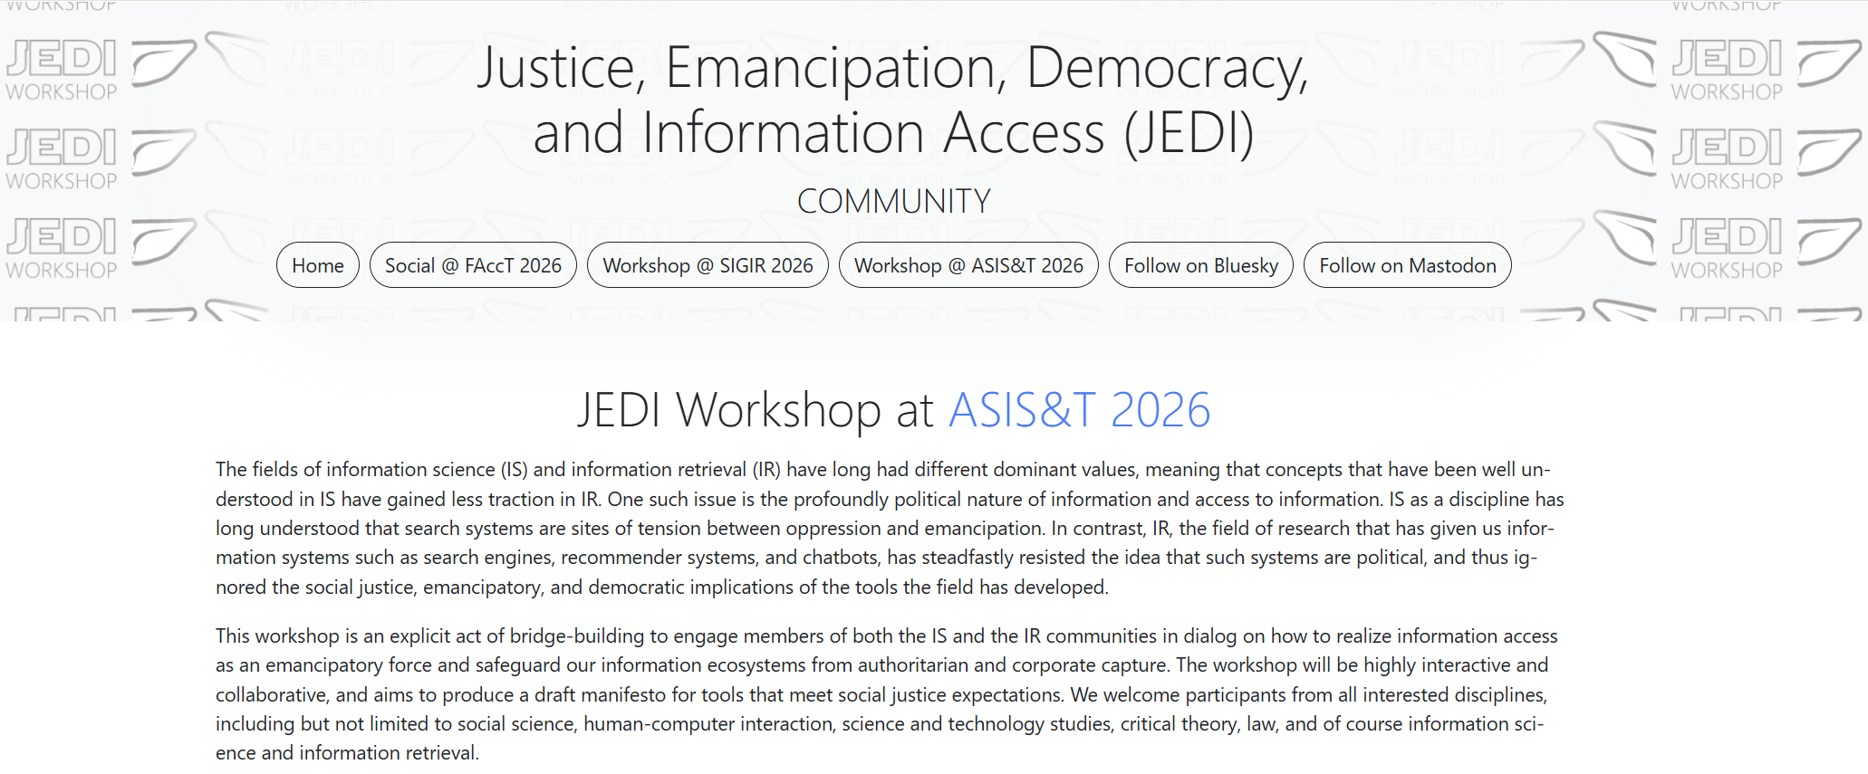
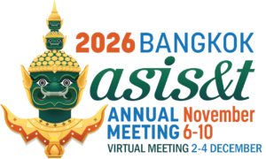

https://jedi.inertial.science/asist2026/

Slide 28
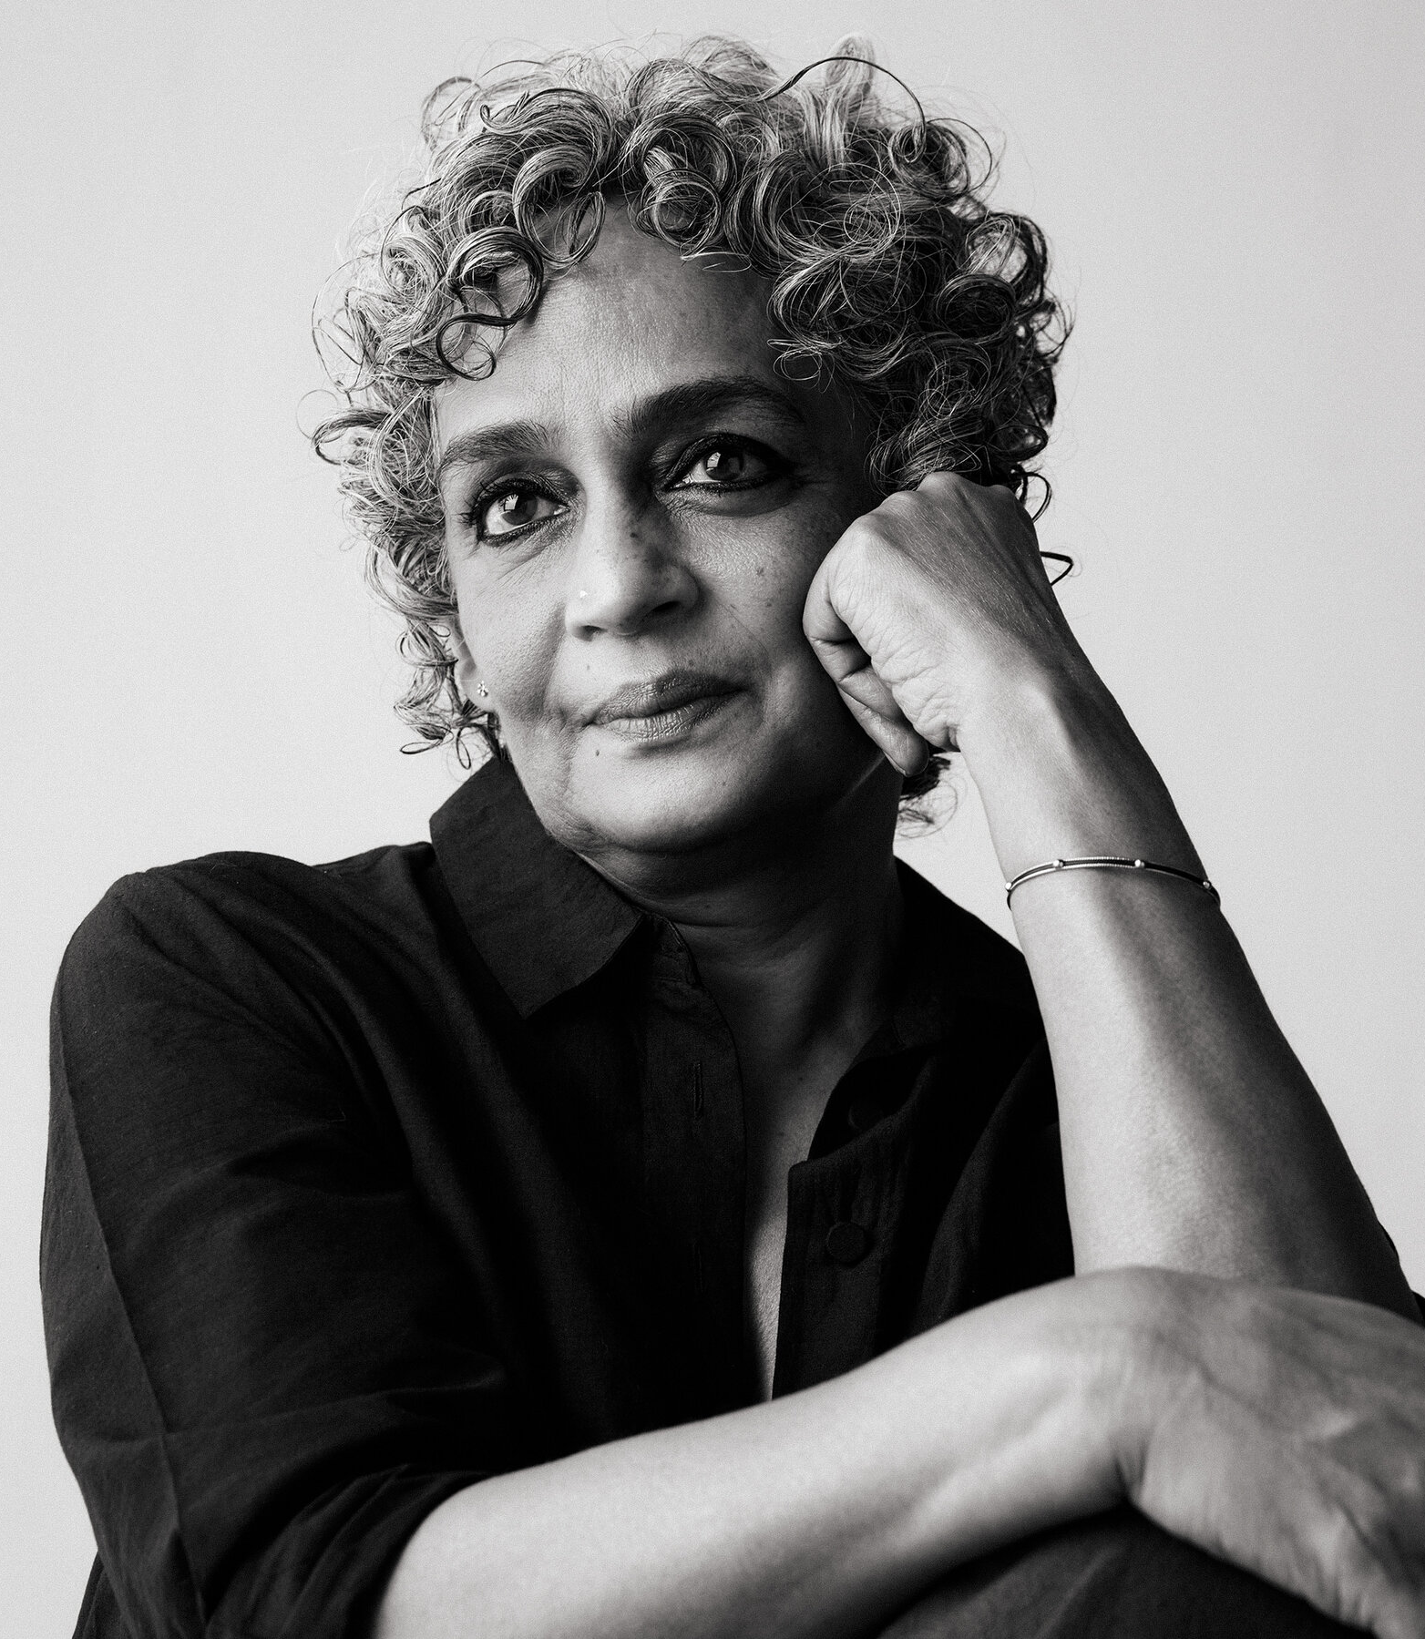
“Another world is not only possible, she is on her way. On a quiet day, I can hear her breathing.”
– Arundhati Roy
THANK YOU
bhaskar-mitra.github.io
@bmitra.bsky.social
bhaskar.mitra@acm.org

