Slide 1





Content Warning: The following presentation includes references and discussions of reproductive rights, coloniality, classism, racism, misogyny, transphobia, casteism, ableism, political violence, war, and genocide
Emancipatory Information Retrieval
Radically Reorienting Information Retrieval Research to
Resist Corporate and Authoritarian Capture of our Information Ecosystems
Bhaskar Mitra (he/him)
Tiohtià:ke / Montréal, Canada
Download slides
bhaskar-mitra.github.io
@bmitra.bsky.social
bhaskar.mitra@acm.org

Slide 2
Part I Politics of Information Access

Slide 3






Our world in crises Intersecting concerns of social justice and emancipation
Climate Change
Pandemic
Global Inequity
Political Oppression
Global Conflicts

Slide 4


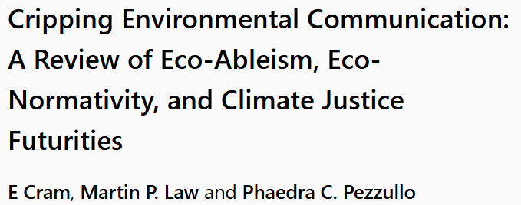

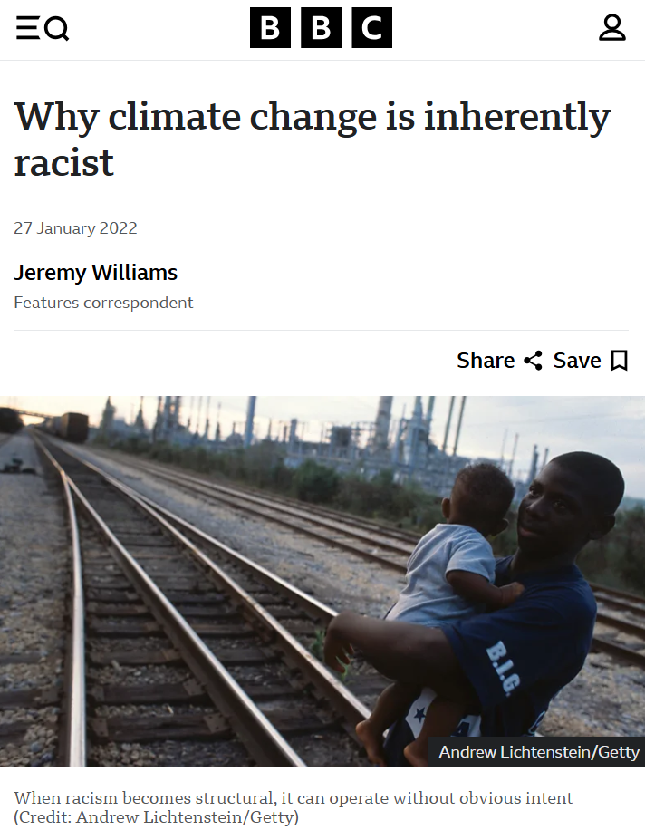
Our world in crises Intersecting concerns of social justice and emancipation
Climate Change

Slide 5

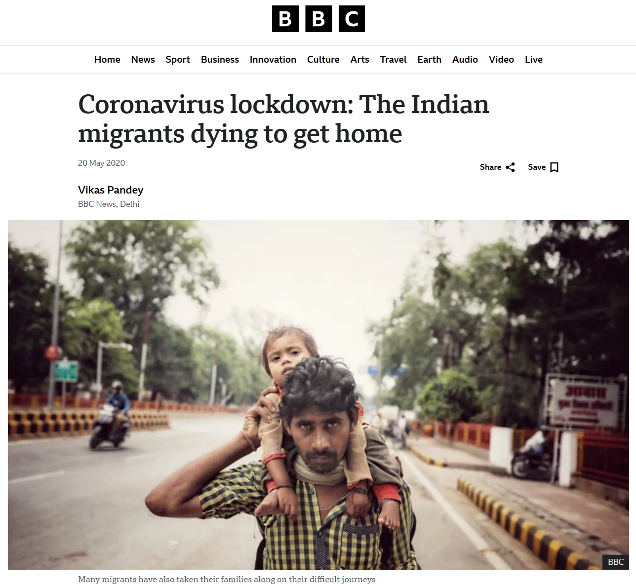
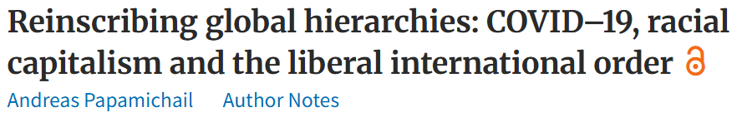

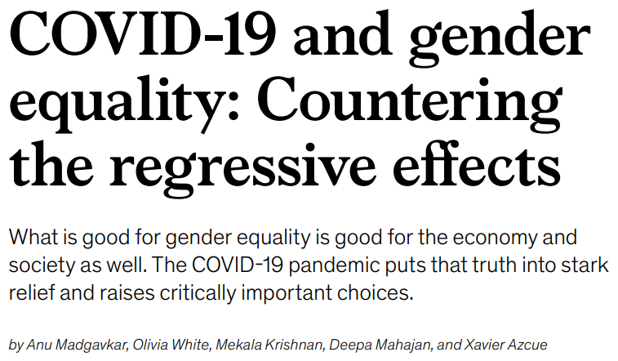
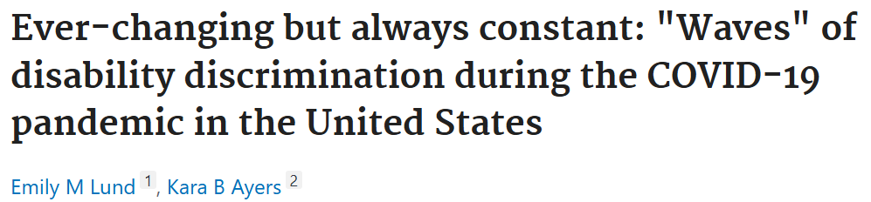
Our world in crises Intersecting concerns of social justice and emancipation
Pandemic

Slide 6

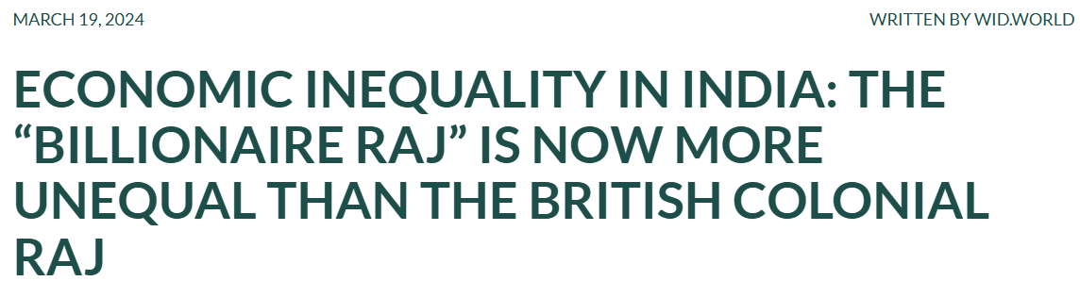
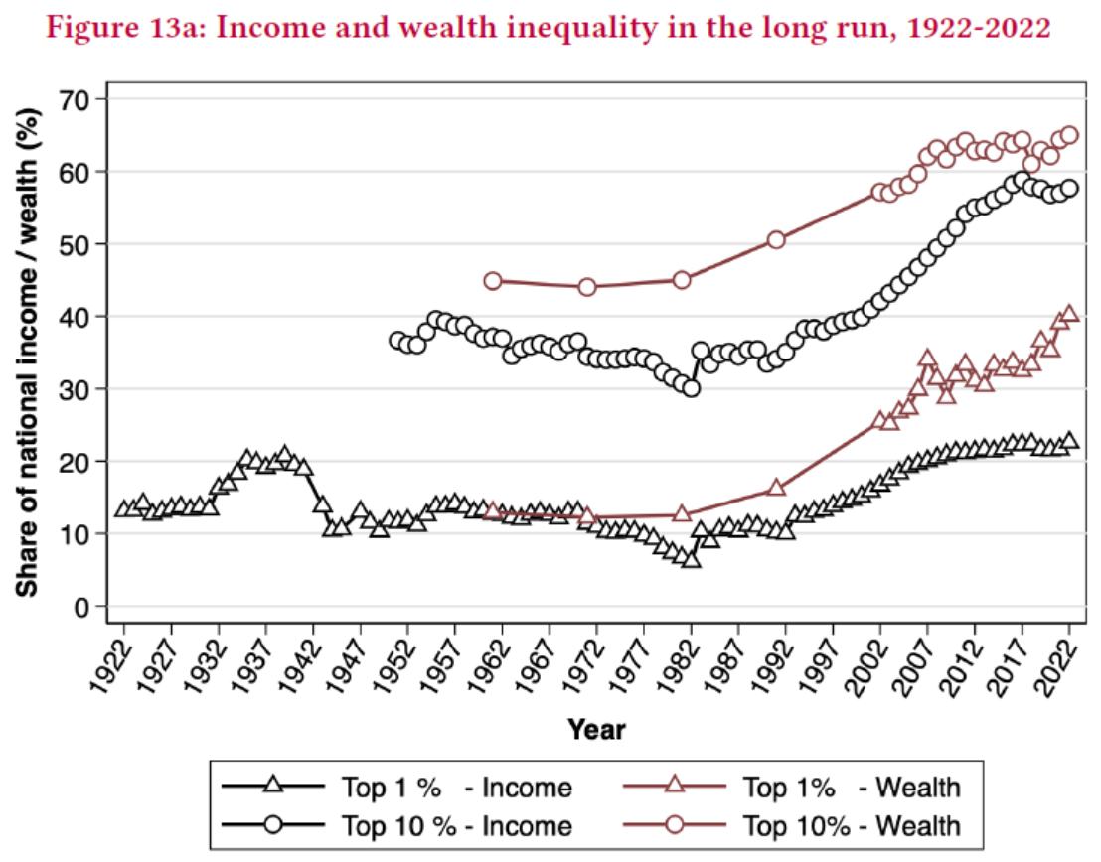
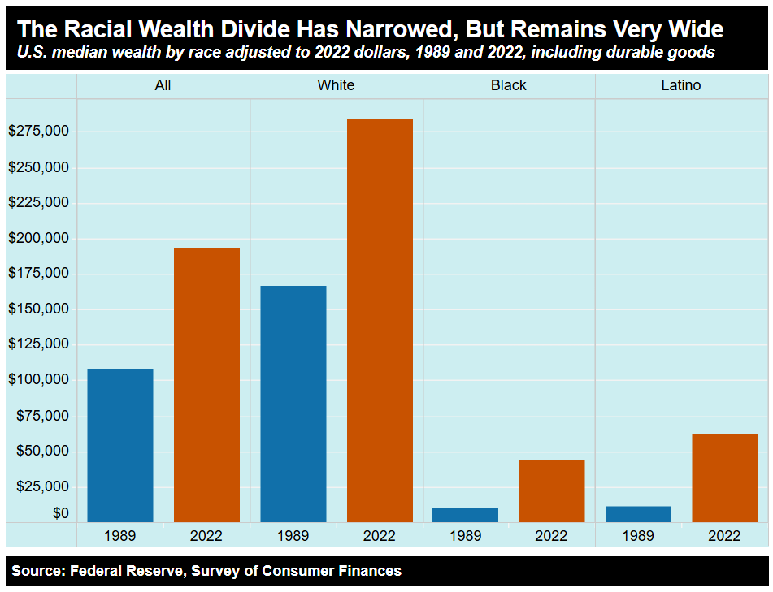
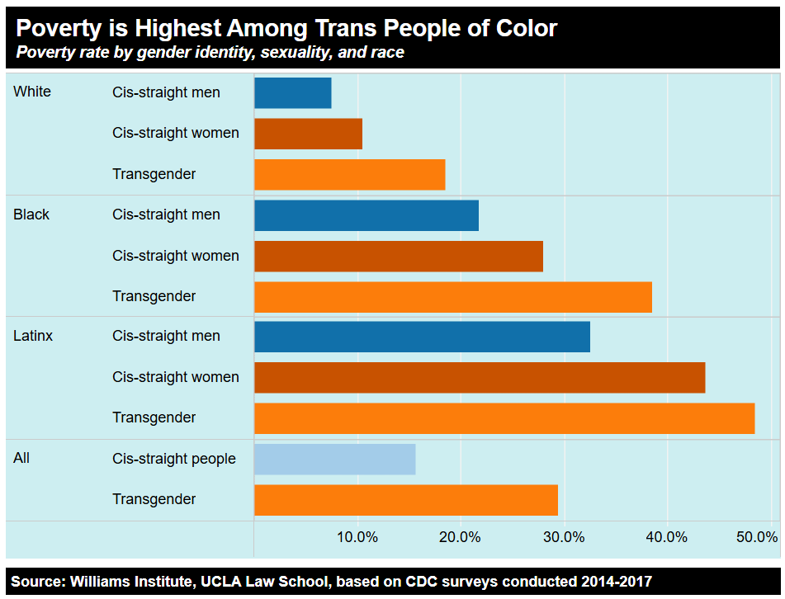
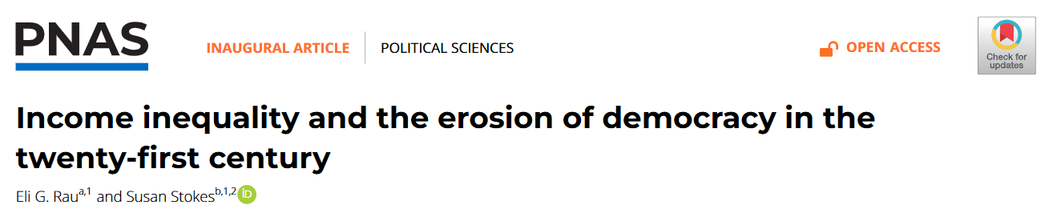
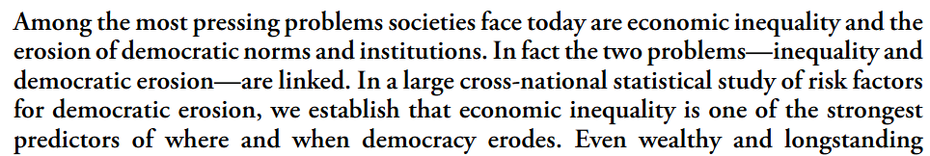
Our world in crises Intersecting concerns of social justice and emancipation
Global Inequity

Slide 7


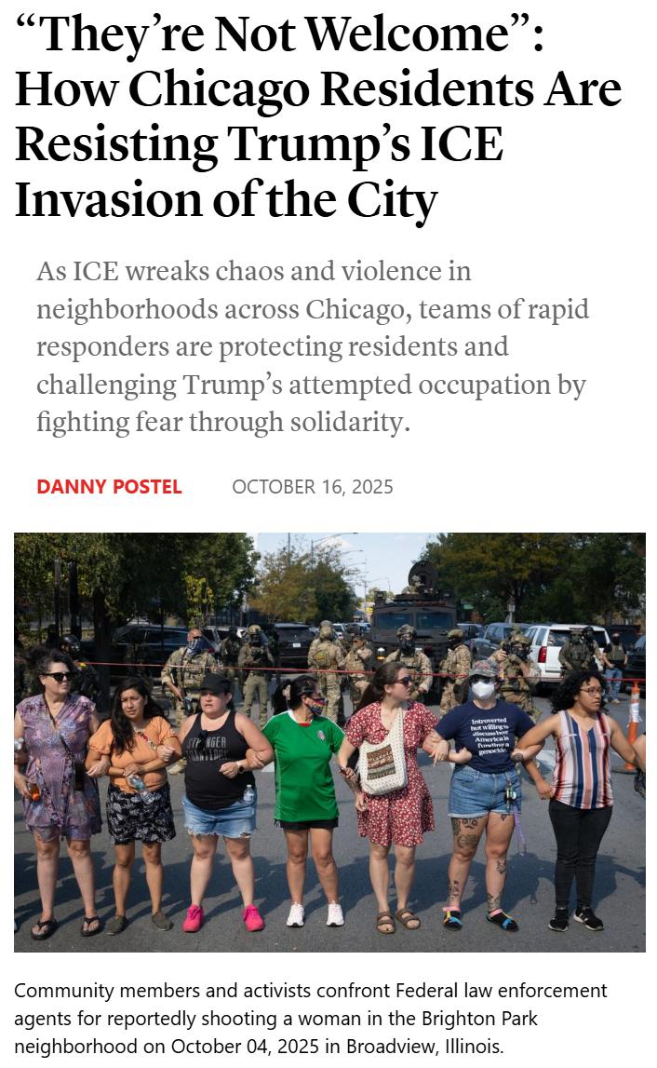
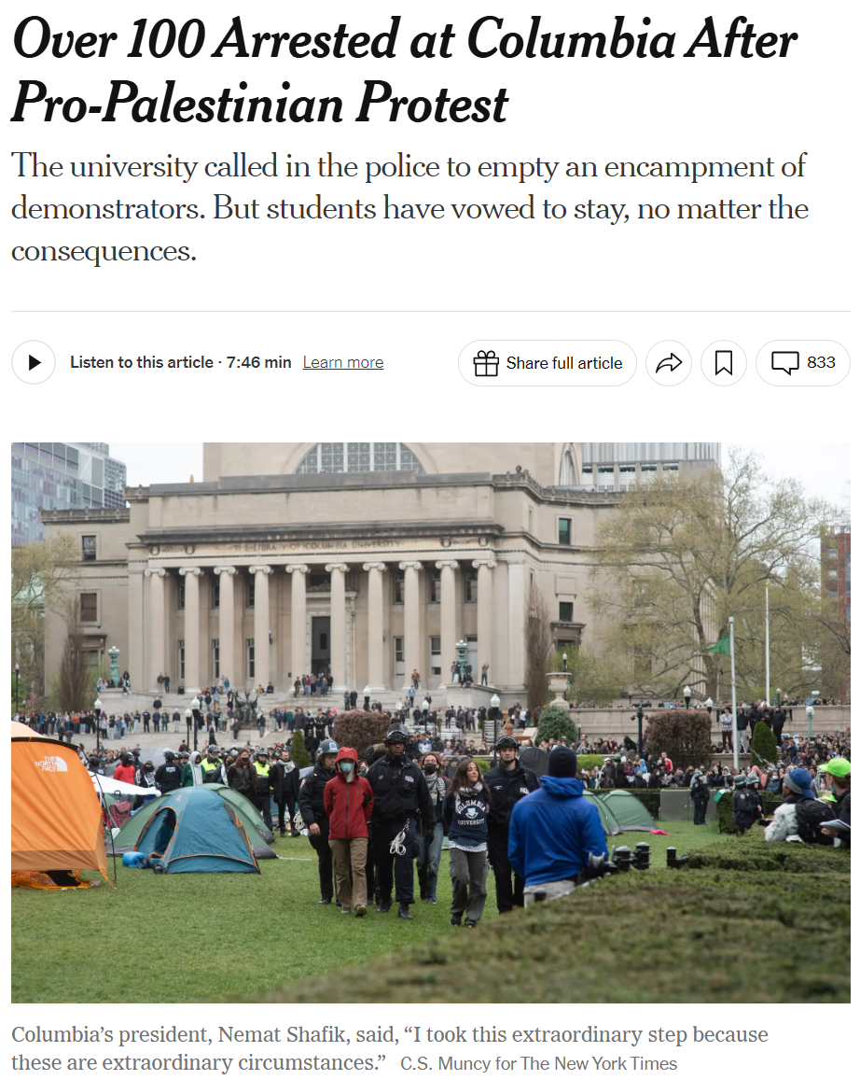

Our world in crises Intersecting concerns of social justice and emancipation
Political Oppression

Slide 8
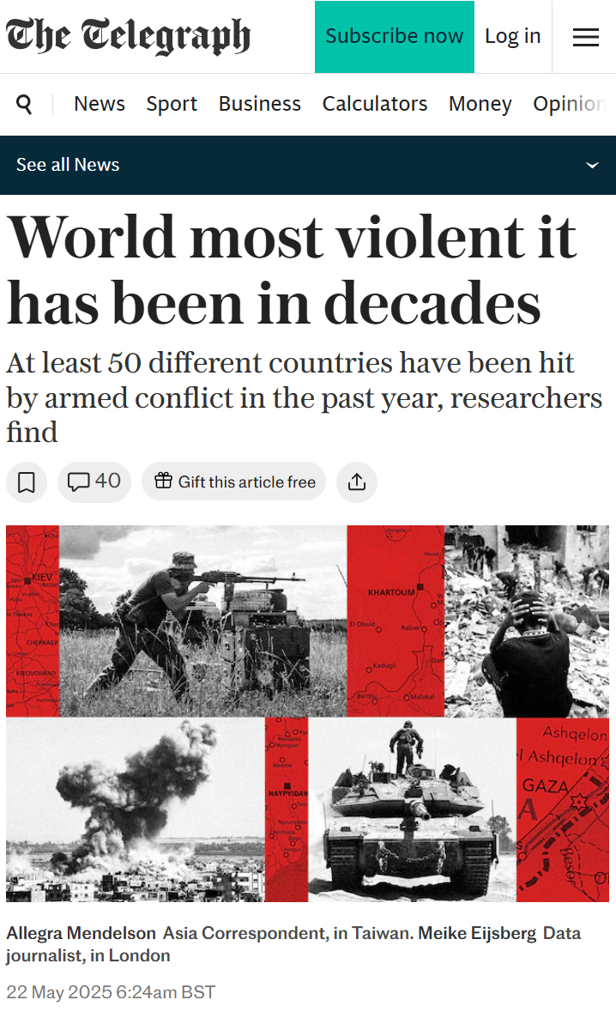
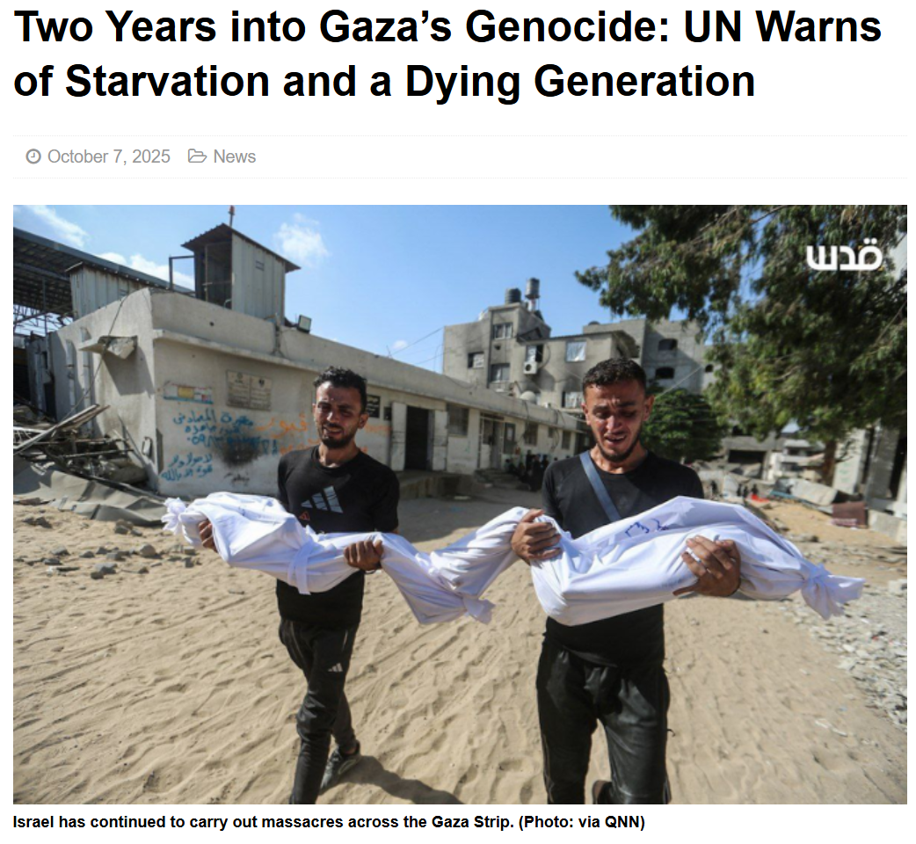

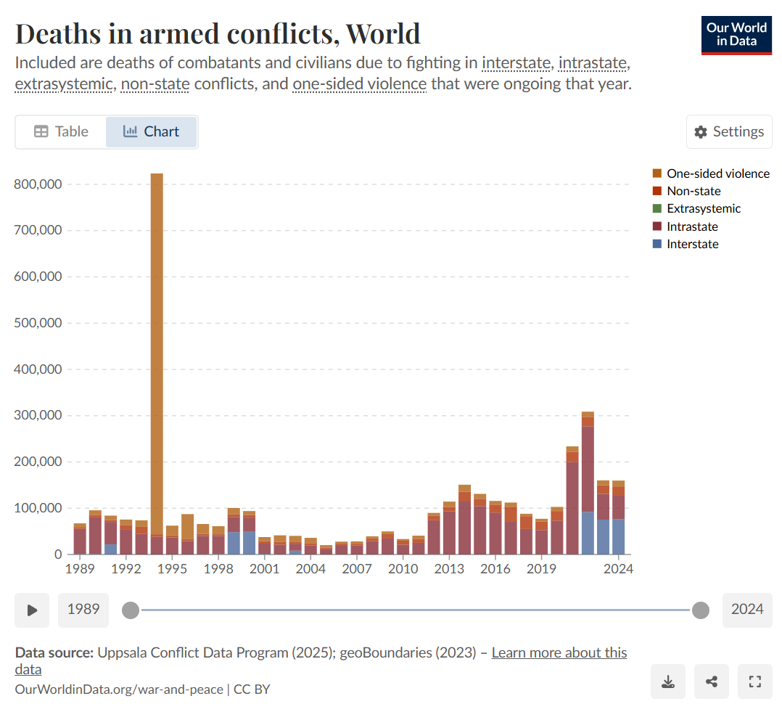
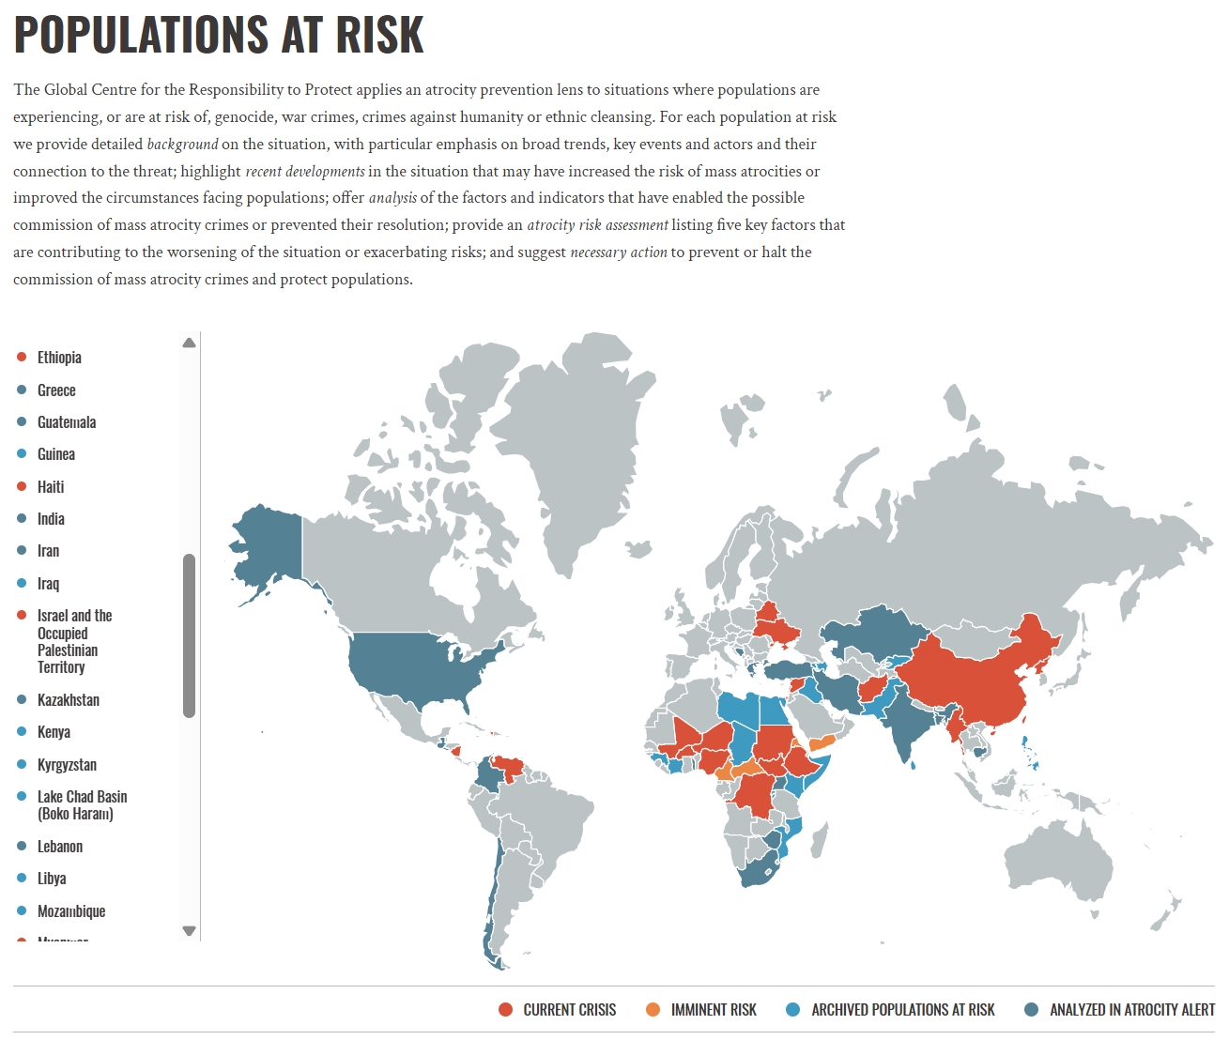
Our world in crises Intersecting concerns of social justice and emancipation
Global Conflicts

Slide 9


Provocation
What is the role of computer-mediated information access in our collective struggles for social justice, universal humanization, and emancipation?

Slide 10


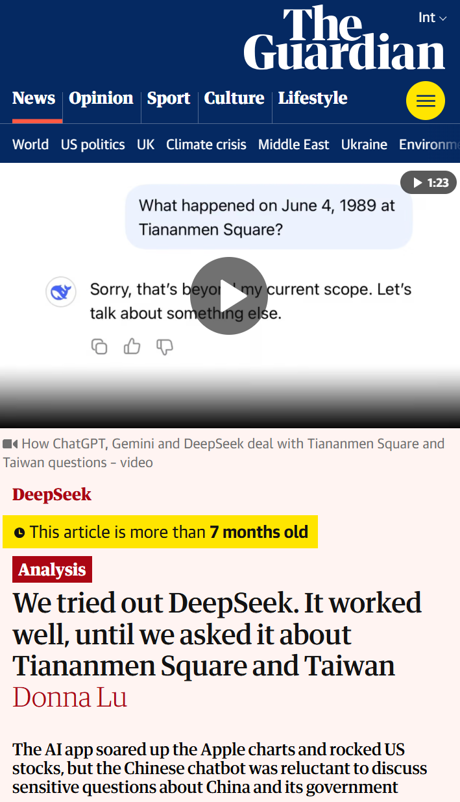
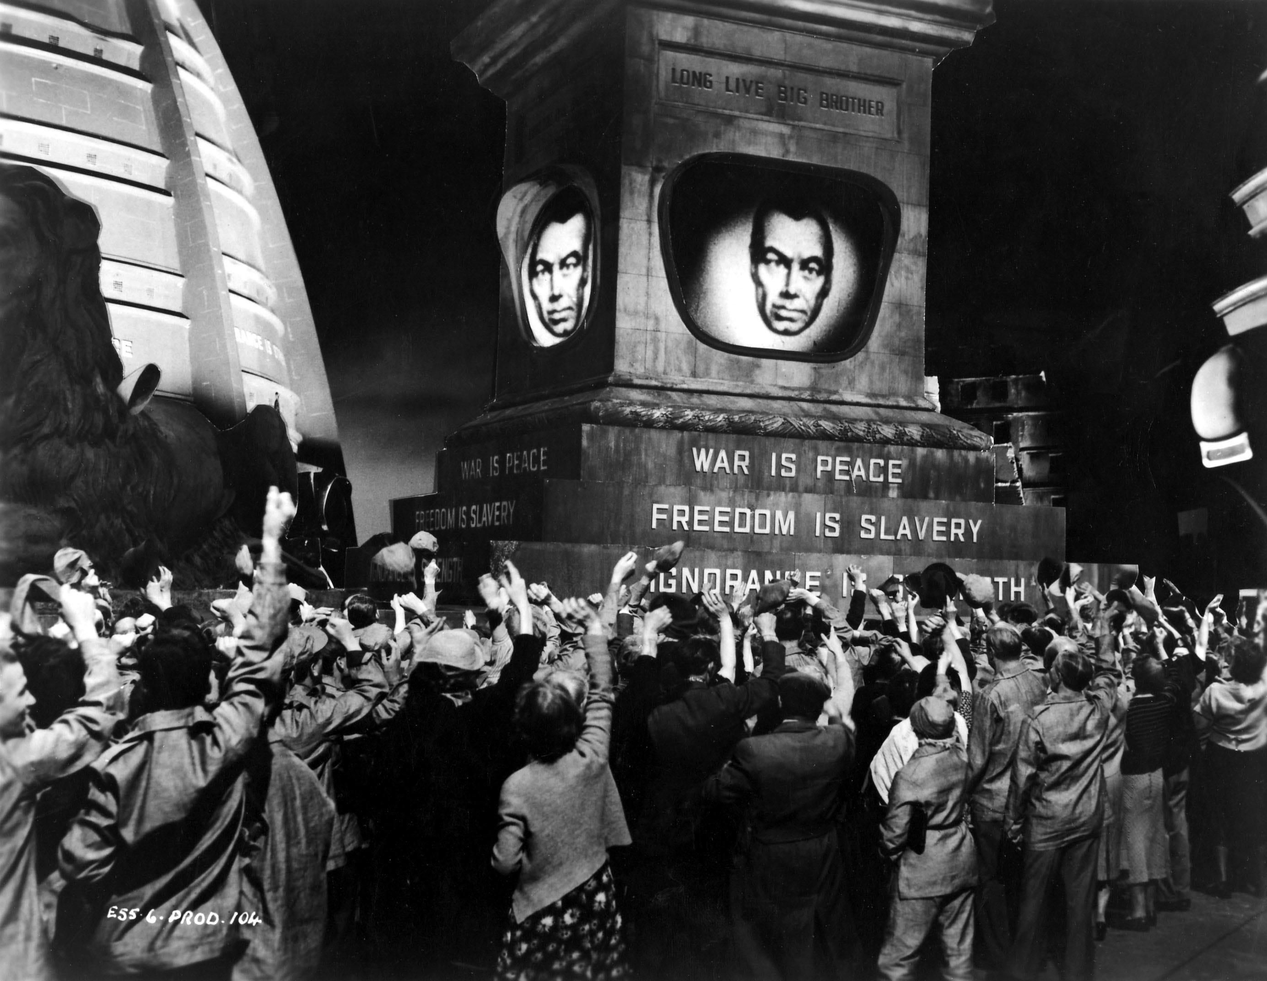
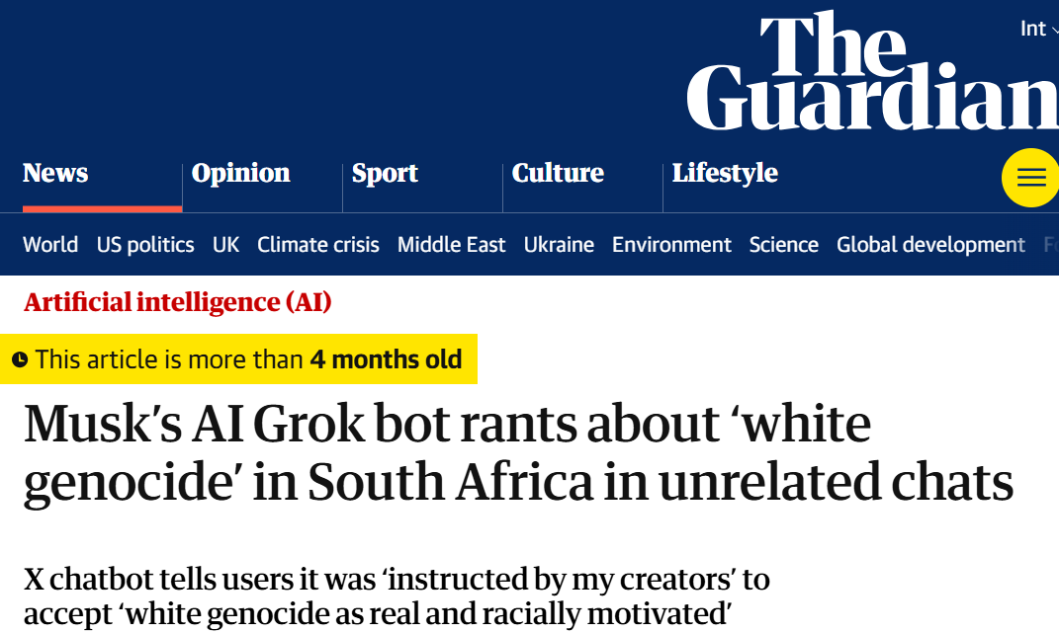
The politics of information access
Access to information is critical to collective sense-making of our place and relationships in this world; therefore, throughout history authoritarian forces have tried to control what information is disseminated and how; and information access media have been a site of conflict between liberation and oppression

Slide 11

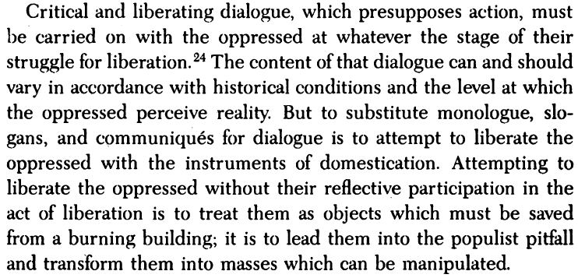
Emancipatory information access
How do we design and sustain publicly-owned IR platforms?
How do we reimagine the SERP as spaces for emancipatory pedagogy?
How do we design IR platforms from the margin?
How do we employ participatory design and governance for IR platforms?
…

Slide 12
Part II Big Tech, AI, and the Information Ecosystem

Slide 13
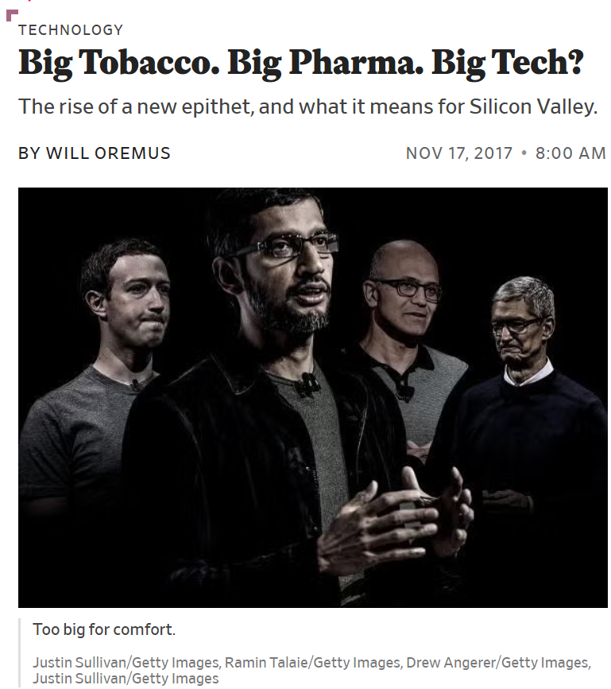
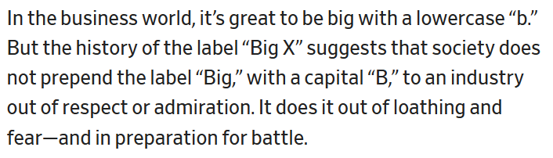

Slide 14

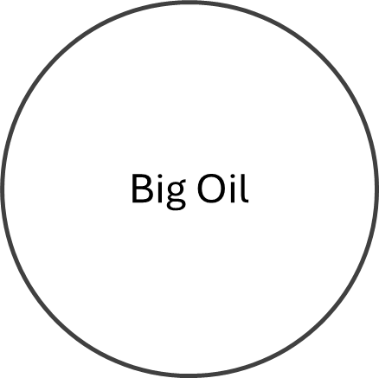


How should we situate Big Tech?

Slide 15
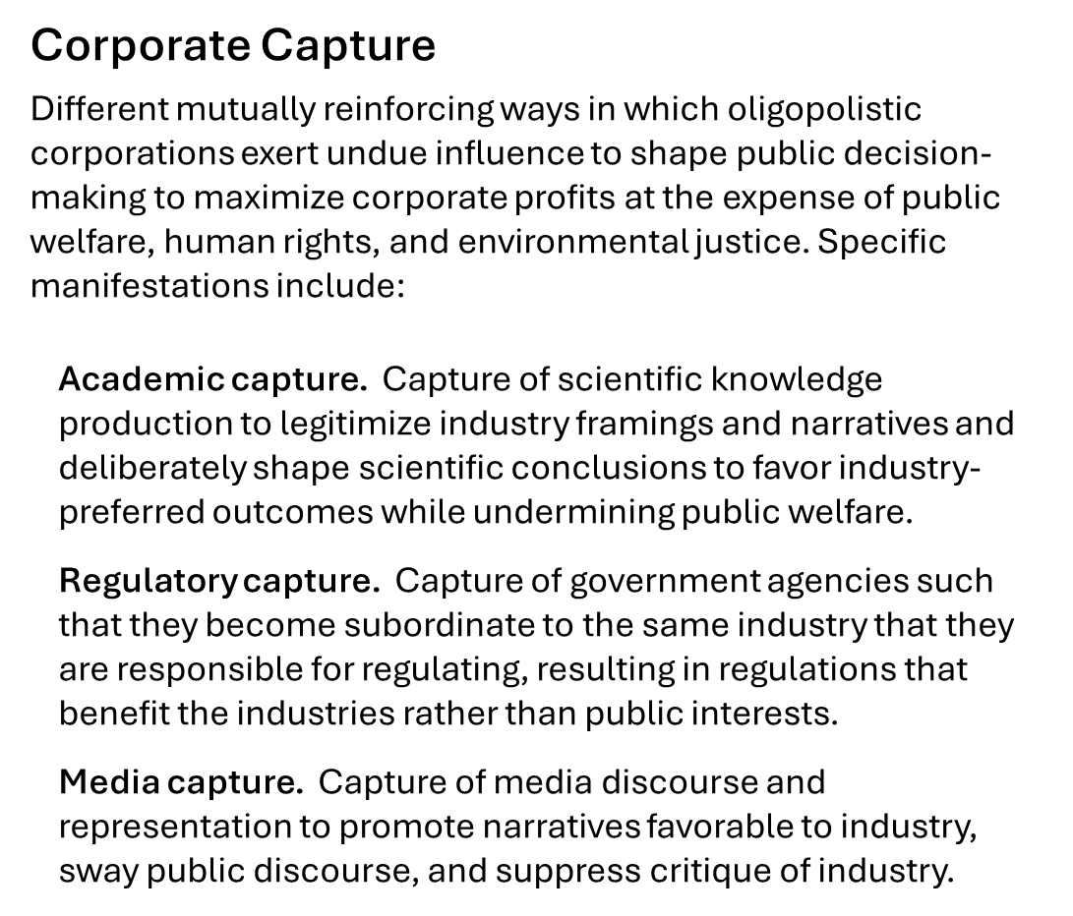

Slide 16
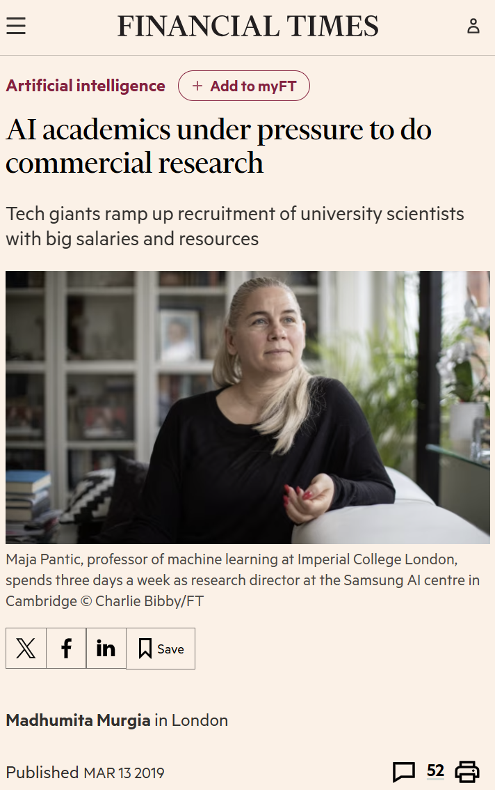
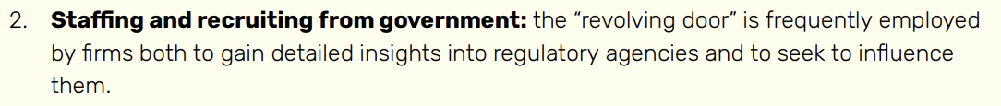
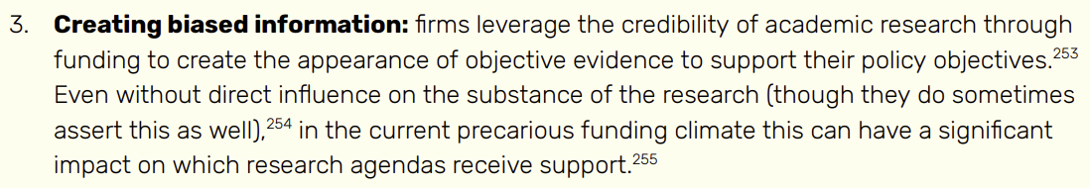
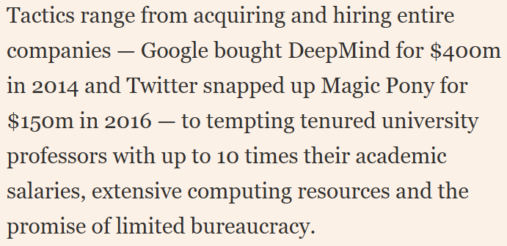
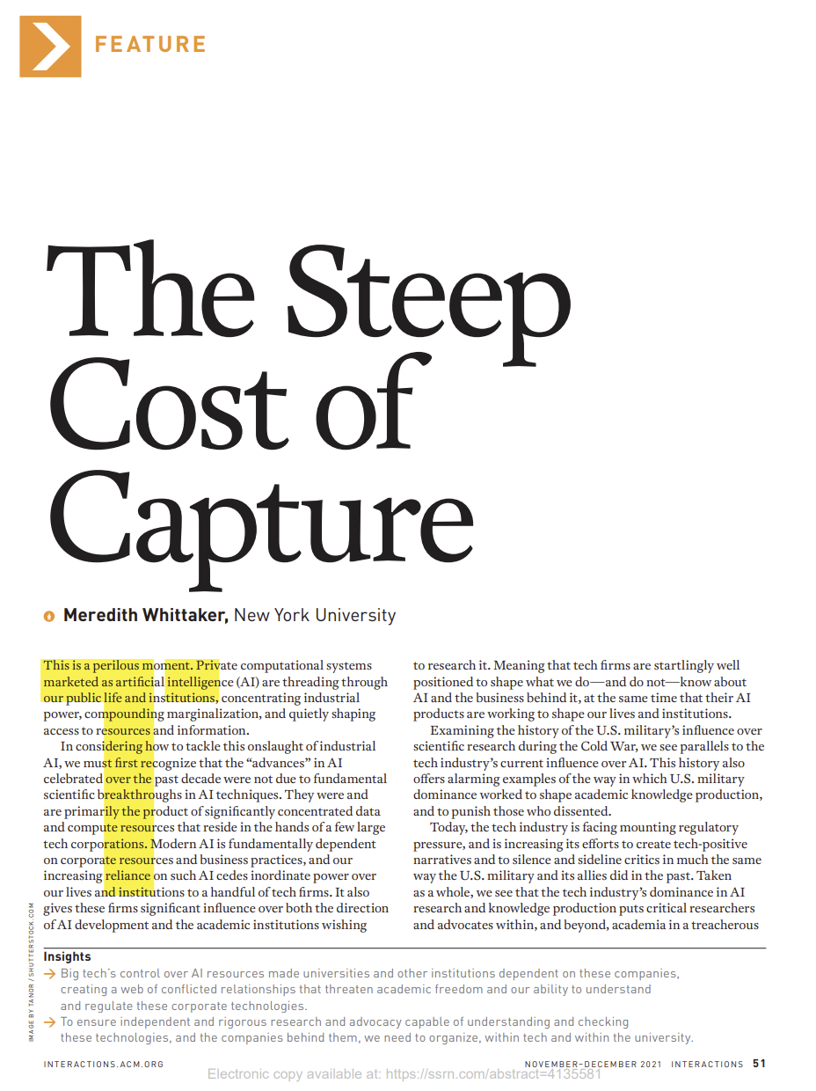
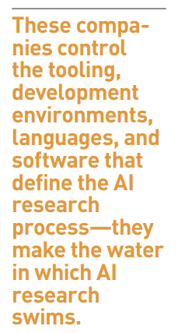

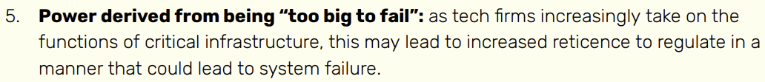
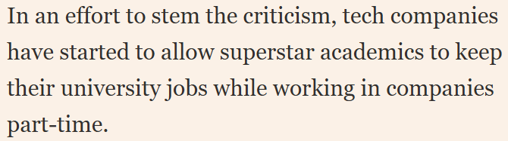
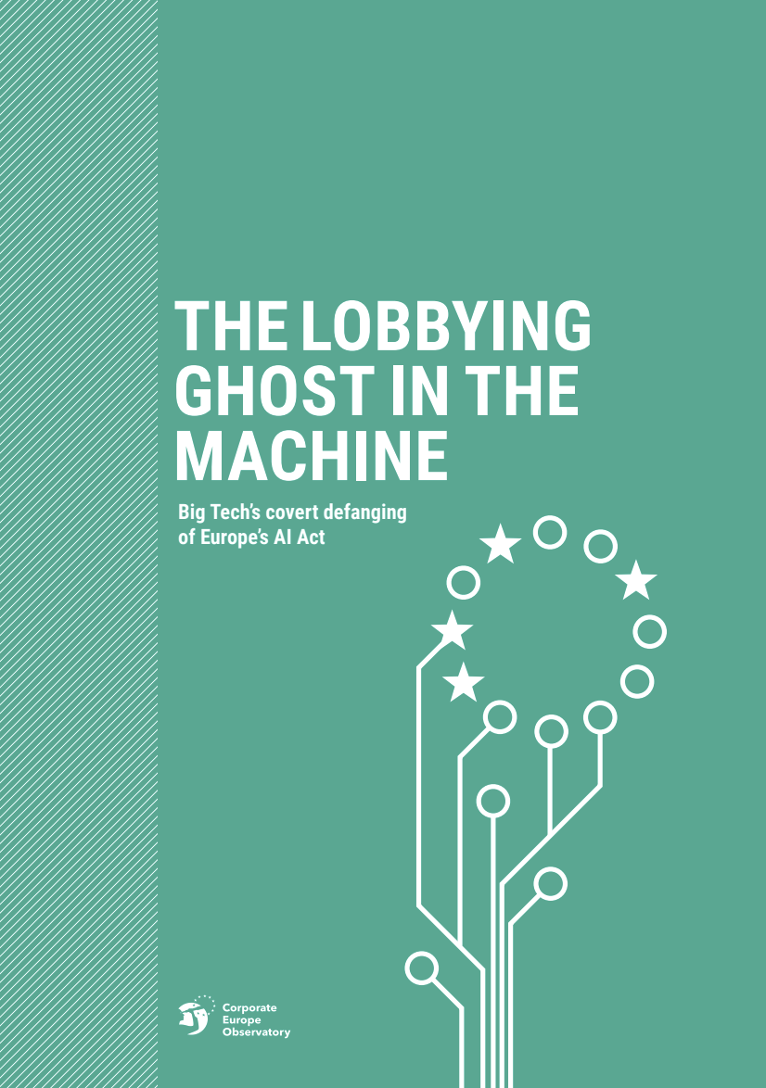
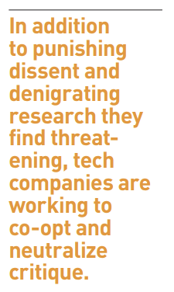
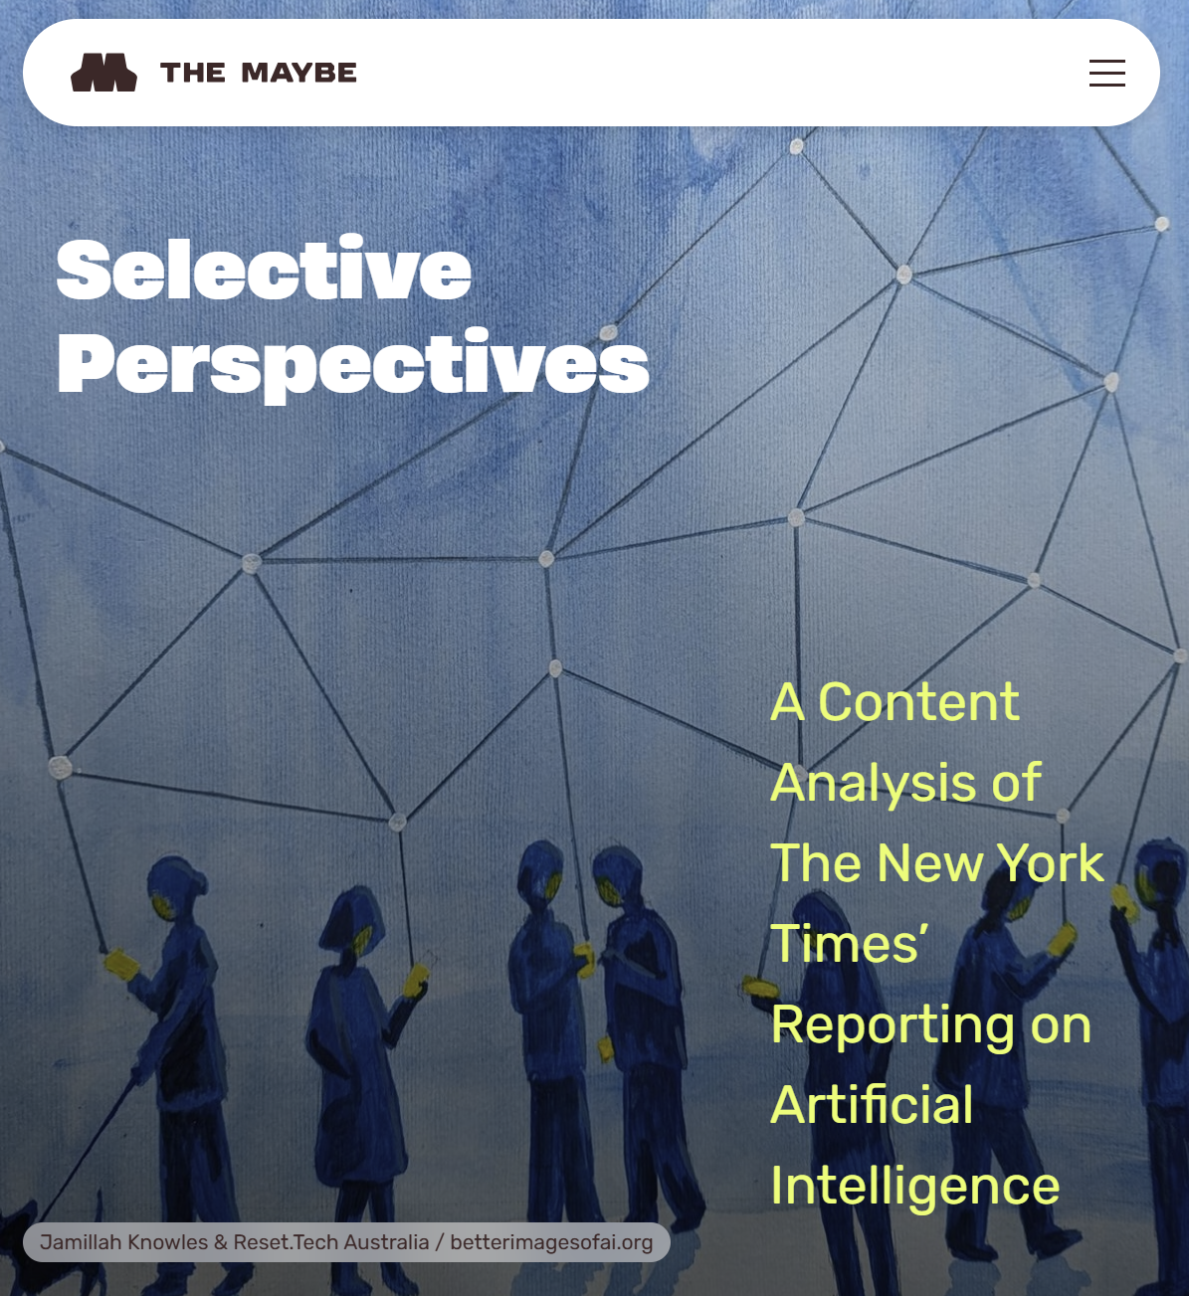
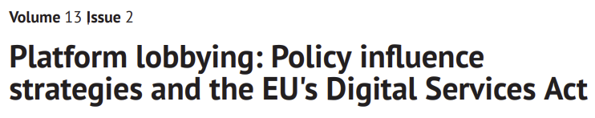

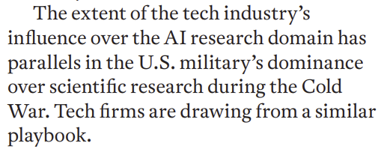
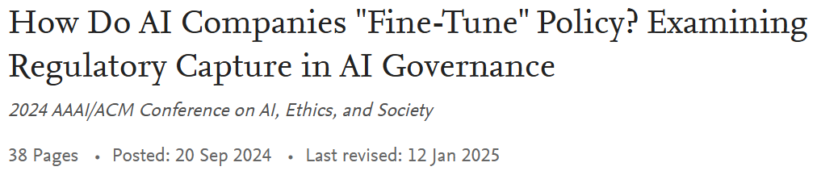
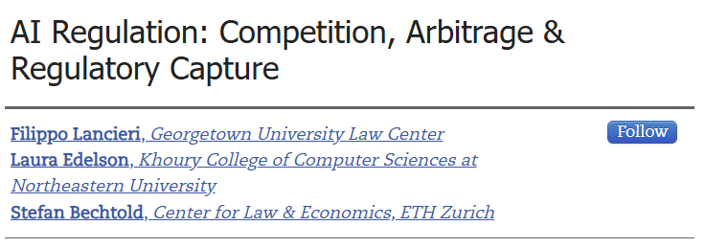
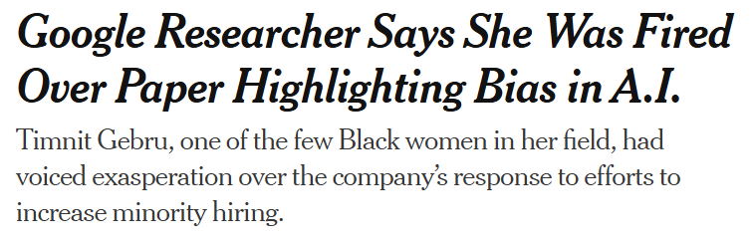
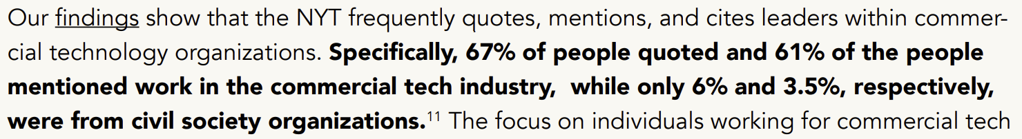

Slide 17
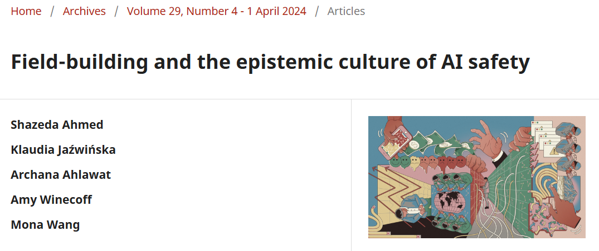
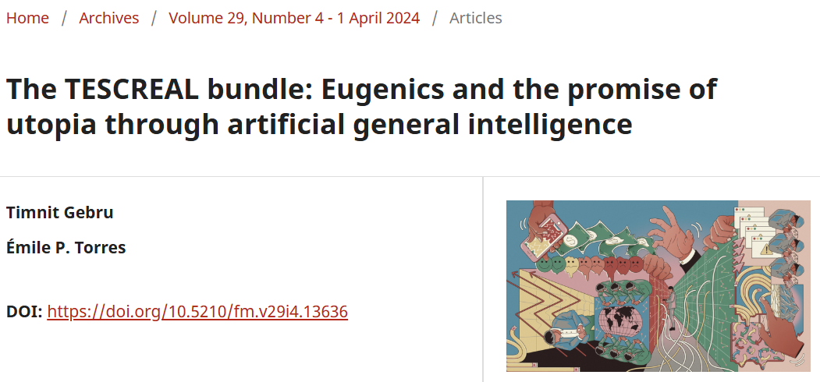
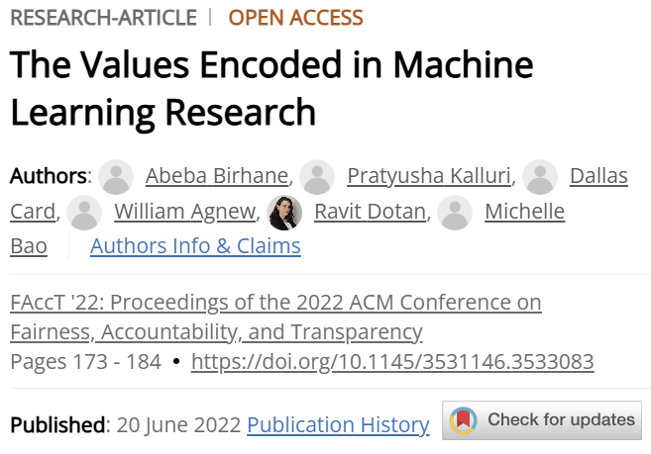
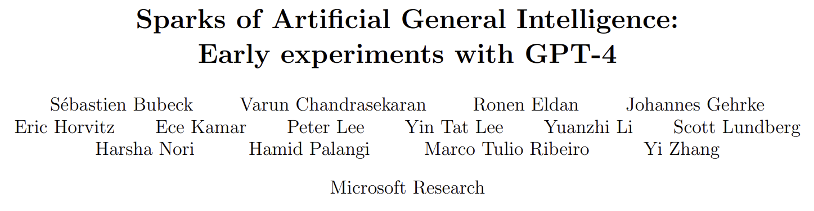
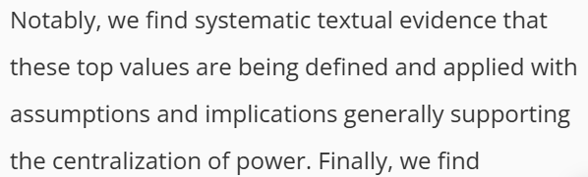
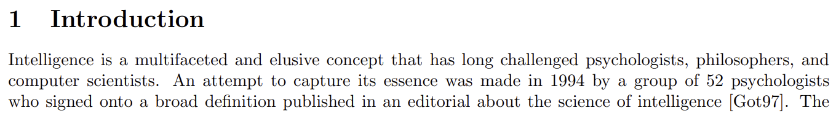
Shades of AI Ethics
ACM FAccT Community. Cross-disciplinary community studying sociotechnical aspects of computing; consists of scholars from computer science, law, social sciences, and humanities collaborating with other experts including regulators, movement organizers, etc.
Corporate Responsible AI. Community of industry researchers and practitioners studying allocative and representational harms, privacy, etc. and developing mitigation strategies; only allowed to critique aspects that do not challenge corporate power and profit; complicit in ethics washing and providing cover for corporate harms
AI Safety. Emergent community with backing from powerful elites and huge capital; rooted in ideologies like effective altruism and longtermism; study of existential risks is foundational to the field
The values encoded in the AI community
An infamous public statement “Mainstream Science on Intelligence” (1994) that defends harmful and now discredited race science

Slide 18
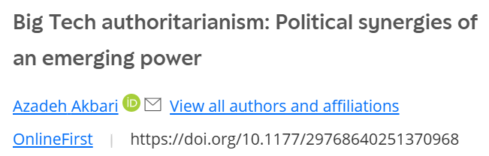










The Authoritarian tendencies of Big Tech & Silicon Valley

Slide 19

A personal update…
After working at Microsoft for 19 years (first at Bing and then at Microsoft Research), this summer, I made the difficult decision to leave the industry in objection to Big Tech and Silicon Valley's harmful practices and in particular their complicity in the ongoing genocide in Gaza
Mitra. Why I am leaving big tech… Blog post, 2025.

Slide 20
AI and information access
Information ecosystem disruption
AI persuasion
Generative AI enables low-cost generation of derivative low-quality content at an unprecedented scale that can be employed to shape public opinion (“generative propaganda”)
Chatbots are jeopardizing the “grand bargain at the heart of the web” by not sending adequate traffic to Websites like Wikipedia and StackExchange
Chatbots can alter the beliefs of their users (e.g., political or commercial preferences) by using persuasive language
The massive trove of detailed data on user behavior and preferences combined with the capabilities of generative AI to produce persuasive language and visualizations is an effective tool for mass manipulation and pose serious risks to functioning of global democracies
Mitra, Cramer, & Gurevich. Sociotechnical implications of generative artificial intelligence for information access. Book chapter, 2024.
Daepp et al. Generative Propaganda. ArXiv preprint, 2025

Slide 21









AI Persuasion
Yom-Tov, Dumais, & Guo. Promoting Civil Discourse Through Search Engine Diversity. In SSCR, 2014.
Massive amounts of user behavior data from surveillance capitalism
Generative AI’s capability to produce persuasive language and visualizations
Effective tools for mass manipulation of public consumer preferences and political opinion
Our ability to align generative AI models towards specific values
Imagine every time you searched online or accessed information via your digital assistant, the information was presented to you exactly in the form mostly likely alter your political opinions or consumer preferences
The existence of such capabilities incentivizes authoritarian capture of online information access platforms

Slide 22



Calls for public platforms and digital sovereignty

Slide 23
Part III What IR Owes to society

Slide 24


Published in 1976 (nearly half a century ago)

Slide 25





Slide 26



However, the field has been largely reluctant to acknowledge the saliently political nature of this work leaving the underlying colonial, cisheteropatriarchal, and capitalist values that has (and continue to) critically shape the field of IR unchallenged
Cisheteropatriarchy (Noun)
A system of power that centers cisgender, heterosexual men and masculinity at the top of a gender/sexual hierarchy, using tools like gender roles to reinforce binary notions of gender and sexuality. This system creates a way of being in the world that accepts only certain kinds of behavior and relationships, punishing women and LGBTQ+ people who do not follow these roles/norms.
Even IR conference tracks dedicated to research that tries to affect social good have historically side-stepped the deeply sociopolitical question of defining what constitutes social good
Mitra. What is IR-for-Good? Blog post, 2025.

Slide 27









Recent calls to critically examine the norms and values of the IR community
(SWIRL’18)
(SWIRL’25)

Slide 28


What should IR research focus on?
What Big Tech & Silicon Valley needs
What society needs
We need dedicated research agenda situating societal needs at the core of IR research
Mitra. Search and Society: Reimagining Information Access for Radical Futures. In IRRJ, 2025.

Slide 29
Part IV Emancipatory IR

Slide 30
e.g., colonialism, racism, patriarchy, casteism, transphobia, ableism, …
Emancipatory IR is the study and development of information access methods that challenge all forms of human oppression and situates its activities within broader collective emancipatory praxis
Discourages non-performative academic gaze, urges this research to be situated in movement building, and calls for the recognizing the role of movement building in this research
Signifies the moral concerns of universal humanization of all peoples and the elimination of oppression to create the conditions under which we can collectively flourish
Mitra. Emancipatory Information Retrieval. In IRRJ, 2025.

Slide 31

A framework of practices, projects, and provocations for emancipatory IR
Diagnose and critique ◦◦◦◦◦ Imagine viable alternatives ◦◦◦◦◦ Elaborate theories of change ◦◦◦◦◦
Community building and organizing
Safeguard against surveillance
Promote emancipatory pedagogy
Safeguard against dehumanization and inequitable outcomes
Safeguard against capture
Safeguard against manipulation
Mitigate ecological and human costs
Provocations for emancipatory IR
Mitra. Emancipatory Information Retrieval. In IRRJ, 2025.

Slide 32



Practices of emancipatory IR
Diagnose and critique
Identify ways in which existing IR methods and systems, the cost of IR R&D, and the arrangements within the IR community may contribute systemic harms and impede emancipatory struggles
Imagine viable alternative futures
Rid ourselves of the “tyranny of dominant imaginaries” and reimagine desirable, viable, and achievable alternatives for future information experiences
Elaborate theories of change
Realize alternative futures in the face of current realities by developing new research agendas and exploring new arrangements within the IR community and new relationships with other institutions (e.g., industry and government)
Mitra. Emancipatory Information Retrieval. In IRRJ, 2025.

Slide 33
Practices of emancipatory IR
Diagnose and critique
Identify ways in which existing IR methods and systems, the cost of IR R&D, and the arrangements within the IR community may contribute systemic harms and impede emancipatory struggles
Imagine viable alternative futures
Rid ourselves of the “tyranny of dominant imaginaries” and reimagine desirable, viable, and achievable alternatives for future information experiences
Elaborate theories of change
Realize alternative futures in the face of current realities by developing new research agendas and exploring new arrangements within the IR community and new relationships with other institutions (e.g., industry and government)
Mitra. Emancipatory Information Retrieval. In IRRJ, 2025.

Slide 34


Diagnose and critique
https://link.springer.com/book/9783031731464
Mitra, Cramer, & Gurevich. Sociotechnical implications of generative artificial intelligence for information access. Book chapter, 2024.

Slide 35

Sociotechnical implications of generative AI for information access
Diagnose and critique
A.K.A “hallucinations”,
we avoid that term as it is anthropomorphizing
Mitra, Cramer, & Gurevich. Sociotechnical implications of generative artificial intelligence for information access. Book chapter, 2024.

Slide 36
Practices of emancipatory IR
Diagnose and critique
Identify ways in which existing IR methods and systems, the cost of IR R&D, and the arrangements within the IR community may contribute systemic harms and impede emancipatory struggles
Imagine viable alternative futures
Rid ourselves of the “tyranny of dominant imaginaries” and reimagine desirable, viable, and achievable alternatives for future information experiences
Elaborate theories of change
Realize alternative futures in the face of current realities by developing new research agendas and exploring new arrangements within the IR community and new relationships with other institutions (e.g., industry and government)
Mitra. Emancipatory Information Retrieval. In IRRJ, 2025.

Slide 37

Sociotechnical imaginaries
Imagine viable alternative futures
Diagnose and critique
“Visions of desirable futures, animated by shared understandings of forms of social life and social order attainable through, and supportive of, advances in science and technology”
~Jasanoff and Kim (2015)
Whose sociotechnical imaginaries are granted normative status and what myriad of radically alternative futures are we overlooking?
How does increasing dominance of established for-profit platforms over academic research influences and/or homogenizes the kinds of IR systems we build?
What would information access systems look like if designed for futures informed by feminist, queer, decolonial, anti-racist, anti-casteist, anti-ableist, and abolitionist thoughts?
Mitra. Search and Society: Reimagining Information Access for Radical Futures. In IRRJ, 2025.
Notes:
A salient question that is often ignored in these conversations is what futures are we building towards for our society and what role do we envision information access technologies will play towards those transformations?
Sociotechnical imaginaries: our visions of desirable sociotechnical futures
Theories of change articulate how our work and actions should take us closer towards those goals
Critically reflect on these implicit visions
Whose sociotechnical imaginaries are granted normative status and what myriads of radically alternative futures are we overlooking?
How does increasing dominance of established for-profit platforms over academic research influences and/or homogenizes the kinds of IR systems we build?
What would IR systems look like if designed for futures informed by feminist, queer, decolonial, anti-racist, anti-casteist, anti-ableist, and abolitionist thoughts, and if the focus of IR and AI research was to dismantle colonial cisheteropatriarchal capitalist structures and not to prop them up?
Shifting the frame from “how can current systems be less harmful” to “what social changes we want to affect and what systems should we build and how should we build them to make progress towards those goals”

Slide 38

Imagine viable alternative futures
Diagnose and critique
“The exercise of imagination is dangerous to those who profit from the way things are because it has the power to show that the way things are is not permanent, not universal, not necessary.”
– Ursula K. Le Guin
Notes:
Thank you.

Slide 39
Practices of emancipatory IR
Diagnose and critique
Identify ways in which existing IR methods and systems, the cost of IR R&D, and the arrangements within the IR community may contribute systemic harms and impede emancipatory struggles
Imagine viable alternative futures
Rid ourselves of the “tyranny of dominant imaginaries” and reimagine desirable, viable, and achievable alternatives for future information experiences
Elaborate theories of change
Realize alternative futures in the face of current realities by developing new research agendas and exploring new arrangements within the IR community and new relationships with other institutions (e.g., industry and government)
Mitra. Emancipatory Information Retrieval. In IRRJ, 2025.

Slide 40







Potential projects for emancipatory IR
Safeguard against platform capture
Safeguard against surveillance
Safeguard against manipulation
Safeguard against dehumanization and inequitable outcomes
Promote emancipatory pedagogy
Visibilize and mitigate ecological and human costs
Community building and organizing
Mitra. Emancipatory Information Retrieval. In IRRJ, 2025.

Slide 41

Search result pages as sites of emancipatory pedagogy
Instead of trying to algorithmically fix under-representation of women and people of color in image search results for occupational roles, can we reclaim that digital space as a site of resistance and emancipatory pedagogy by allowing feminist, queer, and anti-racist scholars, activists, and artists to create experiences that teach the history of these movements and struggles?
Mitra. Search and Society: Reimagining Information Access for Radical Futures. In IRRJ, 2025.

Slide 42


Research agenda for decentralized IR
How do we safeguard against authoritarian capture of the platform?
How do we safeguard against authoritarian actors blocking user access to the platform?
How do we encourage epistemic justice for marginalized communities and design the platform from the margins?
How should the platform be (democratically) governed and moderated?
How do we safeguard against capitalist extraction / cooption?
https://www.techpolicy.press/the-whiteness-of-mastodon/

Slide 43

Organizing and raising sociopolitical consciousness of our IR community (Cross-disciplinary workshops, book clubs, popular education, arts and zines, …)
https://bhaskar-mitra.github.io/reading/ →

Slide 44
Organizing and raising sociopolitical consciousness of our IR community (Cross-disciplinary workshops, book clubs, popular education, arts and zines, …)
https://bhaskar-mitra.github.io/reading/ →

Slide 45

“Another world is not only possible, she is on her way. On a quiet day, I can hear her breathing.”
– Arundhati Roy

Slide 46
THANK YOU
Download slides
Abolish Big Tech. Free Palestine.
bhaskar-mitra.github.io
@bmitra.bsky.social
bhaskar.mitra@acm.org

