Slide 1
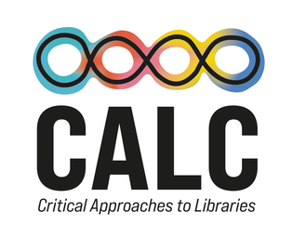




2026
Information Access of the Oppressed
Envisioning Emancipatory Information Access Platforms
Bhaskar Mitra (he/him)
Independent Researcher
Tiohtià:ke / Mooniyang / Montréal, Canada
My relevant research themes:
Exposure Fairness and Transparency in Information Access
Emancipatory Information Access
AI & Society
bhaskar-mitra.github.io
@bmitra.bsky.social
bhaskar.mitra@acm.org

Slide 2

Information retrieval (IR) is a field in computing that studies and develops tools and methods to satisfy people’s information needs by finding relevant information—e.g., search engines, recommender systems, and chatbots
IR has roots in library and information science and linguistics
Societal implications. These systems affect what information receive exposure which shapes consumer behavior, political discourse, and culture, and influence economic outcomes

Slide 3


Provocation for this talk
What is the role of computer-mediated information access in our collective struggles for social justice, universal humanization, and emancipation?

Slide 4
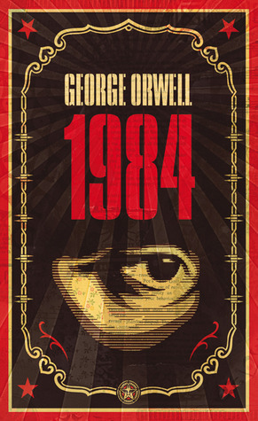

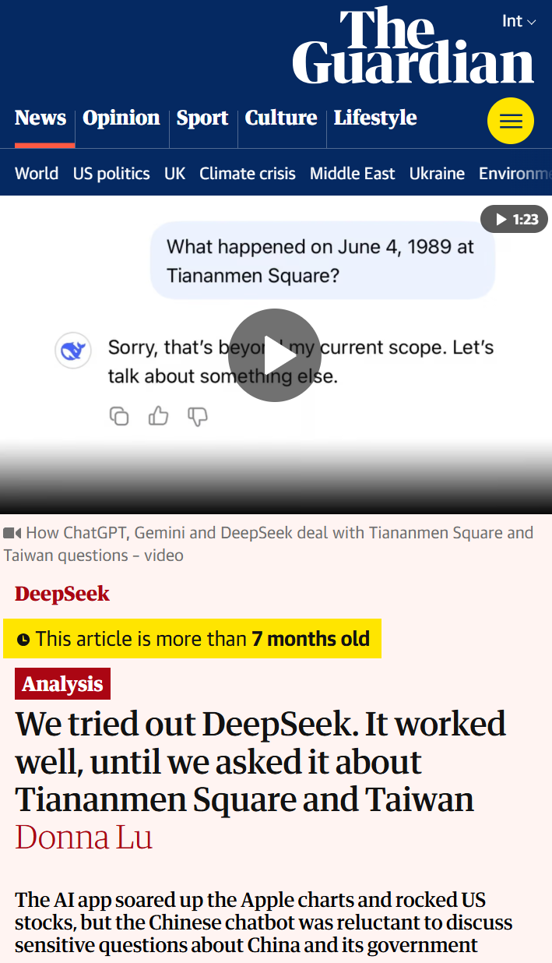
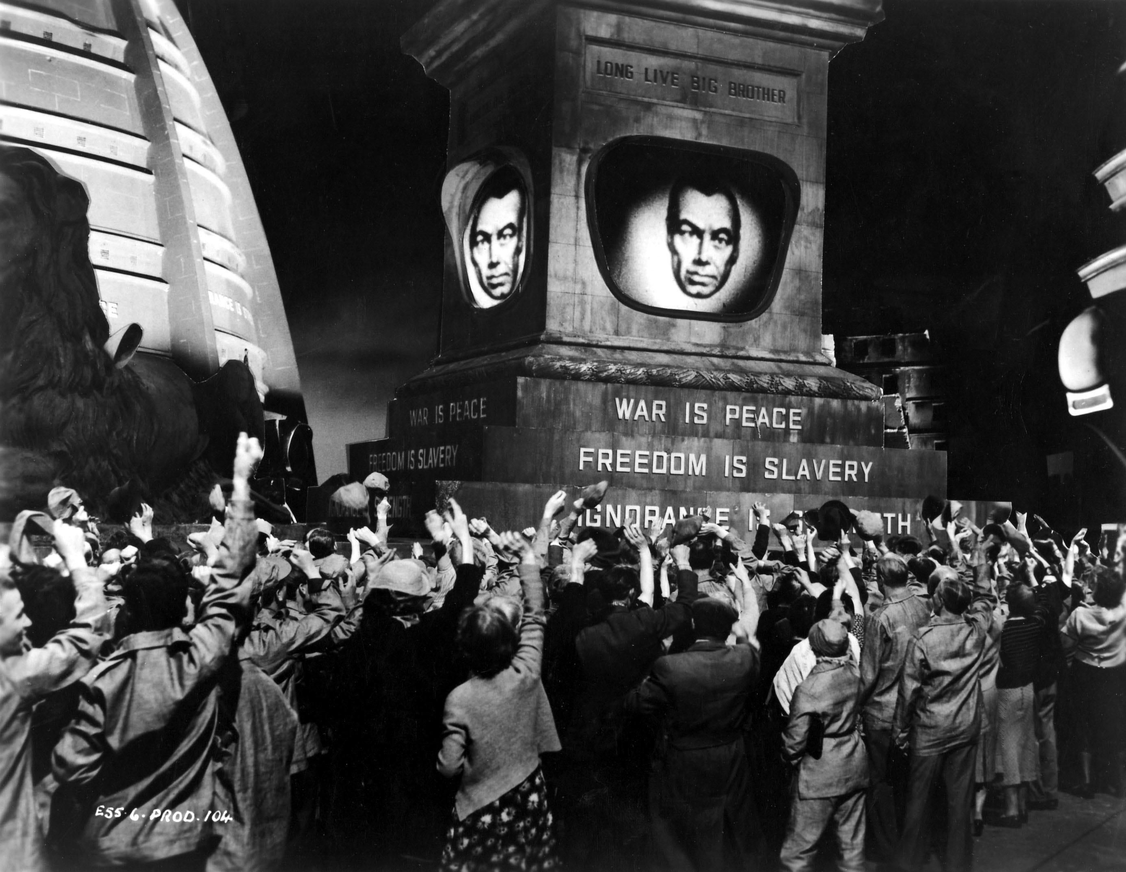
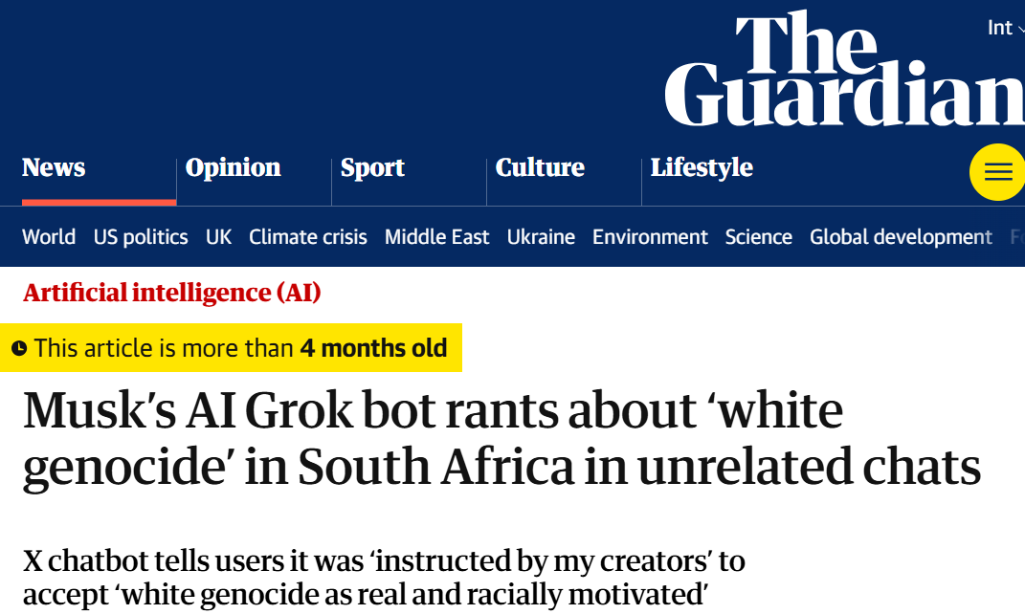
The politics of information access
Access to information is critical to collective sense-making of our place and relationships in this world; therefore, throughout history authoritarian forces have tried to control what information is disseminated and how; and information access media have been a site of conflict between liberation and oppression

Slide 5
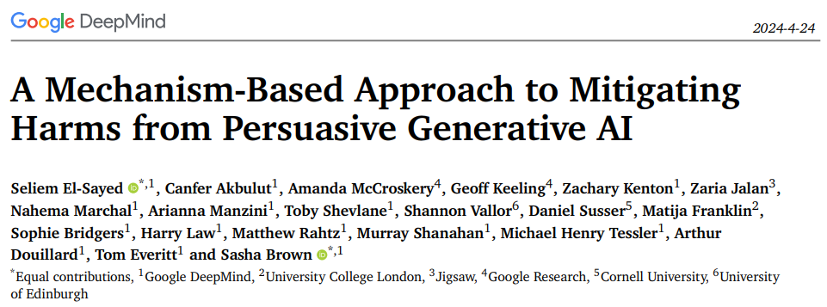
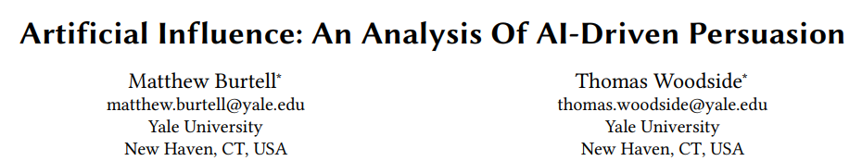
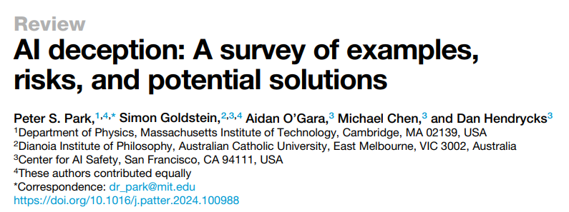
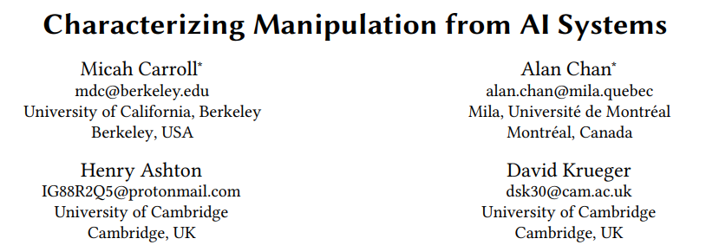
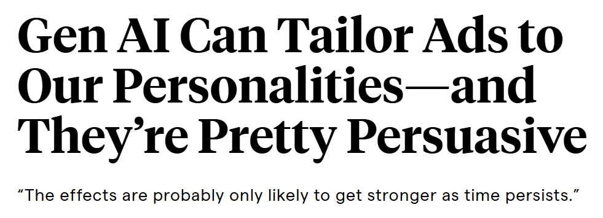
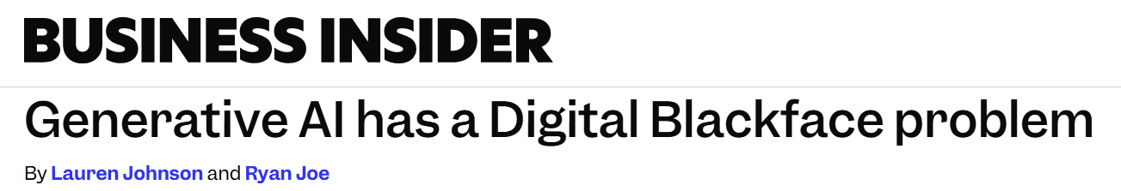
AI Persuasion
Imagine every time or accessed information online the information was presented to you in the form mostly likely to alter your political opinions or consumer preferences
The existence of such capabilities incentivizes authoritarian capture of online information access platforms
Massive amounts of user behavior data from surveillance capitalism
Generative AI’s capability to produce persuasive language and visualizations
Effective tools for mass manipulation of public consumer preferences and political opinion
Our ability to align generative AI models towards specific values
Mitra, Cramer, & Gurevich. Sociotechnical implications of generative artificial intelligence for information access. Book chapter, 2024.

Slide 6
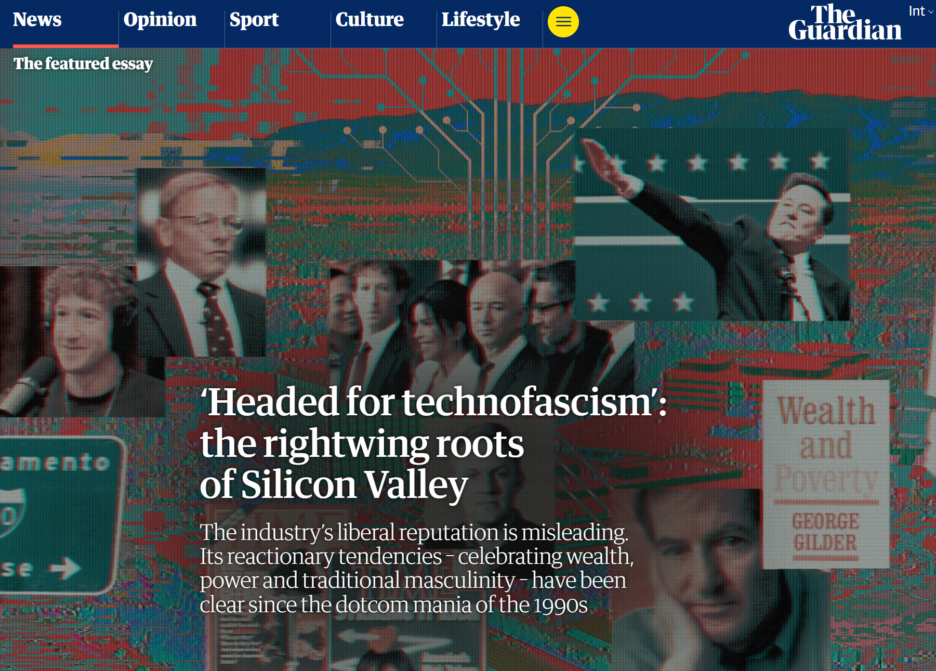
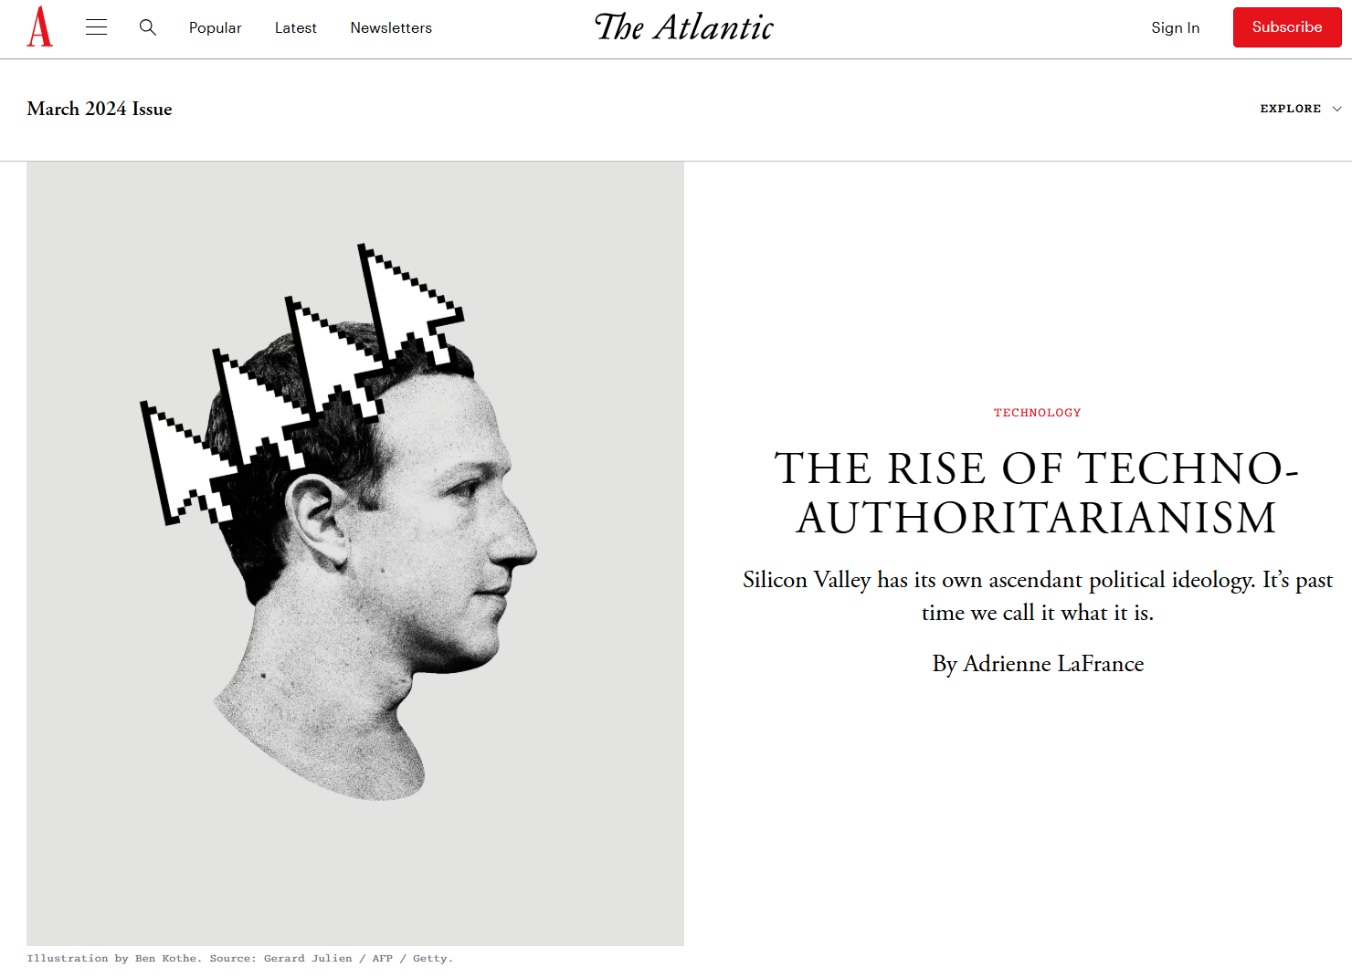
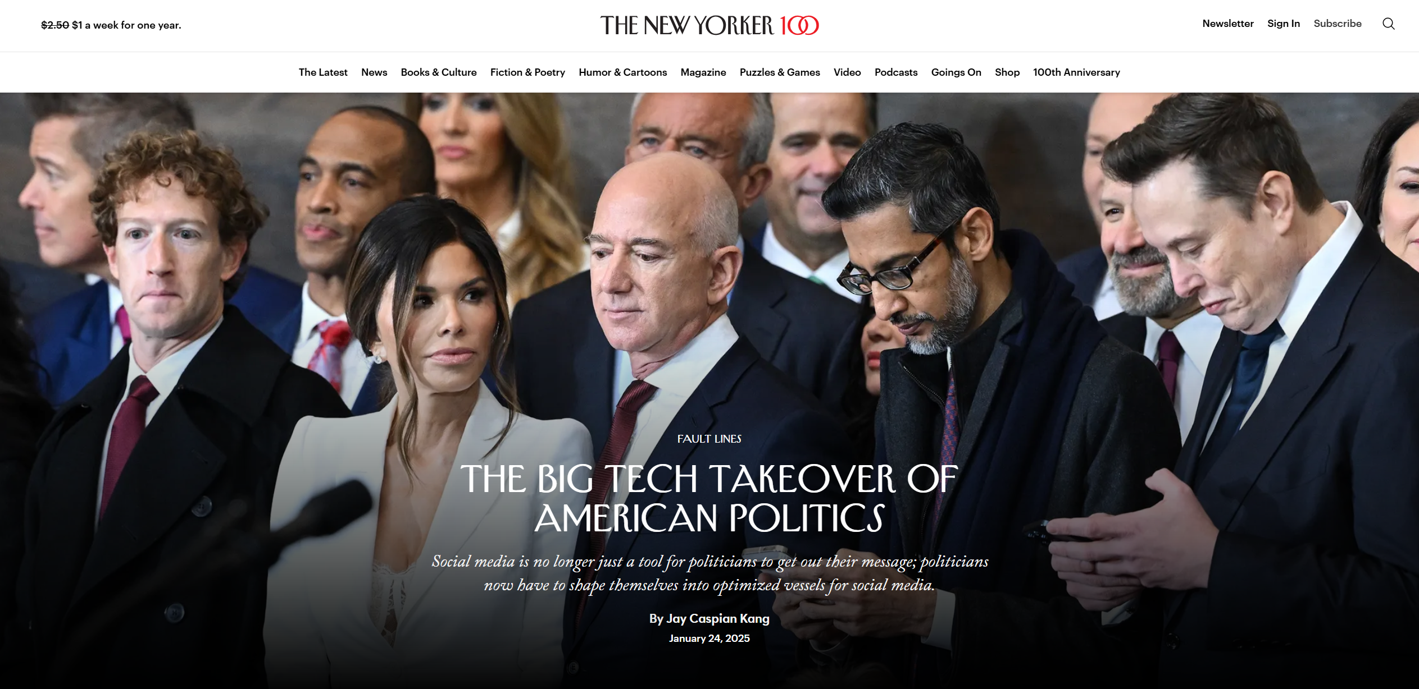
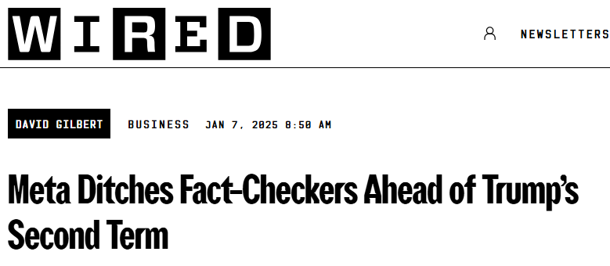
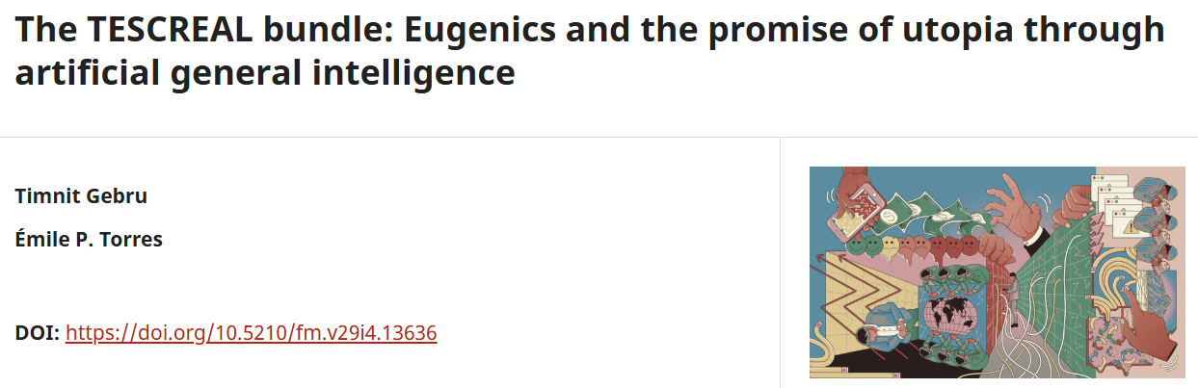
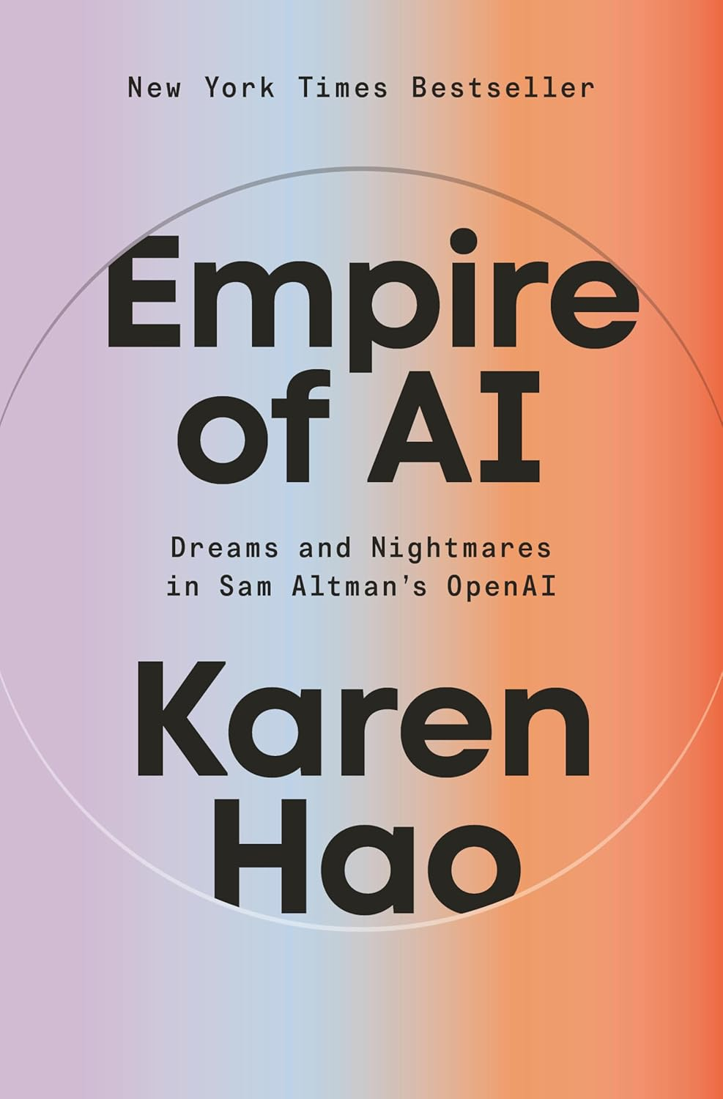
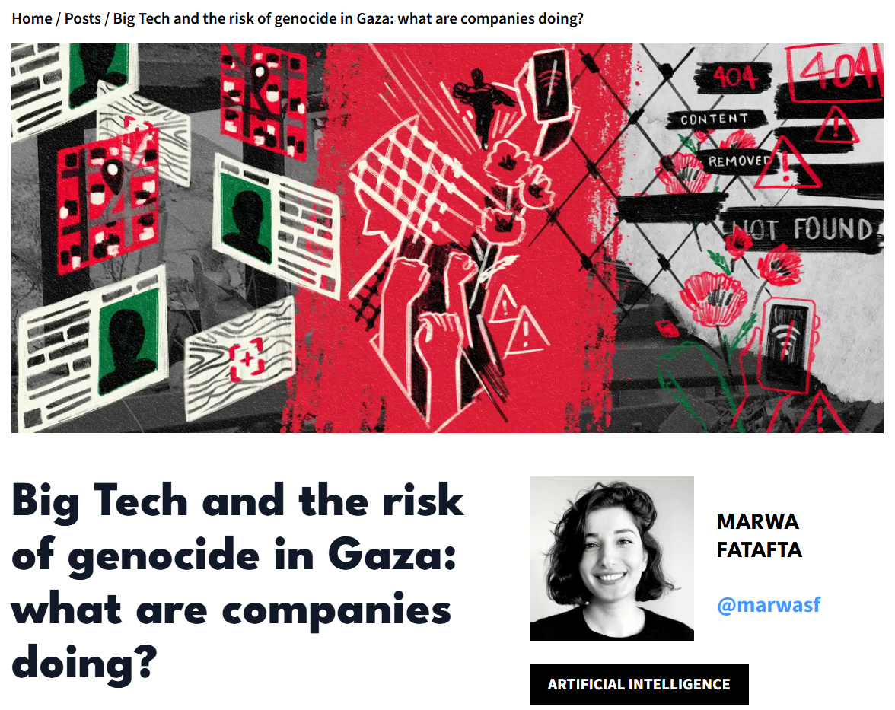
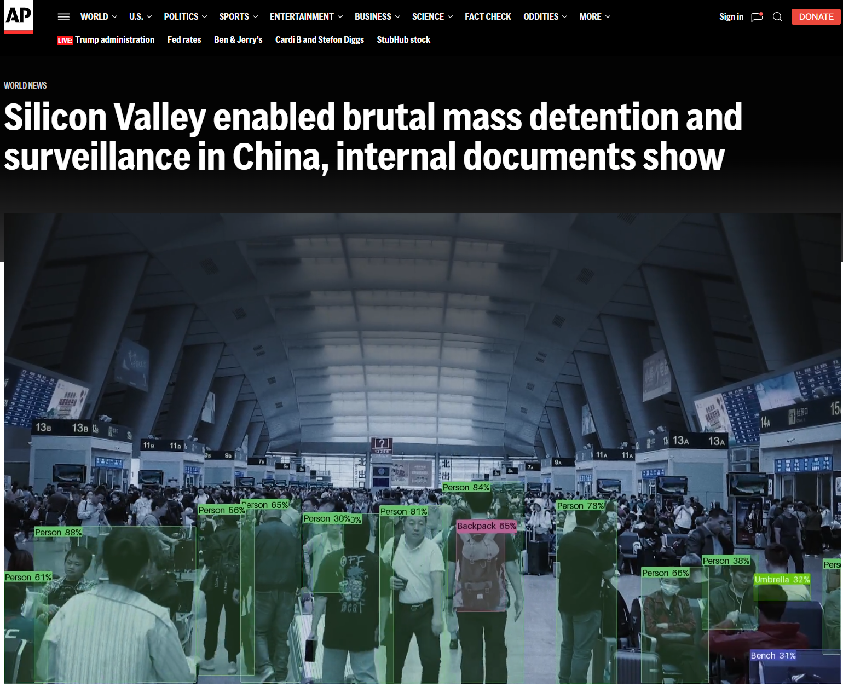
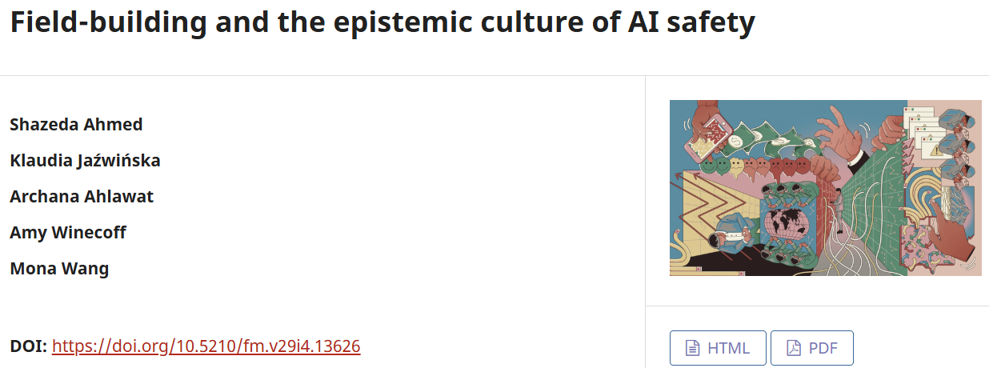
The Authoritarian tendencies of
Big Tech &
Silicon Valley
⚠️Beware of the pseudo-scientific community on x-risk / AI Safety; and the harmful TESCREAL bundle of ideologies
For more details, please read Gebru and Torres (2024) and Ahmed et al. (2024)

Slide 7
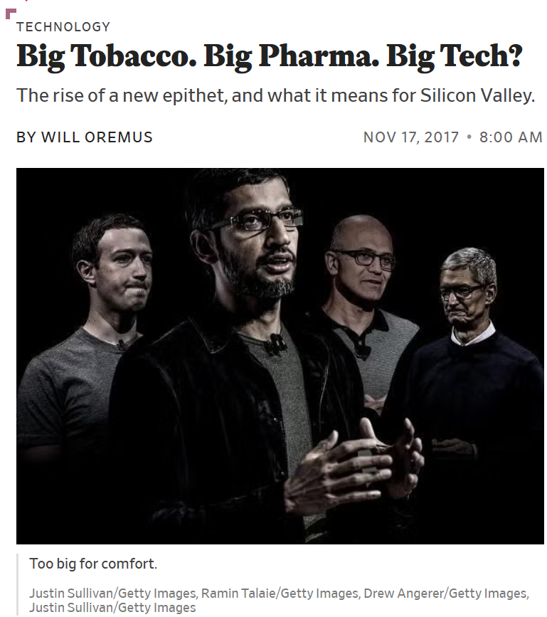
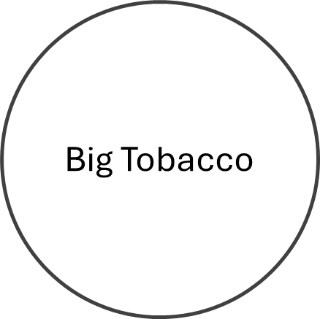
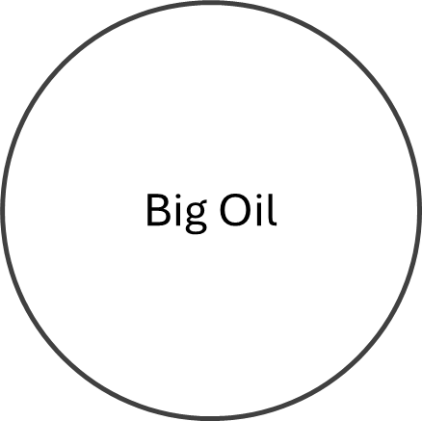
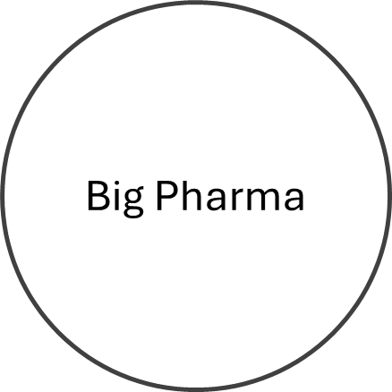

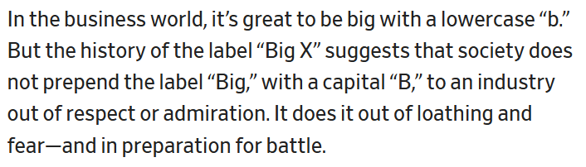
Oremus. Big Tobacco. Big Pharma. Big Tech? Slate, 2017.

Slide 8
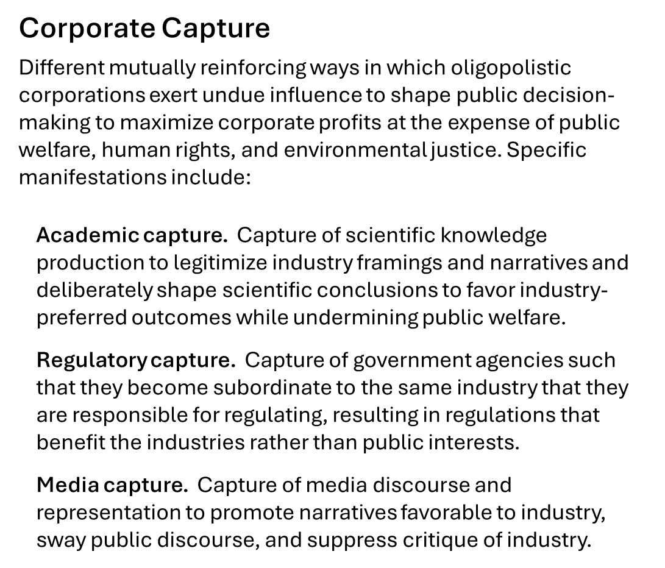
Whittaker. The steep cost of capture. In Interactions, 2021.
Birhane, Angius, Agnew, Pandit, Mitra, Dobbe, and Talat. Big AI's Regulatory Capture: Mapping Industry Interference and Government Complicity. In proc. ACM FAccT, 2026.
Barakat. Selective perspectives: A content analysis of The New York Times’ reporting on artificial intelligence. Computer Says Maybe, 2024.

Slide 9
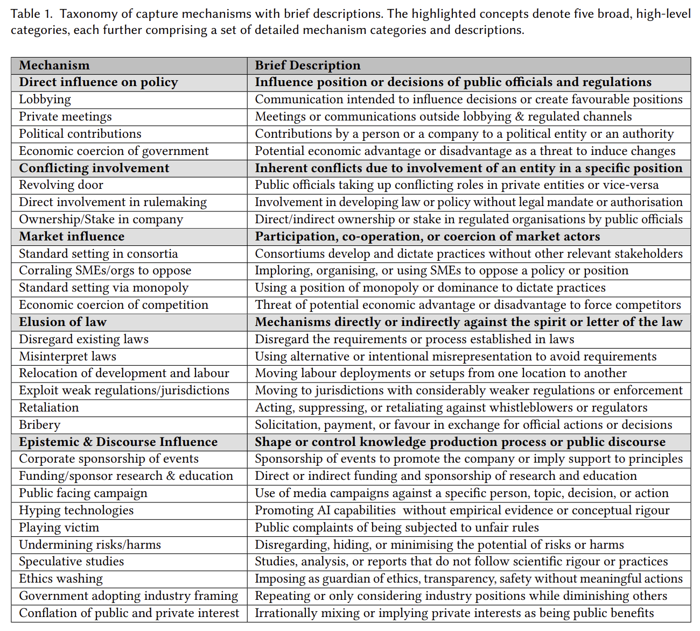

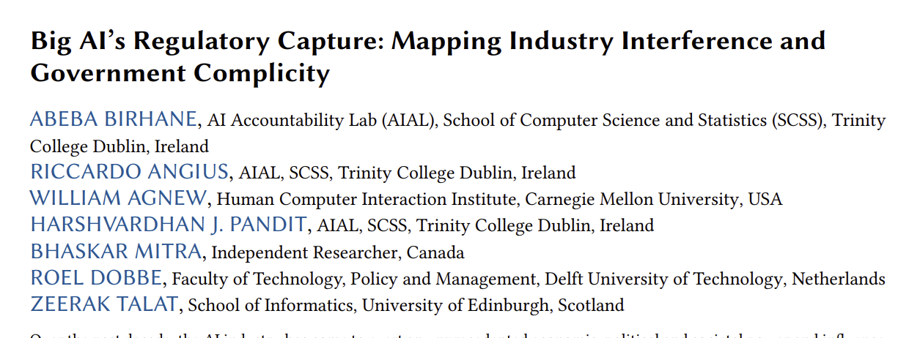
Birhane, Angius, Agnew, Pandit, Mitra, Dobbe, and Talat. Big AI's Regulatory Capture: Mapping Industry Interference and Government Complicity. In proc. ACM FAccT, 2026.

Slide 10
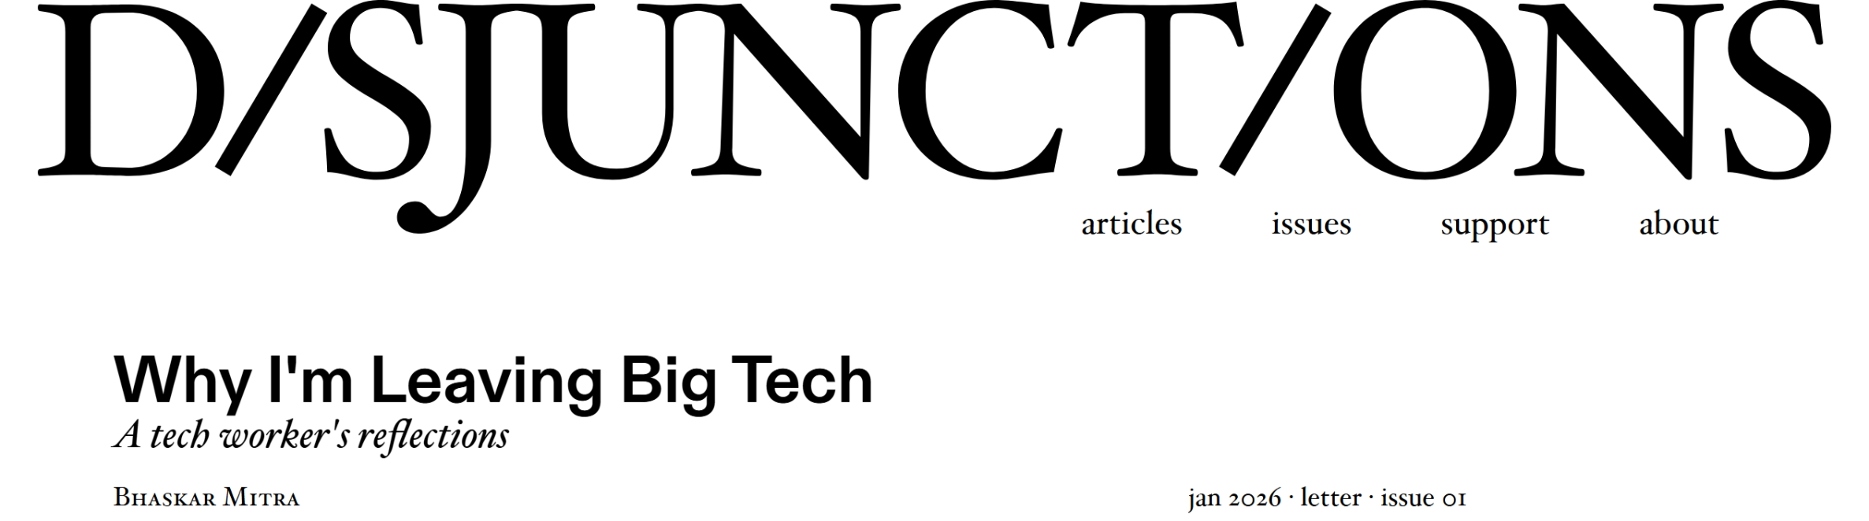

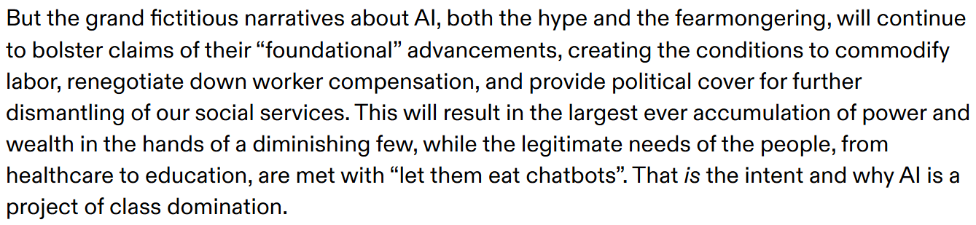
A personal note…
After working at Microsoft (Bing and Microsoft Research) for two decades, last year, I made the decision to leave the Big Tech / Silicon Valley ecosystem in objection to their active role in class oppression, fascism, and ongoing genocide in Palestine
Mitra. Why I'm Leaving Big Tech: A tech worker's reflections. Disjunctions, 2026.

Slide 11
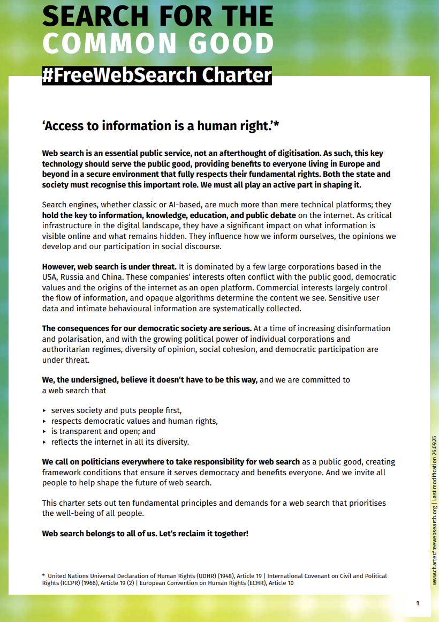
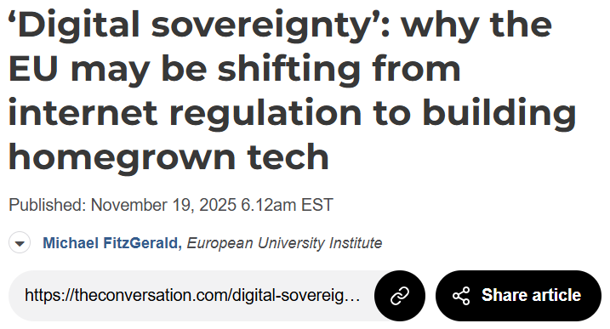
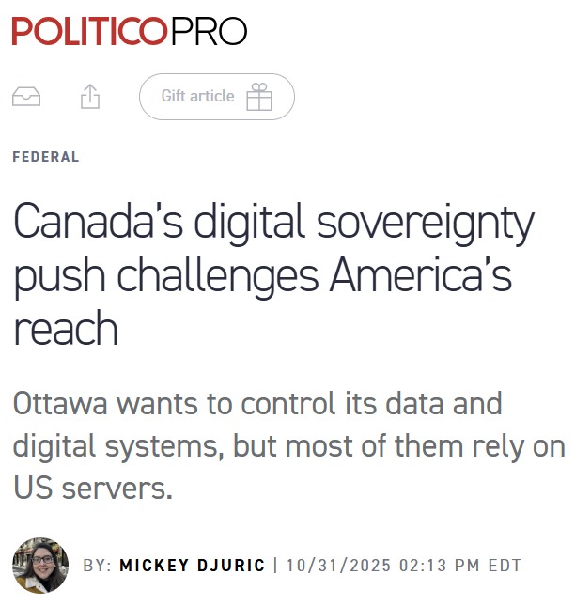
Calls for public platforms and digital sovereignty
However, Eurocentrism is not a meaningful antidote to American Exceptionalism
No search engine is truly open nor reflects the internet in all its diversity if it systemically erases the voices of the global south that represents 85% of the world’s population
Mitra, Neophytou, and Gururaja. Information Access of the Oppressed: A Problem-Posing Framework for Envisioning Emancipatory Information Access Platforms ✊🏽✊🏾✊🏼. Preprint, 2026.

Slide 12
Open, to what end?
E.g., code, data, models, tooling, compute, labor, and governance
Commodities
Computing has a long tradition of pursuing openness to challenge tech oligopolies (e.g., open source, open AI models)
Within these movements, there is tension of values (e.g., free software vs. open source), and issues of co-option and open-washing by corporations defending their dominance
Openness should not be appraised w.r.t. what is being made open; but rather w.r.t. what capabilities and functionings it affords to those the system is being opened to
Formalized using Amartya Sen’s Capability-Theory from welfare economics
Depends on both the commodities being made open and actor-specific circumstances
Capabilities
(to function)
Functionings
E.g., critique, copy, and co-opt and co-construct
E.g., digital sovereignty, meet underserved needs, market competition, open science, social justice, emancipation, and democracy
Well-beings
Sen. Commodities and Capabilities. Oxford university press, 1999.
Neophytou and Mitra. Open, to What End? A Capability-Theoretic Perspective on Open Search. Preprint, 2026.

Slide 13
How can IR ensure that information access technologies act as a force of societal good centering the needs of the marginalized and oppressed?

Slide 14
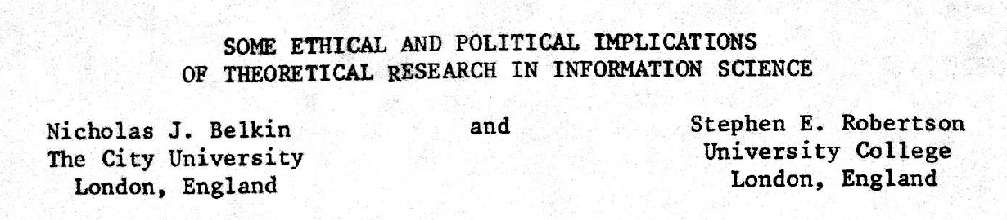
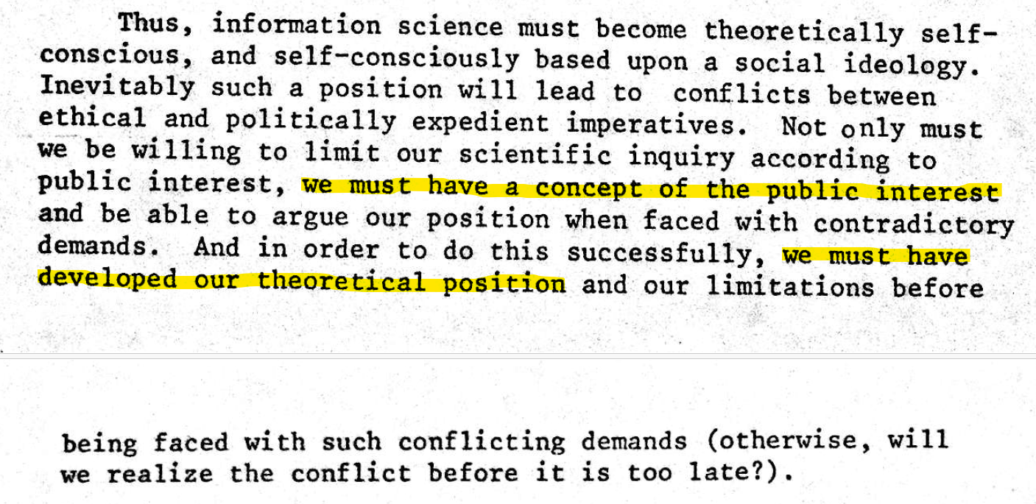
Published in 1976 (half a century ago)

Slide 15
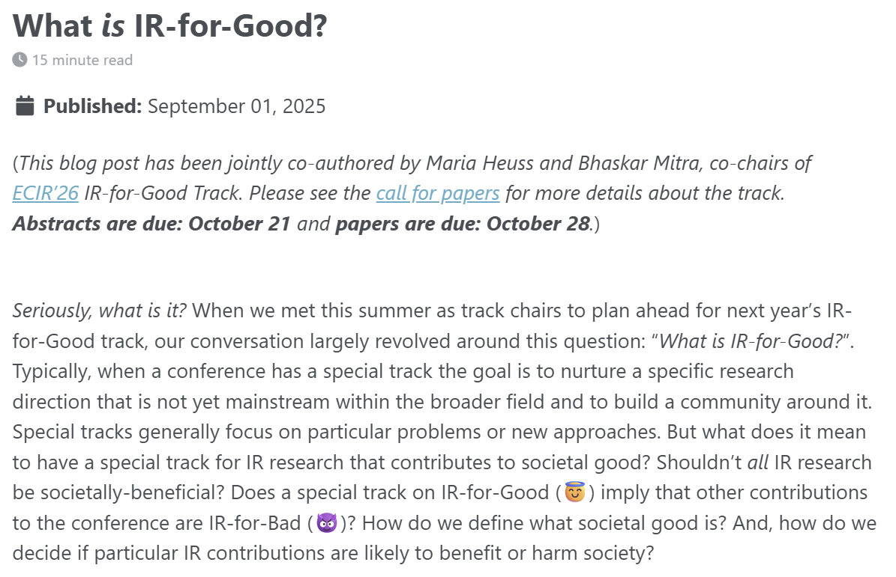
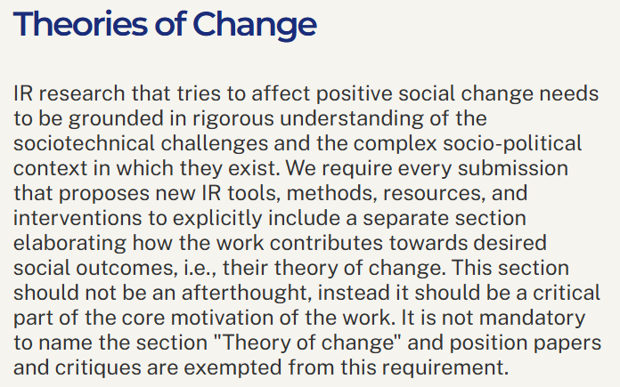
The boundaries of
IR & Society
The topic of “societal good” is currently undertheorized in IR
As Belkin and Robertson (1976) point out, we must develop our position on what constitutes societal good to make appropriate progress and resist contradictory demands
Definition. A theory of change is a method that explains how a given intervention, or set of interventions, is expected to lead to specific change
Mitra and Heuss. What is IR-for-Good? Blog post, 2025.
Belkin and Robertson. Some Ethical and Political Implications of Theoretical Research in Information Science. In proc. ASIS, 1976.

Slide 16
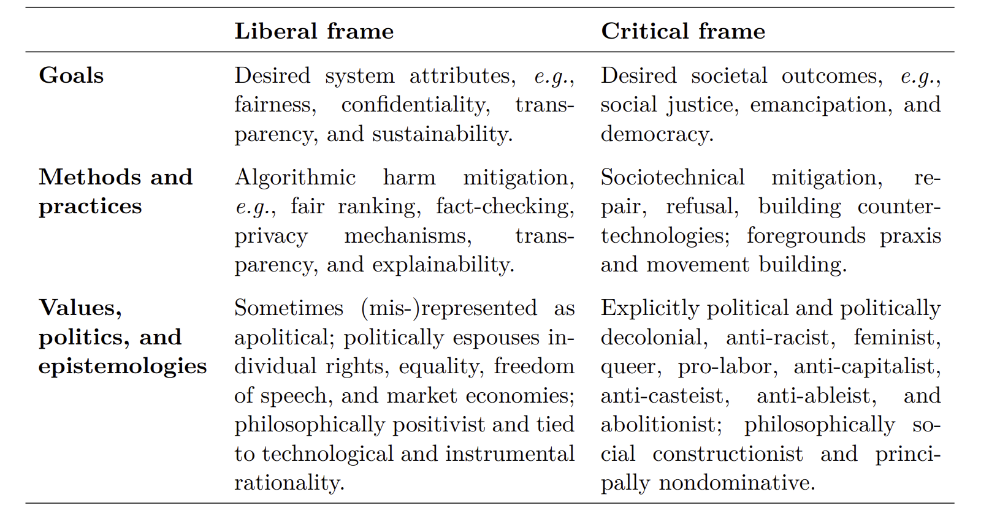
The two frames of IR & Society
Mitra. Towards Critical IR Theories and Practices. Preprint, 2026.

Slide 17
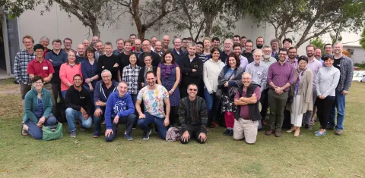
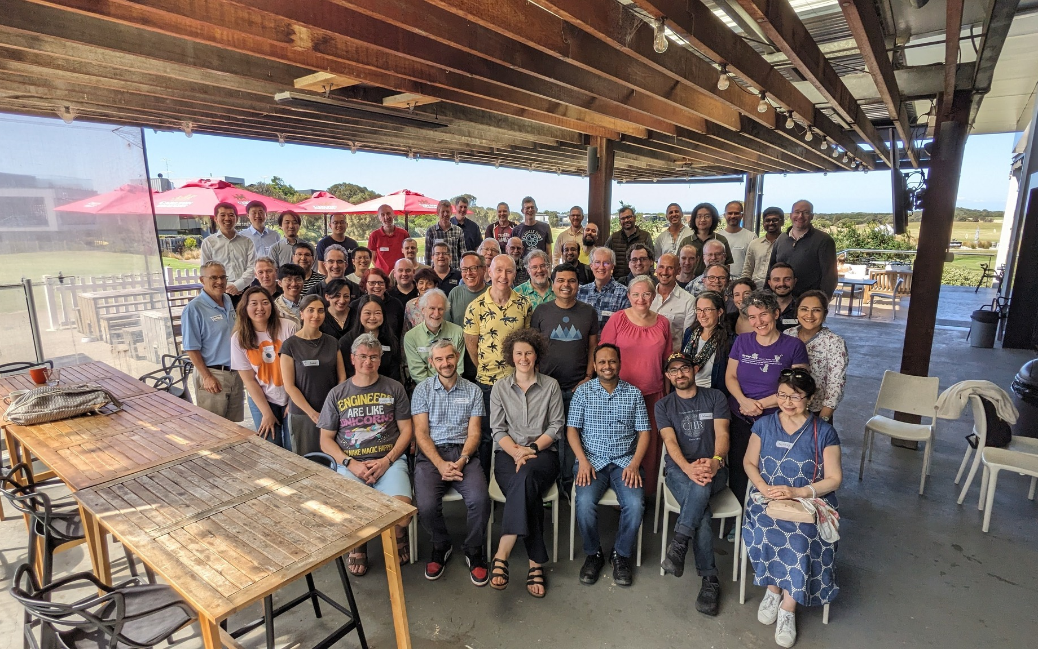
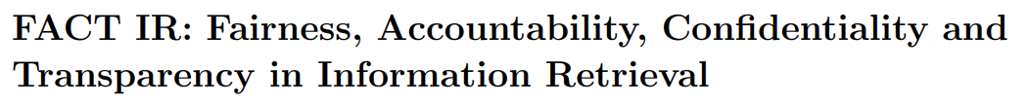
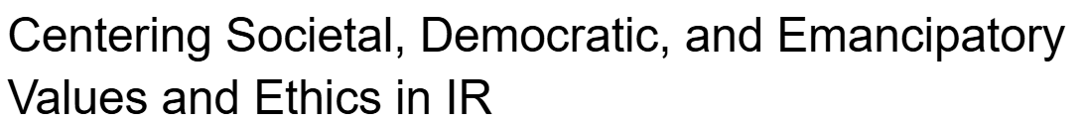

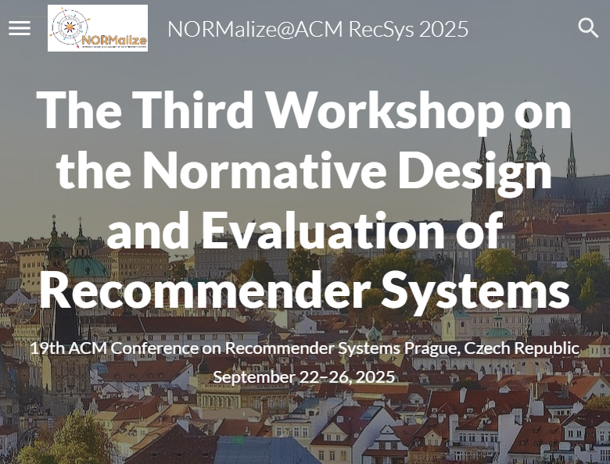
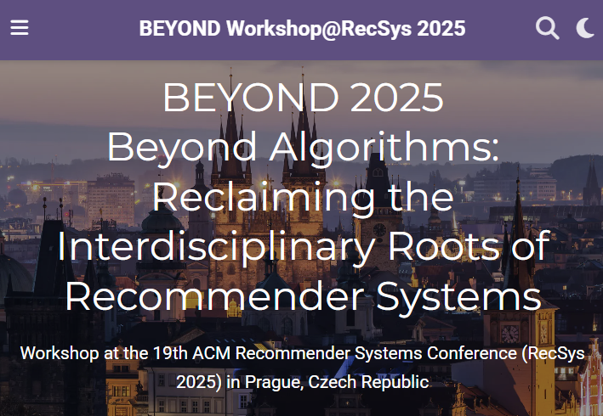
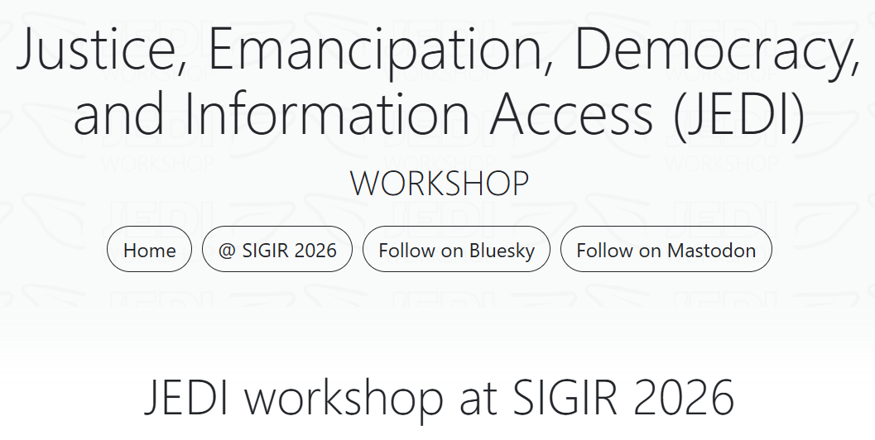
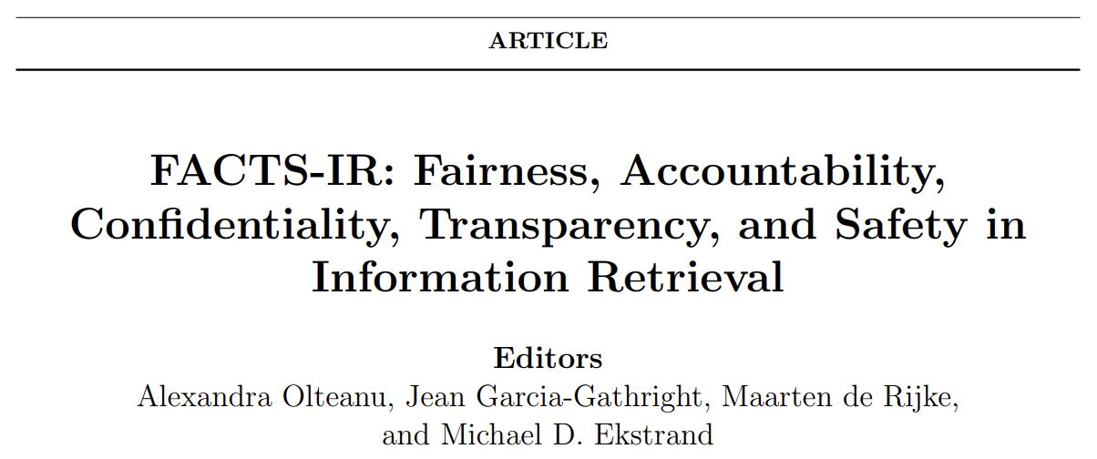
Shifting towards critical IR theories and practices
The 3rd Strategic Workshop on Information Retrieval in Lorne (SWIRL), 2018
The 4th Strategic Workshop on Information Retrieval in Lorne (SWIRL), 2025
Culpepper et al. Research Frontiers in Information Retrieval: Report from the Third Strategic Workshop on Information Retrieval in Lorne (SWIRL 2018). In ACM SIGIR Forum, 2018.
Trippas et al. Report from the 4th Strategic Workshop on Information Retrieval in Lorne (SWIRL 2025). In ACM SIGIR Forum, 2025.

Slide 18
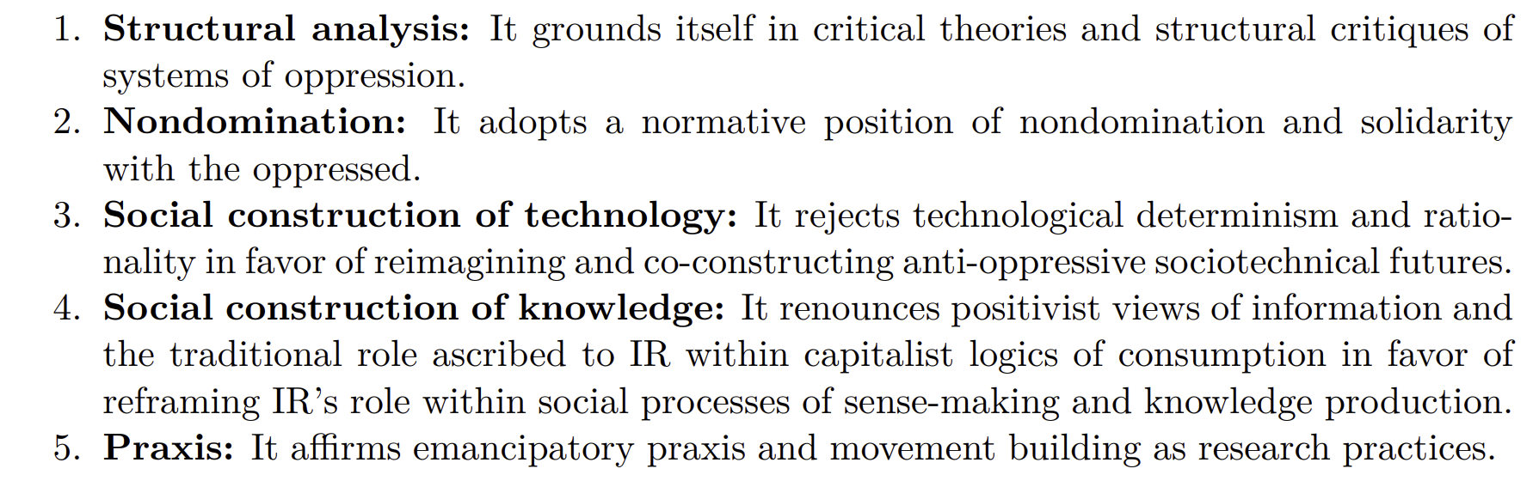
Distinctive features of the critical IR frame
Mitra. Towards Critical IR Theories and Practices. Preprint, 2026.

Slide 19

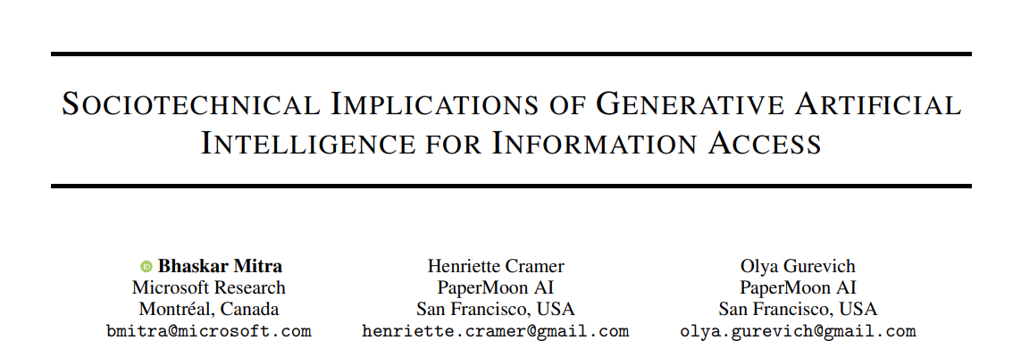
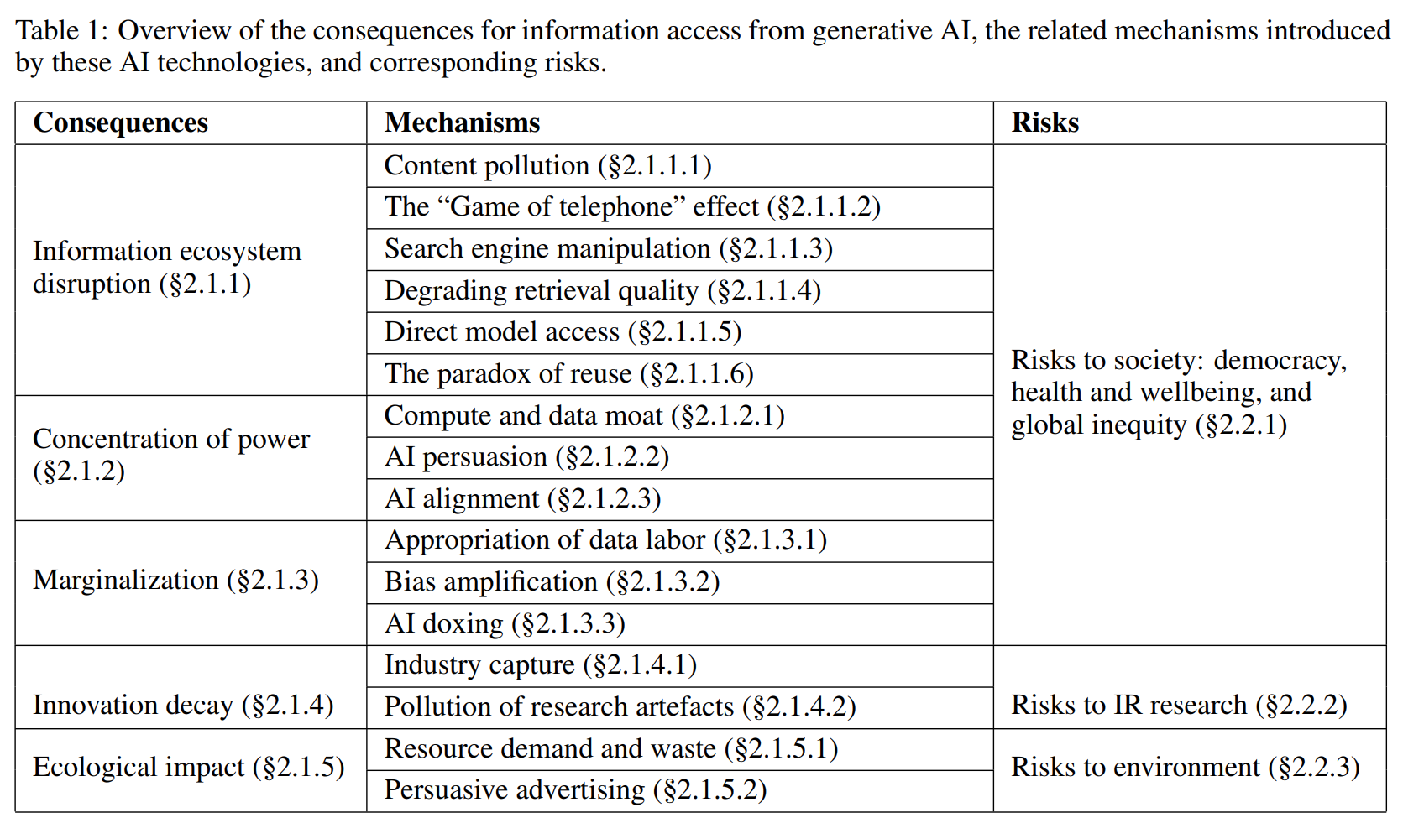
IR needs a structural understanding of our world
Structural analysis
Rigorous IR research cannot emerge from a reactionary understanding of our world and the role of information in it
IR needs theoretical foundation to situate itself in the context of power relations in society and the matrix of domination
IR needs grounding in relevant epistemologies incl. critical theories, feminist theories, and decolonial theories—as well as other forms of knowledge from activism, political organizing, and movement building
Mitra. Towards Critical IR Theories and Practices. Preprint, 2026.
Mitra, Cramer, & Gurevich. Sociotechnical implications of generative artificial intelligence for information access. Book chapter, Springer Nature, 2025.
Gausen, Mitra, & Lindley. A Framework for Exploring the Consequences of AI-Mediated Enterprise Knowledge Access and Identifying Risks to Workers. In Proc. FAccT, 2024.

Slide 20
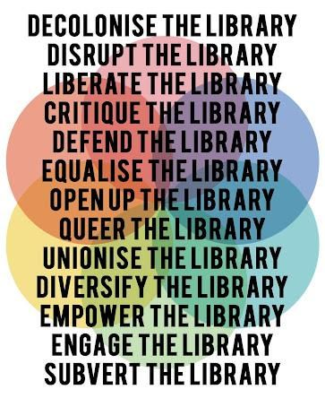
Reconnecting with IR’s roots in library and information sciences
Structural analysis
Decolonise IR
Disrupt IR
Liberate IR
Critique IR
Defend IR
Equalise IR
Open up IR
Queer IR
Unionise IR
Diversify IR
Empower IR
Engage IR
Subvert IR

Slide 21
Critical information theory
Nondomination
“
Critical information theory […] must study not just the role of information and information concepts in society, academia, nature, culture, etc, but how it is related to processes of oppression, exploitation, and domination, which implies a normative judgment in solidarity with the dominated and for the abolishment of domination.
“
Critical theory is intellectual class struggle. It is anti-capitalist and opposed to domination. It struggles for a classless, nondominative, co-operative, participatory democracy.
Fuchs. Towards a critical theory of information. In tripleC: Communication, Capitalism & Critique, 2009.

Slide 22
Nondomination
e.g., colonialism, racism, patriarchy, casteism, transphobia, ableism, …
Emancipatory IR is the study and development of information access methods that challenge all forms of human oppression and situates its activities within broader collective emancipatory praxis
Discourages non-performative academic gaze, urges this research to be situated in movement building, and calls for the recognizing the role of movement building in this research
Signifies the moral concerns of universal humanization of all peoples and the elimination of oppression to create the conditions under which we can collectively flourish
Mitra. Emancipatory Information Retrieval. In IRRJ, 2025.

Slide 23
A framework of practices, projects, and provocations for emancipatory IR
Nondomination
Diagnose and critique ◦◦◦◦◦ Imagine viable alternatives ◦◦◦◦◦ Elaborate theories of change ◦◦◦◦◦
Community building and organizing
Safeguard against surveillance
Promote emancipatory pedagogy
Safeguard against dehumanization and inequitable outcomes
Safeguard against capture
Safeguard against manipulation
Mitigate ecological and human costs
Provocations for emancipatory IR
Mitra. Emancipatory Information Retrieval. In IRRJ, 2025.

Slide 24

Reclaiming our sociotechnical imaginaries
Social construction of technology
“Visions of desirable futures, animated by shared understandings of forms of social life and social order attainable through, and supportive of, advances in science and technology”
~Jasanoff and Kim (2015)
Whose sociotechnical imaginaries are granted normative status and what myriad of radically alternative futures are we overlooking?
How does increasing dominance of established for-profit platforms over academic research influences and/or homogenizes the kinds of IR systems we build?
What would information access systems look like if designed for futures informed by feminist, queer, decolonial, anti-racist, anti-casteist, anti-ableist, and abolitionist thoughts?
Mitra. Search and Society: Reimagining Information Access for Radical Futures. In IRRJ, 2025.
Notes:
A salient question that is often ignored in these conversations is what futures are we building towards for our society and what role do we envision information access technologies will play towards those transformations?
Sociotechnical imaginaries: our visions of desirable sociotechnical futures
Theories of change articulate how our work and actions should take us closer towards those goals
Critically reflect on these implicit visions
Whose sociotechnical imaginaries are granted normative status and what myriads of radically alternative futures are we overlooking?
How does increasing dominance of established for-profit platforms over academic research influences and/or homogenizes the kinds of IR systems we build?
What would IR systems look like if designed for futures informed by feminist, queer, decolonial, anti-racist, anti-casteist, anti-ableist, and abolitionist thoughts, and if the focus of IR and AI research was to dismantle colonial cisheteropatriarchal capitalist structures and not to prop them up?
Shifting the frame from “how can current systems be less harmful” to “what social changes we want to affect and what systems should we build and how should we build them to make progress towards those goals”

Slide 25

Search result pages as sites of emancipatory pedagogy
Social construction of technology
Instead of trying to algorithmically fix under-representation of women and people of color in image search results for occupational roles, can we reclaim that digital space as a site of resistance and emancipatory pedagogy by allowing feminist, queer, and anti-racist scholars, activists, and artists to create experiences that teach the history of these movements and struggles?
Mitra. Search and Society: Reimagining Information Access for Radical Futures. In The Information Retrieval Research Journal (IRRJ), 2025.

Slide 26
What is an IR system?
Social construction of knowledge
Information artifacts are viewed as commodities and valued through the lens of relevance, source authority, factuality, etc.
IR systems exist independent of the corpus and information needs; IR systems are responsible for matching the information artifacts (“supply”) with the information needs (“demand”)
IR tasks represented as pre-curated datasets for model training and evaluation
Information and knowledge are socially constructed and is influenced by power relations within society
IR systems are integral to collective sense-making and knowledge production; cannot be divorced from social and political context
IR systems are embedded within knowledge ecosystems; should grow our collective understanding of our physical and social environments and our relations with them
Positivist view of information and capitalist model of information consumption
Social constructionist view of information and IR as sociotechnical systems
Mitra. Towards Critical IR Theories and Practices. Preprint, 2026.

Slide 27



Social construction of knowledge
What is the role of our communities within our IR systems and how can that safeguard against authoritarian ideological capture of our platforms?
In the social media landscape, decentralization has emerged as a dominant strategy to safeguard against capture
But beyond technological decentralization, we need decentralization and democratization of our social infrastructure for governance and moderation

Slide 28


Emancipatory pedagogy to emancipatory information access
Social construction of knowledge
Freire critiques the banking model of education: the teacher deposit their teachings, while the students patiently receive, memorize, and repeat.
Instead, Freire advocates for a problem-posing dialog between teacher and student that engages the latter in critical reflection and sensemaking of their own state of oppression
Similar dichotomy exists between technologists and users
How can we challenge the technologists-as-liberator frame and extend Freirean theories to technology design
Mitra, Neophytou, and Gururaja. Information Access of the Oppressed: A Problem-Posing Framework for Envisioning Emancipatory Information Access Platforms ✊🏽✊🏾✊🏼. Preprint, 2026.

Slide 29
The technologist-user dichotomy in information access
Social construction of knowledge
  Technologists: who envision and build information access technology
  Users: who seek information via information access platform
By delegating the tasks of envisioning, designing, and governing information access platforms exclusively to technologists, we in turn elevate them to the position of gatekeepers of knowledge and hand them tremendous influence over our collective sensemaking of our place and relationships in this world; while the rest of the population is designated to be the objects of technological influence—their existence digitized for monitoring, modeling, and manipulation.
Mitra, Neophytou, and Gururaja. Information Access of the Oppressed: A Problem-Posing Framework for Envisioning Emancipatory Information Access Platforms ✊🏽✊🏾✊🏼. Preprint, 2026.

Slide 30

Challenging the technologists-as-liberator frame
Social construction of knowledge
To my fellow well-intentioned technologists (“converts”):
Not a critique of research (or researchers) that develop mitigative intervention; but a call to recognize that this work must be grounded in broader movement-building to challenge the power of Big Tech and ultimately to abolish Big Tech
Mitra, Neophytou, and Gururaja. Information Access of the Oppressed: A Problem-Posing Framework for Envisioning Emancipatory Information Access Platforms ✊🏽✊🏾✊🏼. Preprint, 2026.

Slide 31

Freirean approach to technology design
Social construction of knowledge
Inclusion of the oppressed is not symbolic
Technologists cannot “gift” epistemic and representational justice to the marginalized
Historical / cultural context and structures of oppression vary from the inner cities of US to the favelas of Rio to the bastis of Kolkata
Technologists are unlikely to take the risks necessary to challenge oppression; but people are likely to for their own liberation
Co-option and co-construction becomes a site of solidarity and movement building
Freirean design: A design methodology and a political commitment to engage users in the active co-option and co-construction of technologies
Mitra, Neophytou, and Gururaja. Information Access of the Oppressed: A Problem-Posing Framework for Envisioning Emancipatory Information Access Platforms ✊🏽✊🏾✊🏼. Preprint, 2026.

Slide 32
The role of technologists in Freirean design
Social construction of knowledge
#1 Problem-posing dialog
#2 Freirean re-design of platforms
Present the material risks of emerging technologies for the marginalized as an object of study to the people (users), to encourage them to see themselves as the necessary makers and unmakers of technology in support of their own emancipation
Re-envision the structures of our technology stacks—"underdesigning" systems at design time—to facilitate marginalized communities to co-opt and co-construct the technology that encourage information seekers to critically examine their relations with oppressive structures, and to act in support of their own emancipation
Mitra, Neophytou, and Gururaja. Information Access of the Oppressed: A Problem-Posing Framework for Envisioning Emancipatory Information Access Platforms ✊🏽✊🏾✊🏼. Preprint, 2026.

Slide 33
Reflections
Social construction of knowledge
Freirean design does not point to miracle-cures for the ailing growth of global authoritarianism and oppression
It is not the technology that confronts oppression; but rather it is the structural encoding of spaces for community participation, collective deliberation, and democratic negotiation within the platform that we believe holds the key
At the end of the day, it is the sociopolitical arrangements within these spaces that will determine the outcome; emancipatory IR does not brush away this political reality under the rug but rather foregrounds it
Mitra, Neophytou, and Gururaja. Information Access of the Oppressed: A Problem-Posing Framework for Envisioning Emancipatory Information Access Platforms ✊🏽✊🏾✊🏼. Preprint, 2026.

Slide 34


Praxis
Praxis
liberatory research
+
liberatory action
Mitra. Towards Critical IR Theories and Practices. Preprint, 2026.

Slide 35

Organizing and raising sociopolitical consciousness of our IR community
(Cross-disciplinary workshops, book clubs, popular education, arts and zines, …)
Praxis
https://bhaskar-mitra.github.io/reading/ →

Slide 36
Organizing and raising sociopolitical consciousness of our IR community
(Cross-disciplinary workshops, book clubs, popular education, arts and zines, …)
Praxis
https://bhaskar-mitra.github.io/reading/ →

Slide 37


Praxis
https://jedi.inertial.science/sigir2026
Follow us on Bluesky and Mastodon
https://bsky.app/profile/jedi-workshop.bsky.social
https://mastodon.acm.org/@JEDI

Slide 38
Our movement begins here. We are moved not by the opportunity to imagine a different sociotechnical future but by the abject necessity of it in the face of growing authoritarianism and oppression. We do not move alone but in solidarity with others because our liberation, and the struggle for it, are bound together. We move not in fear but with courage and out of love for our own humanity and that of others. Where the oppressor attempts to capture and control, we move to co-opt, co-construct, and liberate. We move not just to negate oppression but to create something new, something joyful, something emancipatory.
Mitra, Neophytou, and Gururaja. Information Access of the Oppressed: A Problem-Posing Framework for Envisioning Emancipatory Information Access Platforms ✊🏽✊🏾✊🏼. Preprint, 2026.

Slide 39

My relevant publications
Mitra. Towards Critical IR Theories and Practices. Preprint, 2026.
Neophytou and Mitra. Open, to What End? A Capability-Theoretic Perspective on Open Search. Preprint, 2026.
Mitra, Neophytou, and Gururaja. Information Access of the Oppressed: A Problem-Posing Framework for Envisioning Emancipatory Information Access Platforms ✊🏽✊🏾✊🏼. Preprint, 2026.
Birhane, Angius, Agnew, Pandit, Mitra, Dobbe, and Talat. Big AI's Regulatory Capture: Mapping Industry Interference and Government Complicity. In proc. ACM FAccT, 2026.
Thieme et al. Engaging Communities Meaningfully in Defining Disability Representation for AI Image Generation. In proc. ACM CHI, 2026.
Mitra. Emancipatory Information Retrieval. In IRRJ, 2025.
Mitra. Search and Society: Reimagining Information Access for Radical Futures. In IRRJ, 2025.
Mitra, Cramer, and Gurevich. Sociotechnical Implications of Generative Artificial Intelligence for Information Access. Book chapter, Springer Nature, 2025.
Cortiñas-Lorenzo, Lindley, Larsen-Ledet, and Mitra. Through the Looking-Glass: Transparency Implications and Challenges in Enterprise AI Knowledge Systems. Preprint, 2024.
Gausen, Mitra, and Lindley. A Framework for Exploring the Consequences of AI-Mediated Enterprise Knowledge Access and Identifying Risks to Workers. In proc. ACM FAccT, 2024
Larsen-Ledet, Mitra, and Lindley. Ethical and Social Considerations in Automatic Expert Identification and People Recommendation in Organizational Knowledge Management Systems. In proc. FAccTRec Workshop, ACM RecSys, 2022.
“Another world is not only possible, she is on her way. On a quiet day, I can hear her breathing.”
– Arundhati Roy
THANK YOU
Abolish Big Tech. Free Palestine.
bhaskar-mitra.github.io
@bmitra.bsky.social
bhaskar.mitra@acm.org

