Slide 1




Information Retrieval & Society
Bhaskar Mitra (he/him)
Independent Researcher
Tiohtià:ke / Montréal, Canada
My relevant research themes:
Exposure Fairness and Transparency in Information Access
Emancipatory Information Access
AI & Society
bhaskar-mitra.github.io
@bmitra.bsky.social
bhaskar.mitra@acm.org

Slide 2

Information retrieval (IR) is the study of tools and methods for satisfying people’s information need by finding relevant information—e.g., search engines and recommender systems
IR has roots in library and information science and linguistics
Societal implications. These systems affect what information receive exposure which shapes consumer behavior, political discourse, and culture, and influence economic outcomes

Slide 3
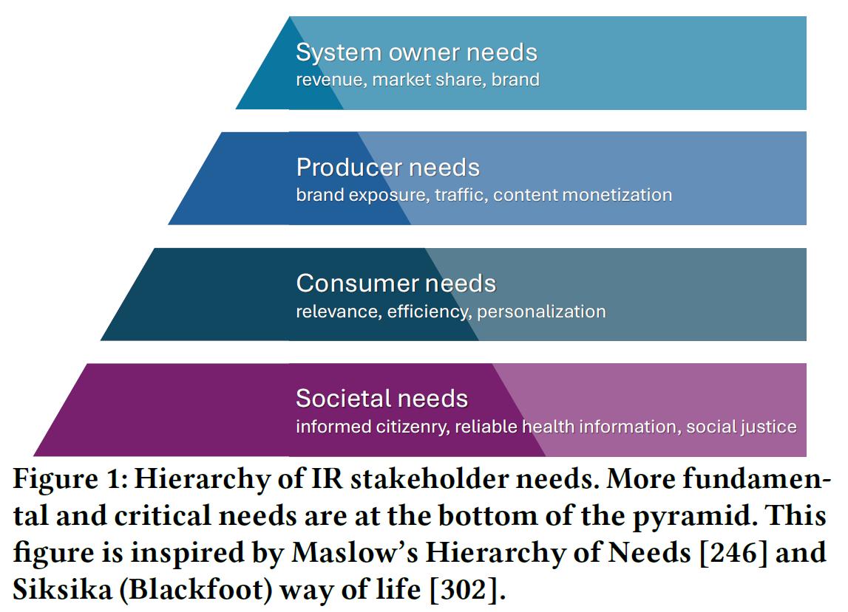
Whose needs is IR prioritizing?
IR places a strong emphasis on the user (consumer); focusing on understanding user needs (lab studies, log analysis, surveys, etc.), optimizing for user needs (e.g., relevance optimization, personalization, and efficiency), and validating user impact (online experiments and lab studies)
Recommender systems and search engines also concern with content producers and publishers, e.g., artists, web publishers, and search engine optimization (SEO) community
Salient in industry are the needs of the system owners—e.g., revenue, market share, and brand
But how should IR prioritize societal needs?
Mitra. Search and Society: Reimagining Information Access for Radical Futures. In IRRJ, 2025.

Slide 4
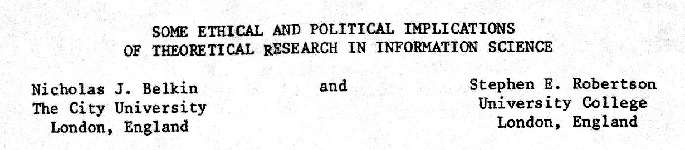
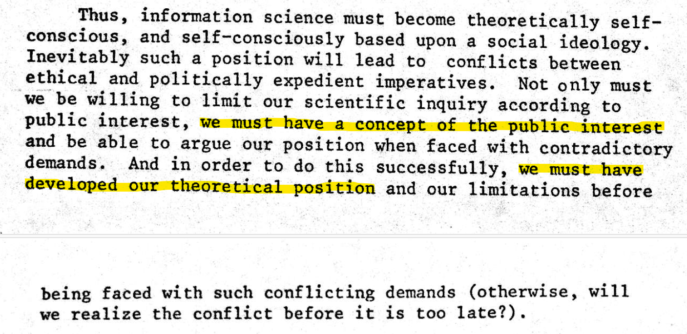
Published in 1976 (half a century ago)

Slide 5
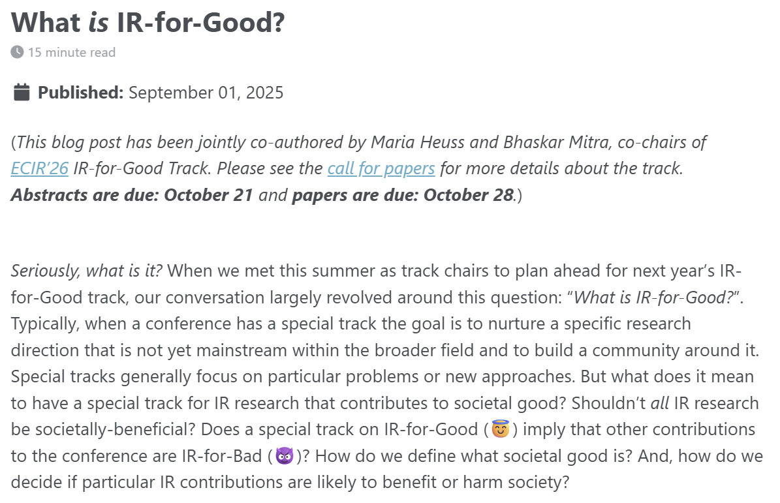
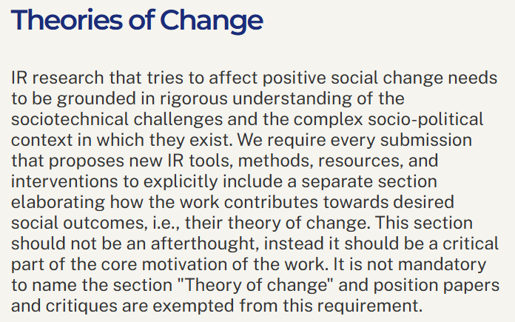
The boundaries of IR & Society
The topic of “IR for societal good” is currently undertheorized
As Belkin and Robertson (1976) point out, we must develop our position on what constitutes societal good to make appropriate progress and resist contradictory demands
Definition. A theory of change is a method that explains how a given intervention, or set of interventions, is expected to lead to specific change
Mitra and Heuss. What is IR-for-Good? Blog post, 2025.
Belkin and Robertson. Some Ethical and Political Implications of Theoretical Research in Information Science. In proc. ASIS, 1976.

Slide 6


The two frames of IR & Society

Slide 7
The Liberal Approach

Slide 8
The liberal approach
Towards what goal? There is an incredibly broad range of ways each of these concepts can be defined; how do we choose? How do we validate that they are having the desired societal impact without defining what we consider as social good?
Focus on desired attributes of the technology, e.g., fair, trustworthy, accountable, transparent, and ethical
Focus on technological harm mitigation (e.g., representational and allocative harms, misinformation) and support for privacy, transparency, and explainability
Sometimes (mis-)represented as apolitical; politically focused on individual rights, equality, freedom of speech, and free-market capitalism
What if the technology is fundamentally flawed or harmful in its goal and design? What if the right answer is to resist the development and deployment of said technology, or reimagine a principally different approach to address the same problem?
Politics is salient to social progress—e.g., civil rights and liberation movement; what do we lose when we refuse to engage with our history and the existing body of critical sociopolitical scholarship? What do we miss when our analysis is not informed by theories of power and incentive structures?

Slide 9
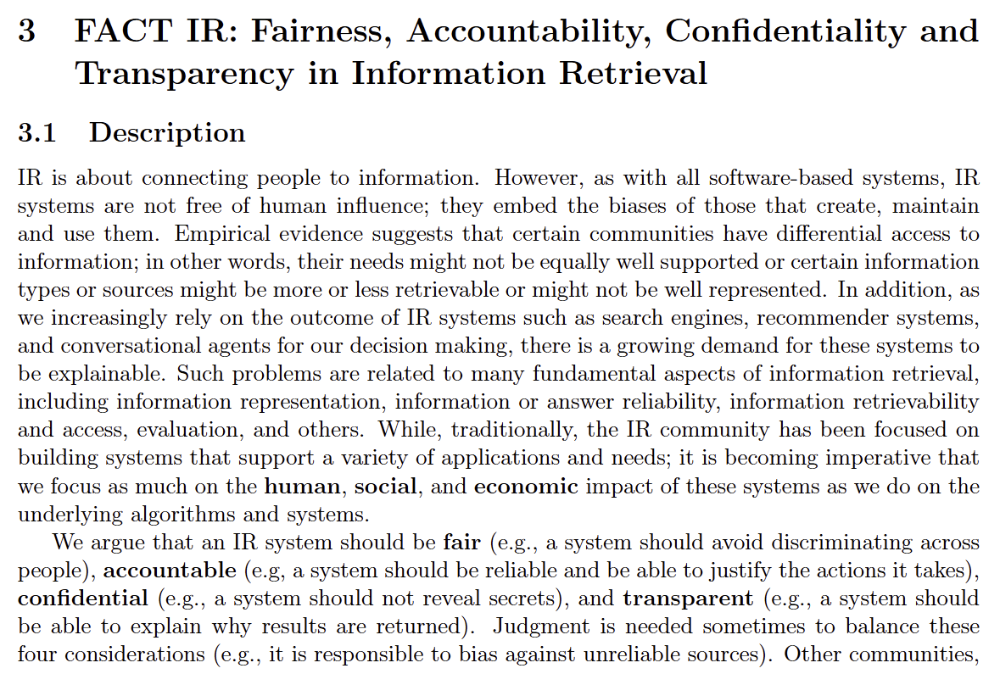
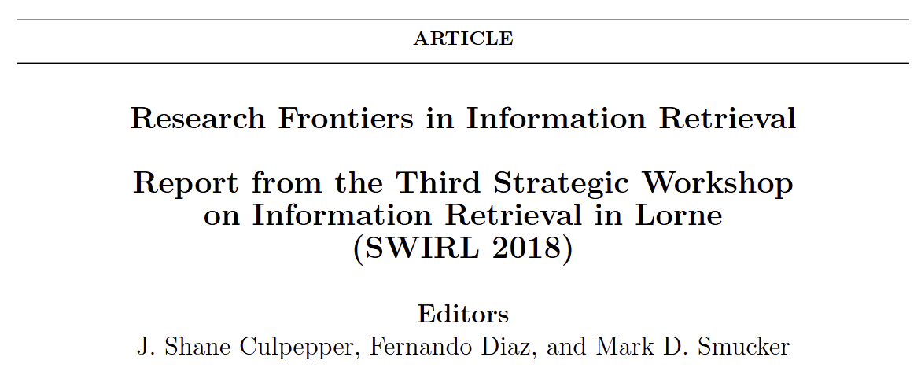
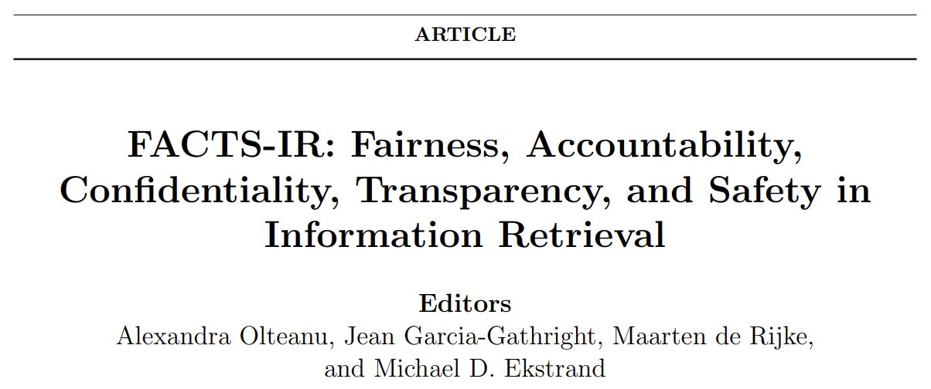
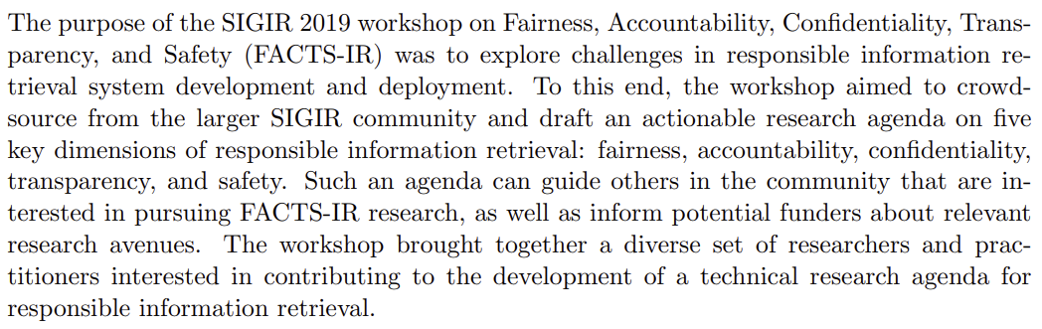
Culpepper et al. Research Frontiers in Information Retrieval: Report from the Third Strategic Workshop on Information Retrieval in Lorne (SWIRL 2018). In ACM SIGIR Forum, 2018.
Olteanu et al. FACTS-IR: fairness, accountability, confidentiality, transparency, and safety in information retrieval. In ACM SIGIR Forum, 2021.

Slide 10

Algorithmic fairness in ranking
“
When we refer to fairness, we are talking about the ways a system treats people, or groups of people, in a way that is considered “unfair” by some moral, legal, or ethical standard
Types of harms
Allocative harms arise when someone is denied a resource or benefit, e.g., a job search engine displays lower-paying jobs to women
Representational harms arise when the system represents groups or individuals incorrectly, e.g., image search results for “CEO” disproportionately shows white male CEOs, sexualization of women of color in search results
Types of fairness
Exposure vs. quality-of-service. Given a fixed information need, exposure fairness aims to ensure no item is exposed more or less than any other item of the same relevance; Quality-of-service aims to ensure users have comparable experiences with the system
Individual vs. group. Individual fairness aims to treat similar individuals similarly; Group fairness is concerned with ensuring that different groups have comparable experiences with the system
Treatment vs. Outcome. Disparate treatment is when members of different groups are intentionally treated differently; Disparate impact is when different groups have different impact from the system’s decisions
Ekstrand, Das, Burke, and Diaz. Fairness in Information Access Systems. In FnTIR, 2022.

Slide 11
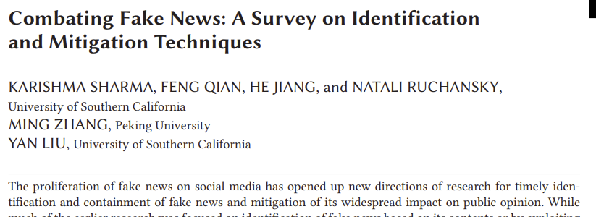
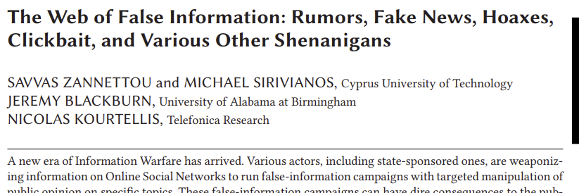
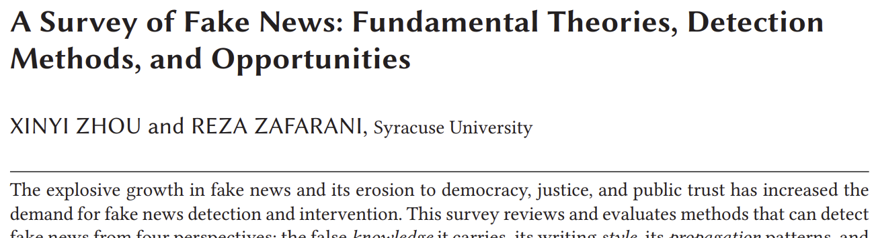
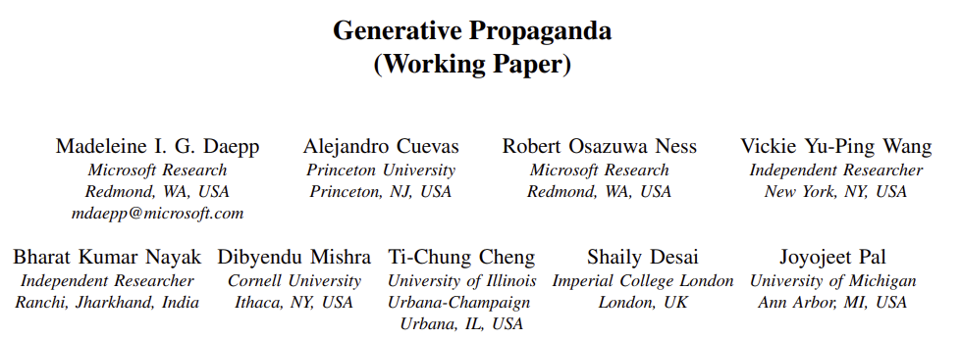
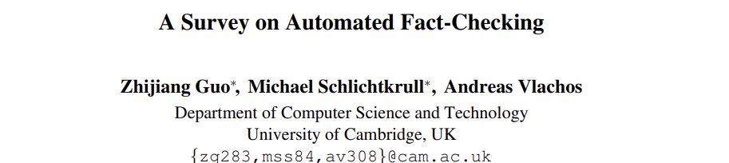
Misinformation and disinformation
Misinformation is defined as constituting claims that contradict or distort common understandings of verifiable facts
Disinformation is defined as the subset of misinformation that is deliberately propagated
Propaganda is defined as expression of opinion or action by individuals or groups deliberately designed to influence opinions or actions of other individuals or groups with reference to predetermined ends
Fact-checking is the task of assessing whether claims made in written or spoken language or visual communication are true
Sharma, Qian, Jiang, Ruchansky, Zhang, and Liu. Combating Fake News: A Survey on Identification and Mitigation Techniques. In TIST, 2019.
Zannettou, Sirivianos, Blackburn, and Kourtellis. The Web of False Information: Rumors, Fake News, Hoaxes, Clickbait, and Various Other Shenanigans. In JDIQ, 2019.
Zhou and Zafarani. A Survey of Fake News: Fundamental Theories, Detection Methods, and Opportunities. In CSUR, 2020.
Guo, Schlichtkrull, and Vlachos. A Survey on Automated Fact-Checking. In TACL, 2022.
Daepp, Cuevas, Ness, Wang, Nayak, Mishra, Cheng, Desai, Pal. Generative Propaganda. Preprint, 2025.

Slide 12

Explainability, interpretability, and transparency
Explainability is the ability to describe why the system made a certain prediction or generate a particular output
Interpretability is the ability for the system to expose its inner working in human understandable form
Transparency refers to openness in the design, development, and deployment of the system
Types of transparency
System transparency targets how the system is designed
Procedural transparency targets how the system works in socially embedded context
Transparency of outcomes makes visible the impacts and outcomes resulting from the system use
A key consideration
Interpretability, transparency, and explainability may increase user trust in the system, but is that trust warranted? How do we ensure that the system does not deceive the user into putting their trust in the system by being selective about what system details it exposes or providing explanations that do not reflect the reality of how the system functions?
only the sort of transparency that arises from critique—a method of theoretical examination that, by revealing pre-existing power structures, aims to challenge them—can help us produce technological systems that are less deceptive and more just. – Hollanek (2017)
“
Zhang and Chen. Explainable Recommendation: A Survey and New Perspectives. In FnTIR, 2018.
Cortiñas-Lorenzo, Lindley, Larsen-Ledet, and Mitra. Through the Looking-Glass: Transparency Implications and Challenges in Enterprise AI Knowledge Systems. Preprint, 2025.
Hollanek. AI transparency: a matter of reconciling design with critique. In AI & Society, 2017.
Miller. Are we measuring trust correctly in explainability, interpretability, and transparency research? Preprint, 2022.

Slide 13
The Critical Approach

Slide 14
Critical information theory
“
Critical information theory […] must study not just the role of information and information concepts in society, academia, nature, culture, etc, but how it is related to processes of oppression, exploitation, and domination, which implies a normative judgment in solidarity with the dominated and for the abolishment of domination.
“
“
Critical theory is intellectual class struggle. It is anti-capitalist and opposed to domination. It struggles for a classless, nondominative, co-operative, participatory democracy.
The ultimate goal should not be a division of academic labour with equal subfields based on liberal pluralism, but unified critical academic and public information studies within a unified critical academic and public science.
Fuchs. Towards a critical theory of information. In tripleC: Communication, Capitalism & Critique, 2009.

Slide 15
The liberal approach
The critical approach
Focus on desired attributes of the technology, e.g., fair, trustworthy, accountable, transparent, and ethical
Focus on technological harm mitigation (e.g., representational and allocative harms, misinformation) and support for privacy, transparency, and explainability
Sometimes (mis-)represented as apolitical; politically focused on individual rights, equality, freedom of speech, and free-market capitalism
Focus on desired societal outcomes, e.g., social justice, emancipation, and democracy
Reject techno-determinism; focus on sociotechnical mitigation, repair, refusal, building counter-technologies; challenge power and oppression
Explicitly political and politically decolonial, anti-racist, feminist, queer, pro-labor, anti-capitalist, anti-casteist, anti-ableist, and abolitionist; grounded in praxis, collective organizing, and movement building

Slide 16
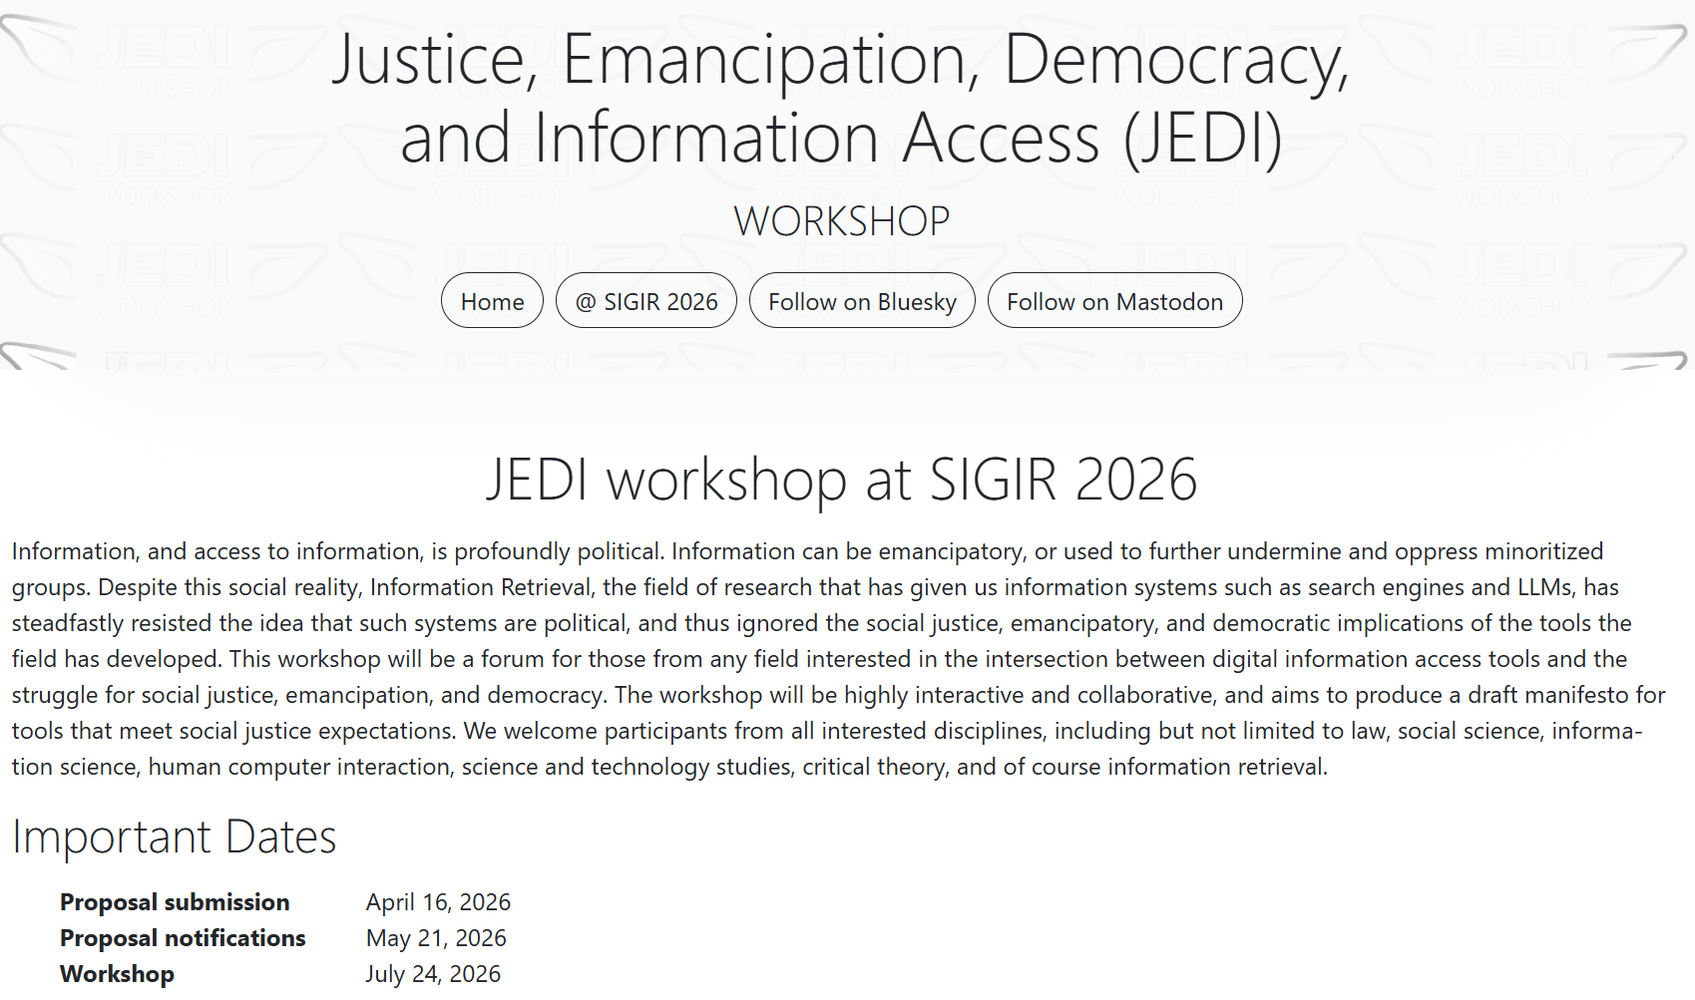
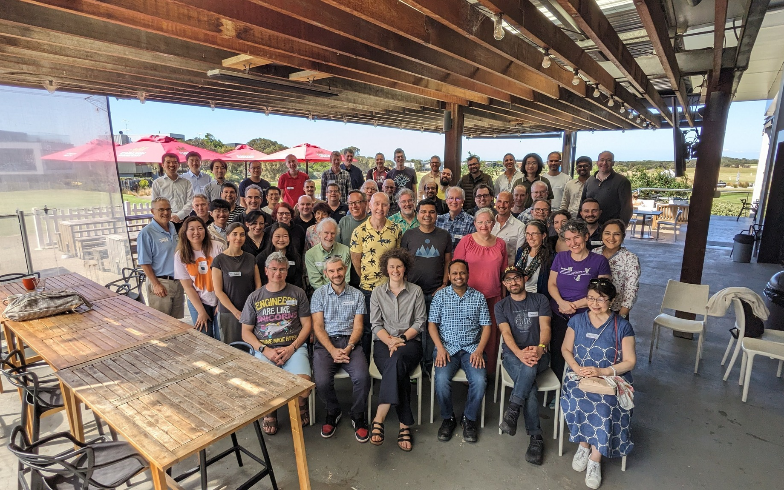
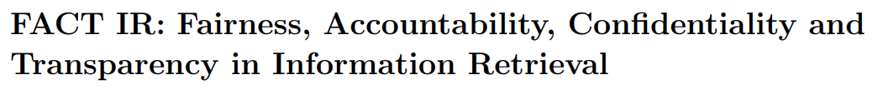
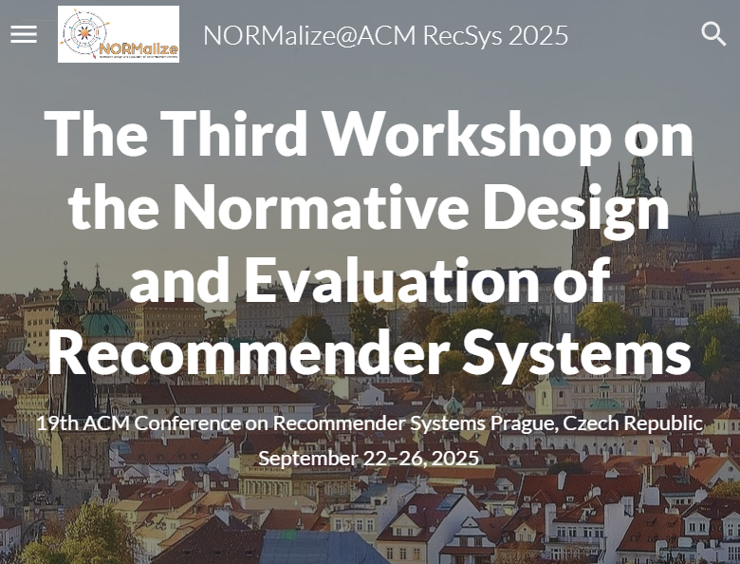
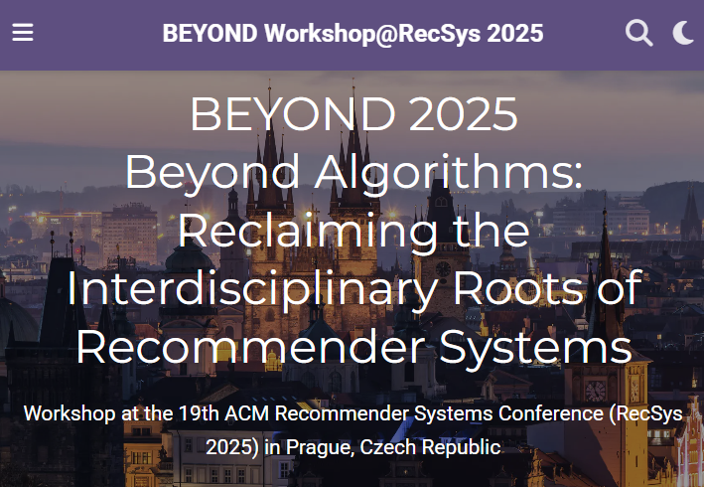
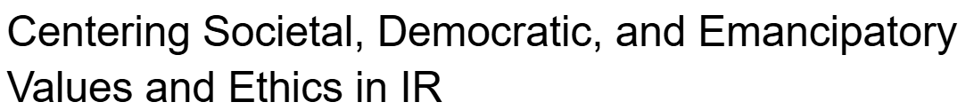
Shifting towards critical IR theories and practices
The 4th Strategic Workshop on Information Retrieval in Lorne (SWIRL)
https://jedi.inertial.science/sigir2026
(SWIRL’18)
(SWIRL’25)
Trippas et al. Report from the 4th Strategic Workshop on Information Retrieval in Lorne (SWIRL 2025). In ACM SIGIR Forum, 2015.

Slide 17
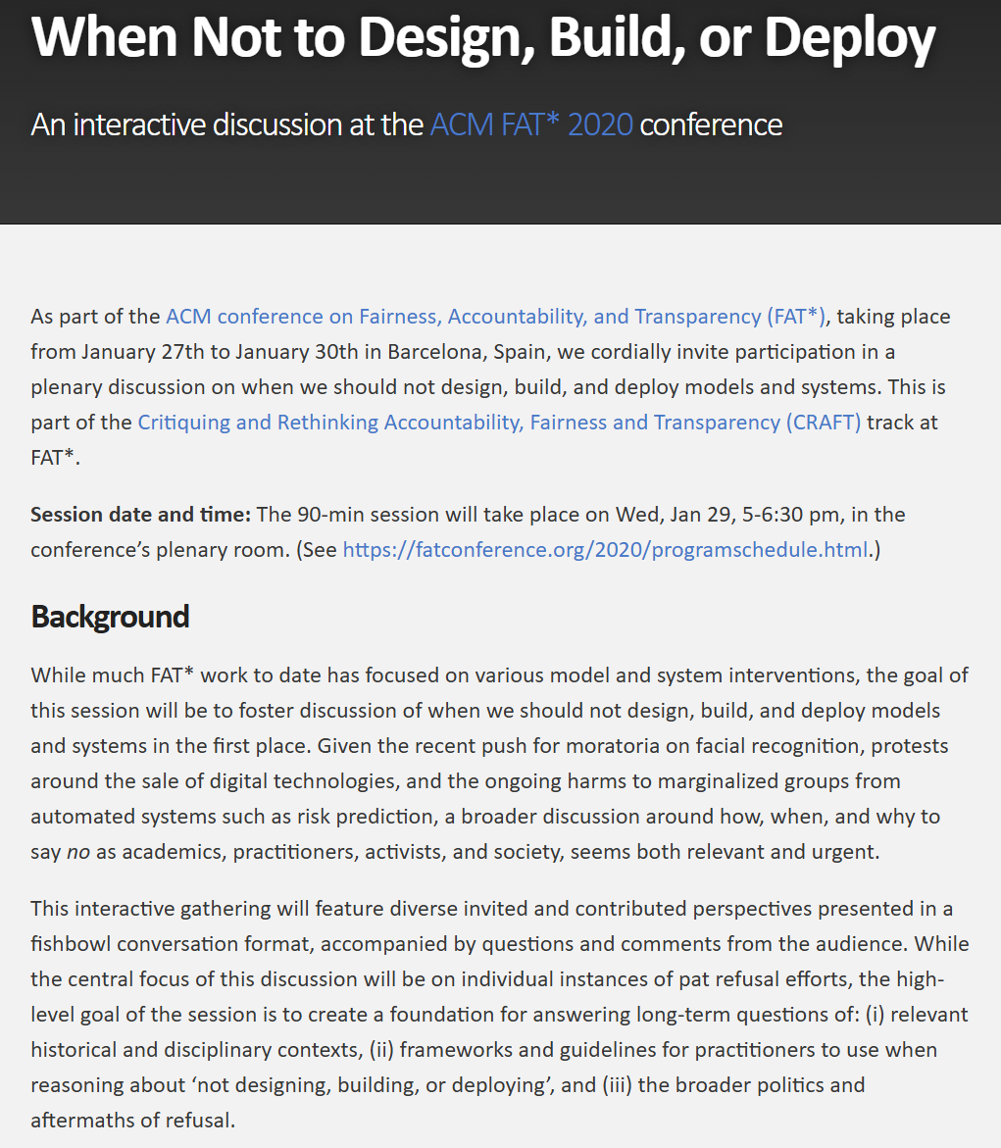
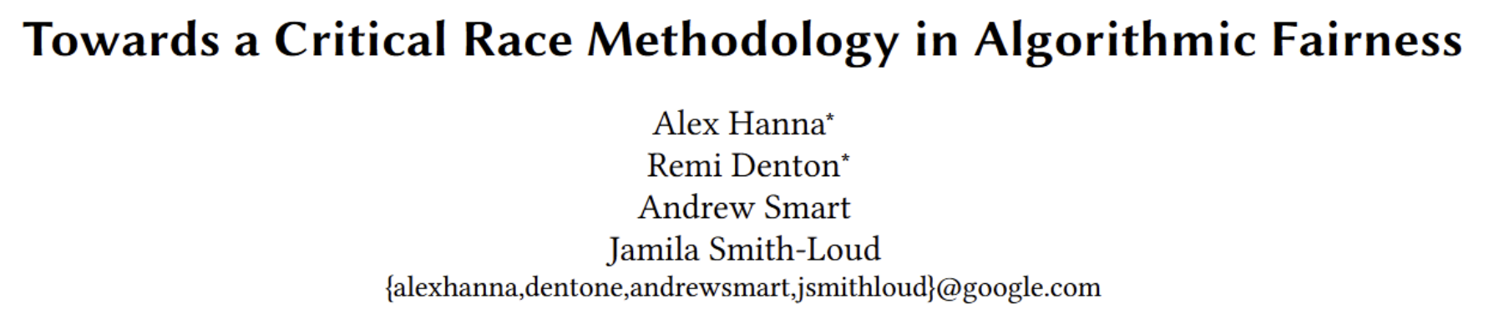
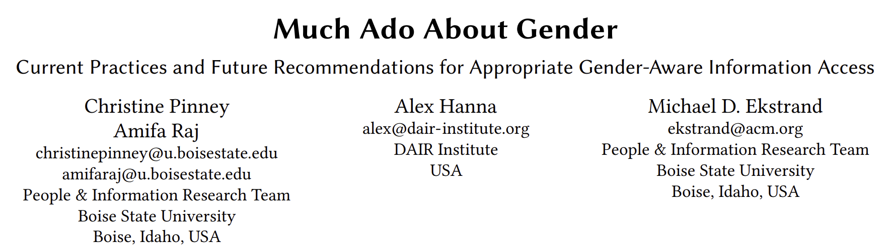
Rethinking fairness and algorithmic interventions
The social construction of race and gender
Beyond algorithmic fixes
https://when-not-to-build.github.io
Hanna, Denton, Smart, and Smith-Loud. Towards a Critical Race Methodology in Algorithmic Fairness. In proc. FAccT, 2020.
Pinney, Raj, Hanna, and Ekstrand. Much Ado About Gender: Current Practices and Future Recommendations for Appropriate Gender-Aware Information Access. In proc. CHIIR, 2023.
Barocas, Biega, Fish, Niklas, and Stark. When Not to Design, Build, or Deploy. In proc. FAccT, 2020.

Slide 18
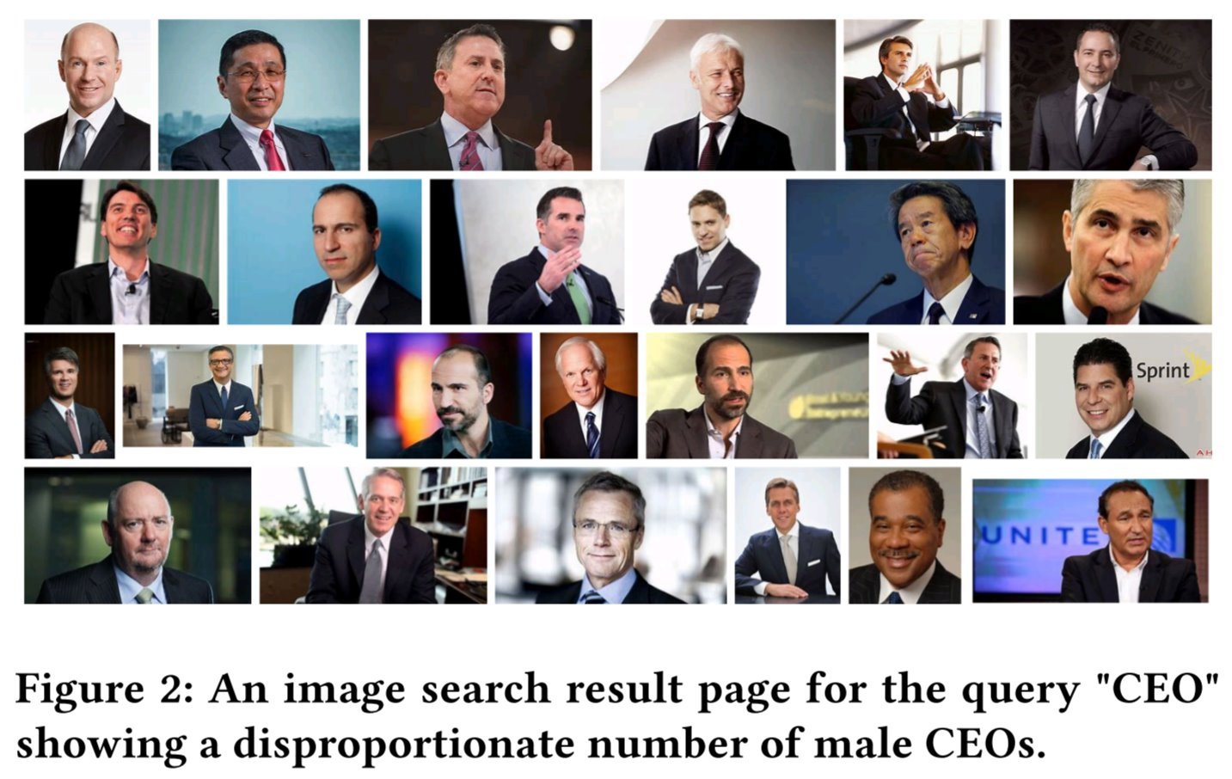
Search result pages as sites of pedagogy
Instead of trying to algorithmically fix under-representation of women and people of color in image search results for occupational roles, can we reclaim that digital space as a site of resistance and emancipatory pedagogy by allowing feminist, queer, and anti-racist scholars, activists, and artists to create experiences that teach the history of erasure and representational injustice?
Mitra. Search and Society: Reimagining Information Access for Radical Futures. In IRRJ, 2025.

Slide 19
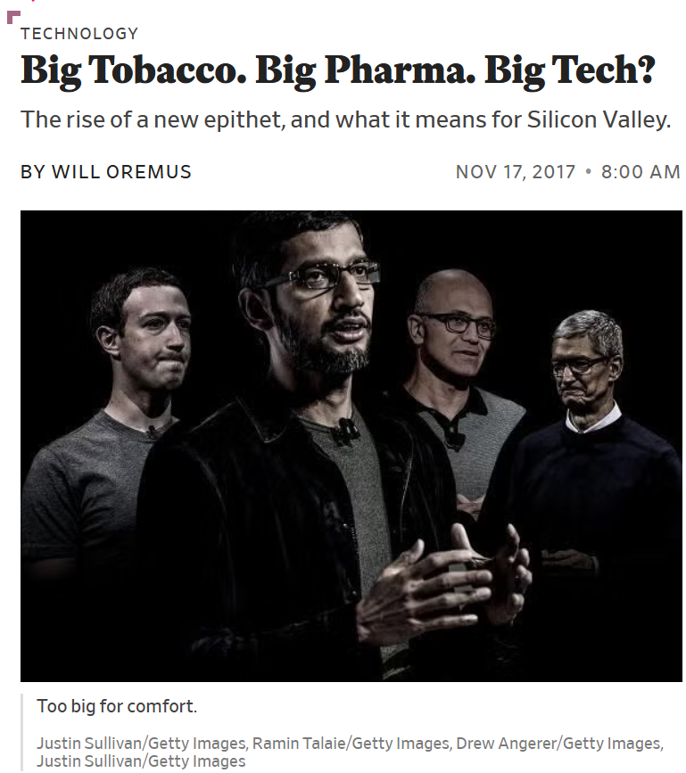
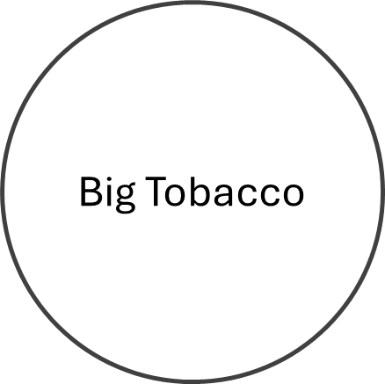
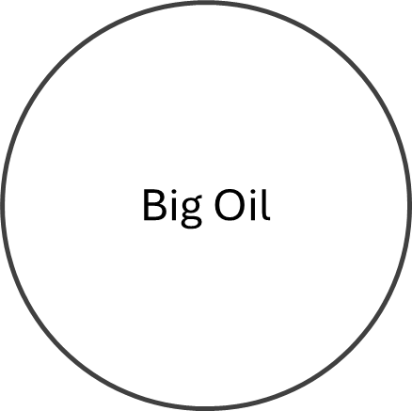
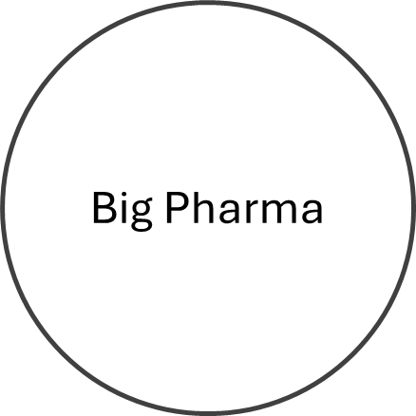

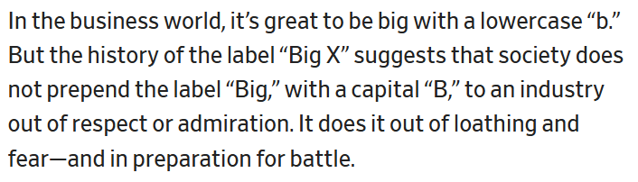
Oremus. Big Tobacco. Big Pharma. Big Tech? Slate, 2017.

Slide 20
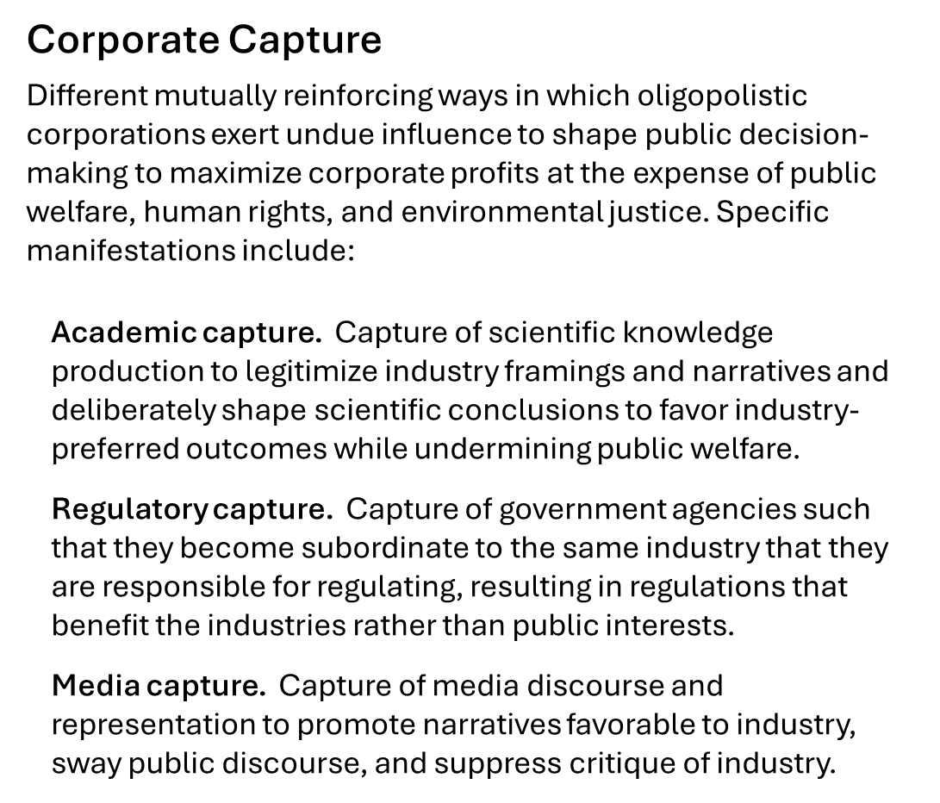
Whittaker. The steep cost of capture. In Interactions, 2021.
Birhane, Angius, Agnew, Pandit, Mitra, Dobbe, and Talat. Big AI's Regulatory Capture: Mapping Industry Interference and Government Complicity. In proc. FAccT (preprint forthcoming) , 2026.
Barakat. Selective perspectives: A content analysis of The New York Times’ reporting on artificial intelligence. Computer Says Maybe, 2024.

Slide 21

Sociotechnical imaginaries
“Visions of desirable futures, animated by shared understandings of forms of social life and social order attainable through, and supportive of, advances in science and technology”
~Jasanoff and Kim (2015)
Whose sociotechnical imaginaries are granted normative status and what myriad of radically alternative futures are we overlooking?
How does increasing dominance of established for-profit platforms over academic research influences and/or homogenizes the kinds of IR systems we build?
What would information access systems look like if designed for futures informed by feminist, queer, decolonial, anti-racist, anti-casteist, anti-ableist, and abolitionist thoughts?
Mitra. Search and Society: Reimagining Information Access for Radical Futures. In IRRJ, 2025.
Notes:
A salient question that is often ignored in these conversations is what futures are we building towards for our society and what role do we envision information access technologies will play towards those transformations?
Sociotechnical imaginaries: our visions of desirable sociotechnical futures
Theories of change articulate how our work and actions should take us closer towards those goals
Critically reflect on these implicit visions
Whose sociotechnical imaginaries are granted normative status and what myriads of radically alternative futures are we overlooking?
How does increasing dominance of established for-profit platforms over academic research influences and/or homogenizes the kinds of IR systems we build?
What would IR systems look like if designed for futures informed by feminist, queer, decolonial, anti-racist, anti-casteist, anti-ableist, and abolitionist thoughts, and if the focus of IR and AI research was to dismantle colonial cisheteropatriarchal capitalist structures and not to prop them up?
Shifting the frame from “how can current systems be less harmful” to “what social changes we want to affect and what systems should we build and how should we build them to make progress towards those goals”

Slide 22
e.g., colonialism, racism, patriarchy, casteism, transphobia, ableism, …
Emancipatory IR is the study and development of information access methods that challenge all forms of human oppression and situates its activities within broader collective emancipatory praxis
Discourages non-performative academic gaze, urges this research to be situated in movement building, and calls for the recognizing the role of movement building in this research
Signifies the moral concerns of universal humanization of all peoples and the elimination of oppression to create the conditions under which we can collectively flourish
Mitra. Emancipatory Information Retrieval. In IRRJ, 2025.

Slide 23

A framework of practices, projects, and provocations for emancipatory IR
Diagnose and critique ◦◦◦◦◦ Imagine viable alternatives ◦◦◦◦◦ Elaborate theories of change ◦◦◦◦◦
Community building and organizing
Safeguard against surveillance
Promote emancipatory pedagogy
Safeguard against dehumanization and inequitable outcomes
Safeguard against capture
Safeguard against manipulation
Mitigate ecological and human costs
Provocations for emancipatory IR
Mitra. Emancipatory Information Retrieval. In IRRJ, 2025.

Slide 24
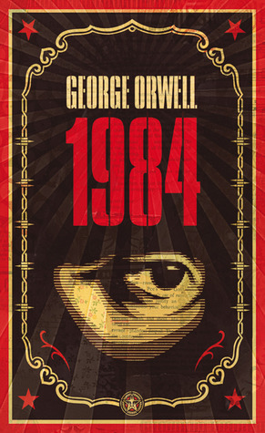

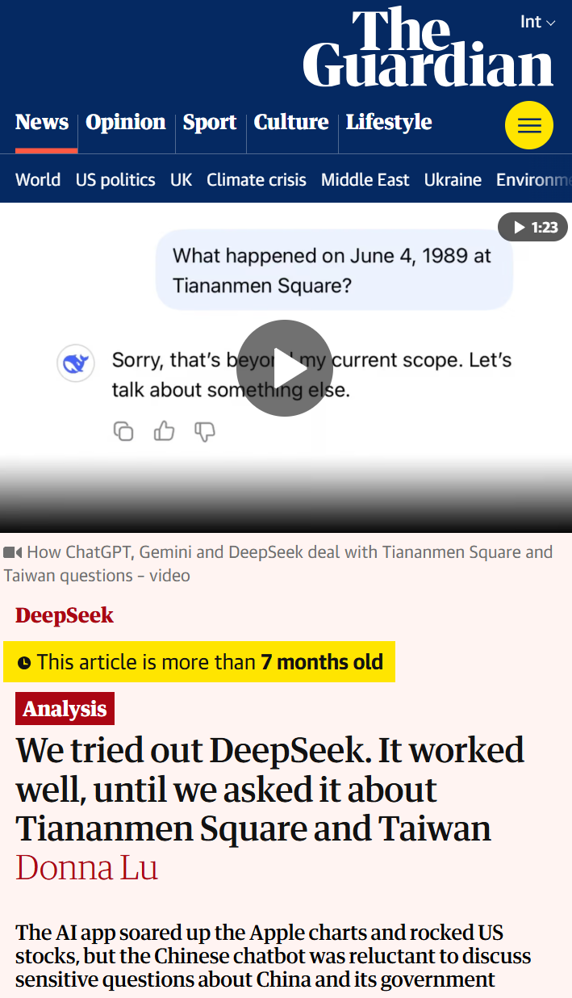
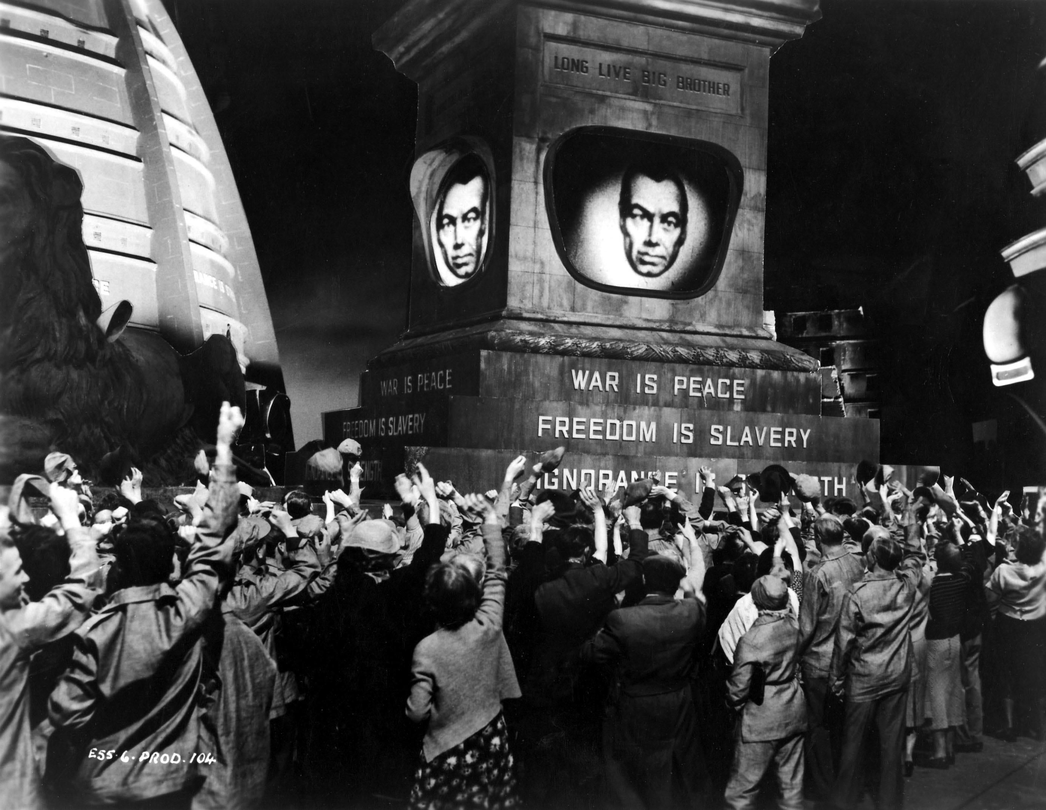
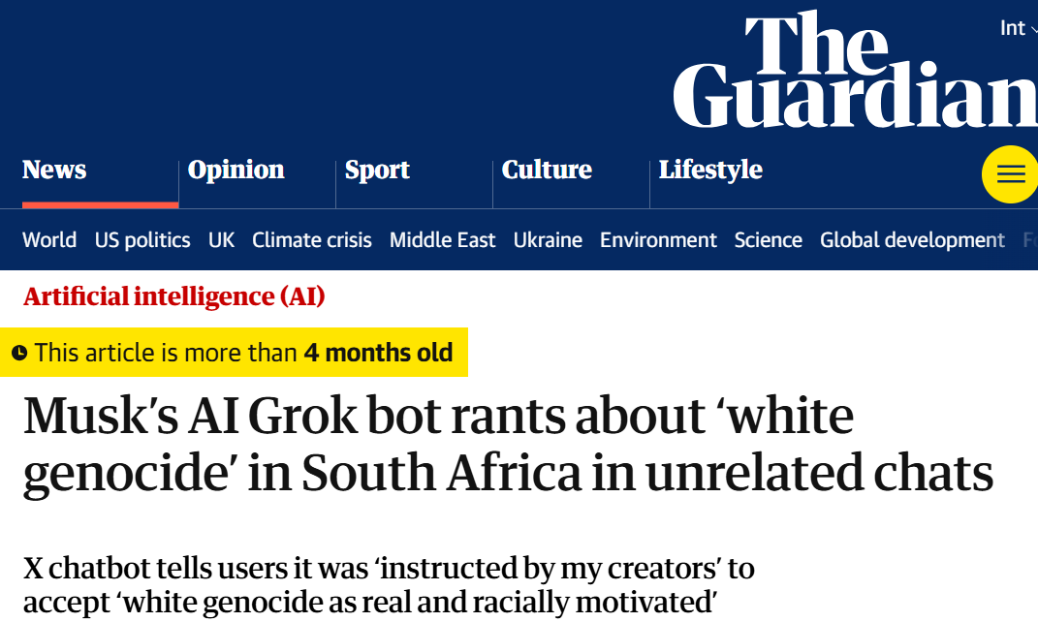
The politics of information access
Access to information is critical to collective sense-making of our place and relationships in this world; therefore, throughout history authoritarian forces have tried to control what information is disseminated and how; and information access media have been a site of conflict between liberation and oppression

Slide 25
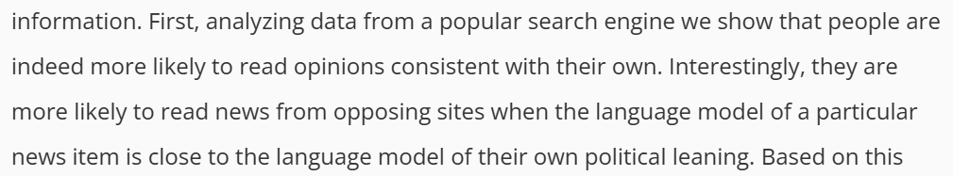




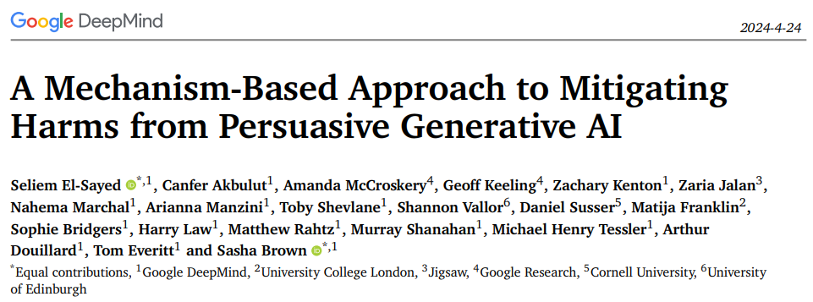
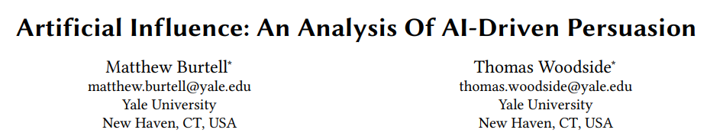
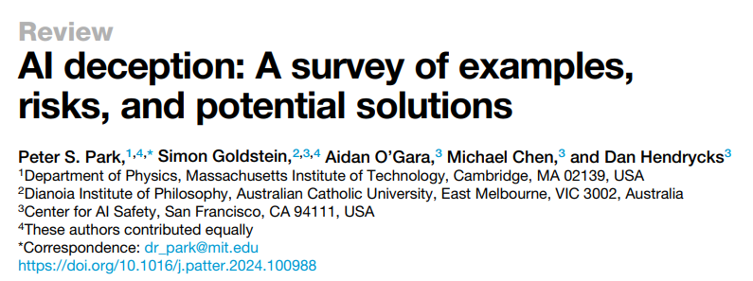
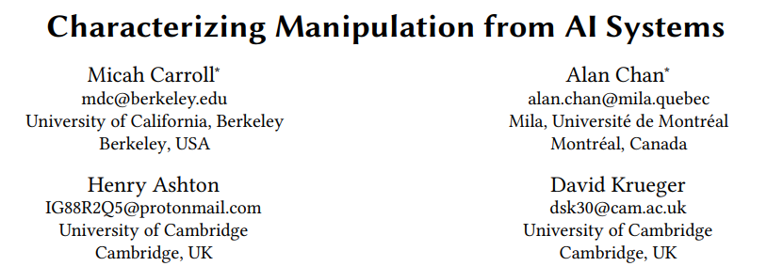
AI Persuasion
Yom-Tov, Dumais, & Guo. Promoting Civil Discourse Through Search Engine Diversity. In SSCR, 2014.
Massive amounts of user behavior data from surveillance capitalism
Generative AI’s capability to produce persuasive language and visualizations
Effective tools for mass manipulation of public consumer preferences and political opinion
Our ability to align generative AI models towards specific values
Imagine every time you searched online or accessed information via your digital assistant, the information was presented to you exactly in the form mostly likely alter your political opinions or consumer preferences
The existence of such capabilities incentivizes authoritarian capture of online information access platforms

Slide 26
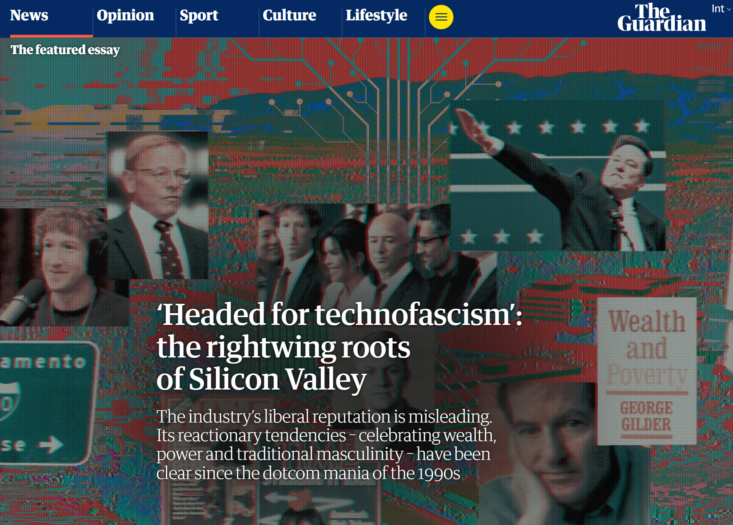
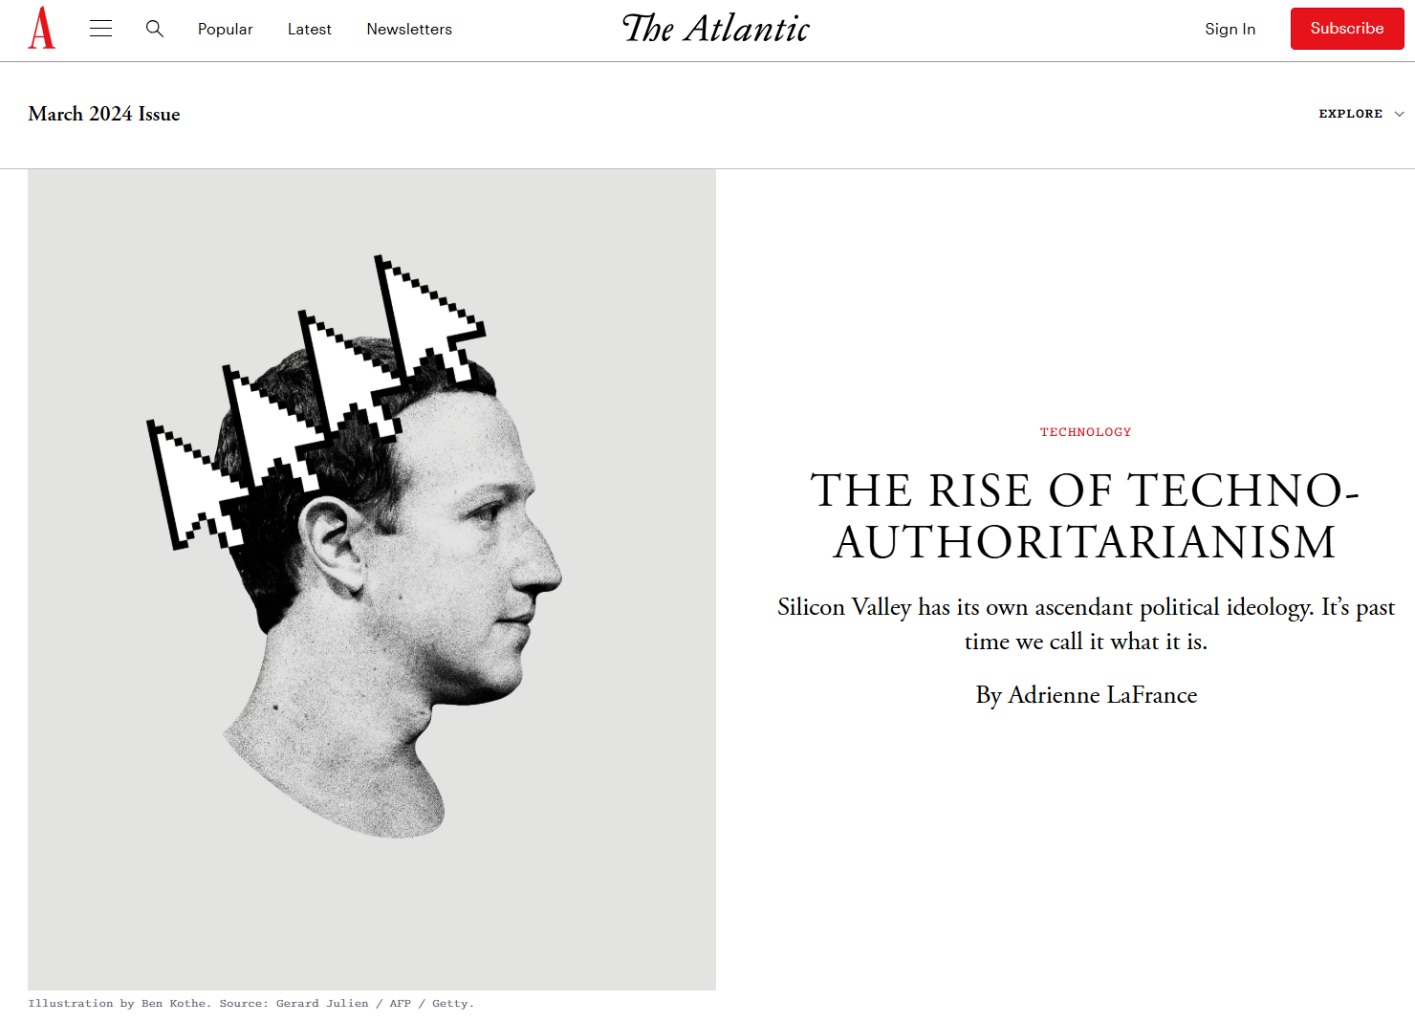
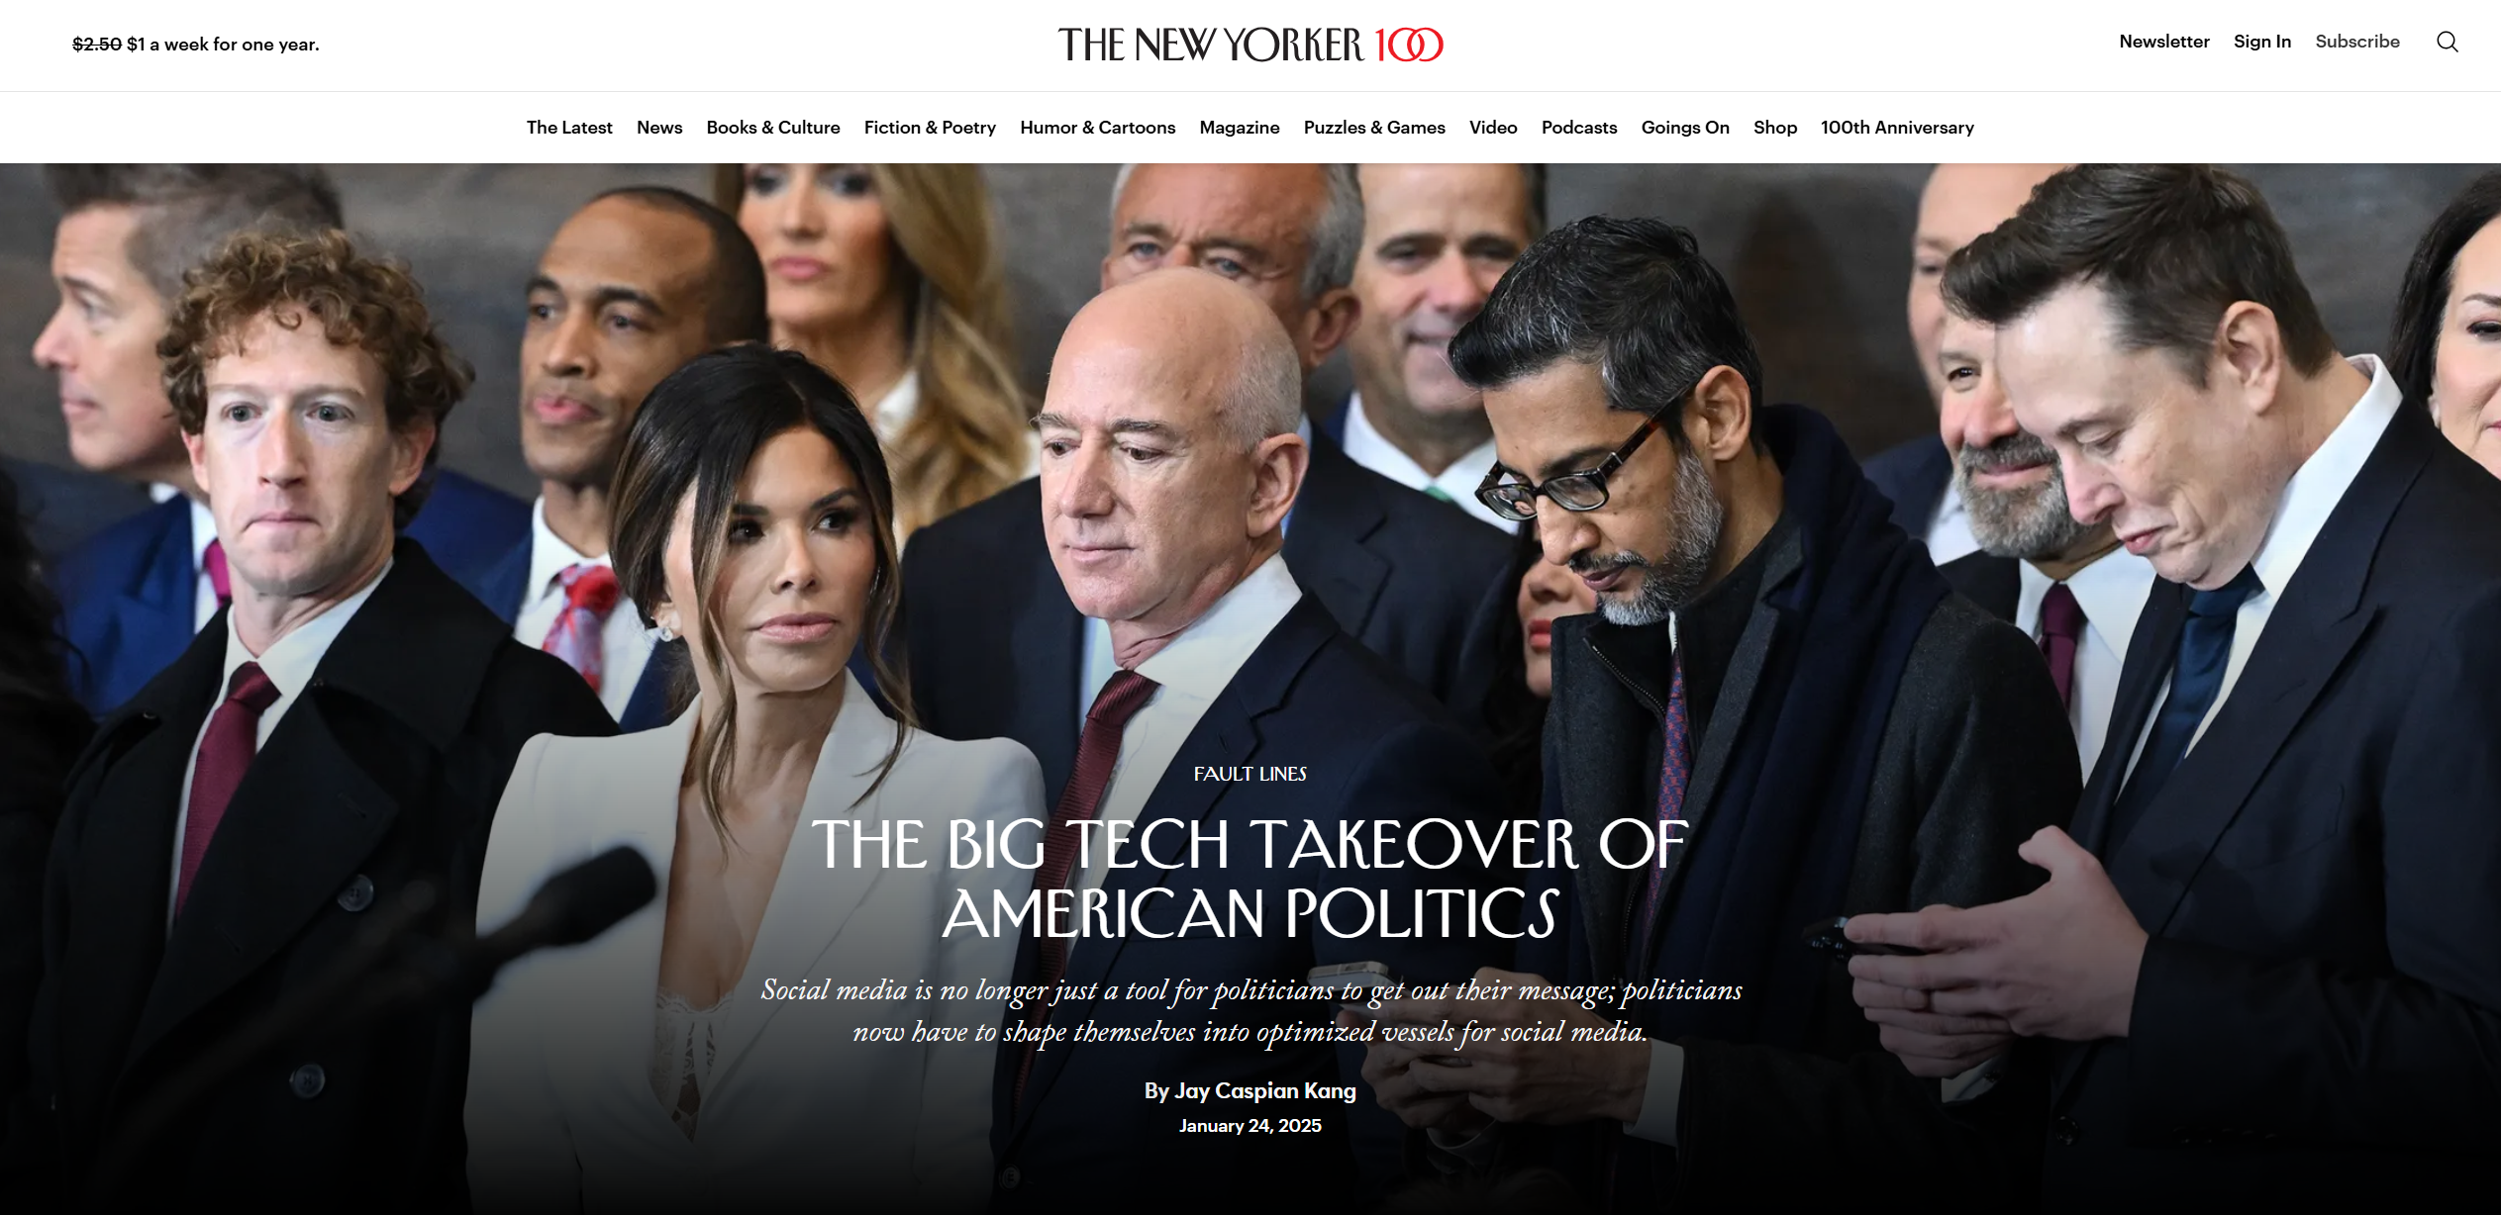
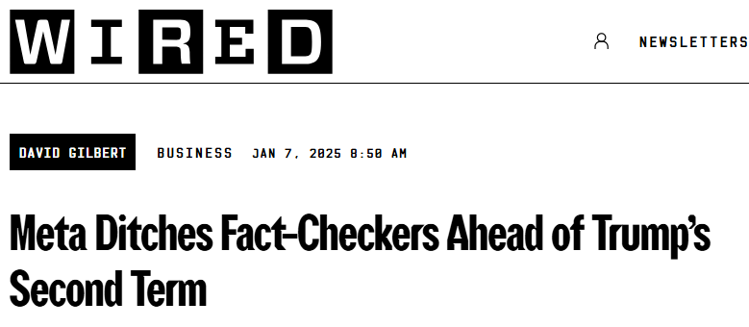
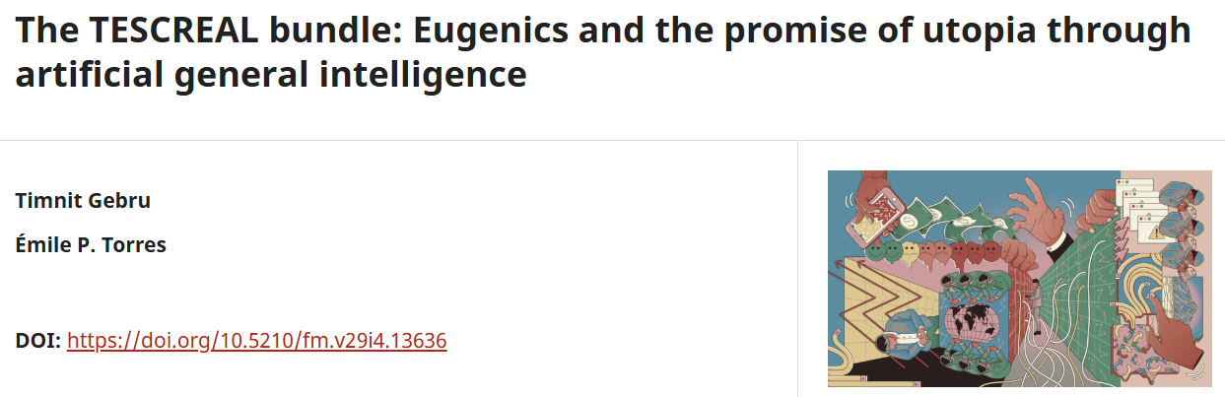
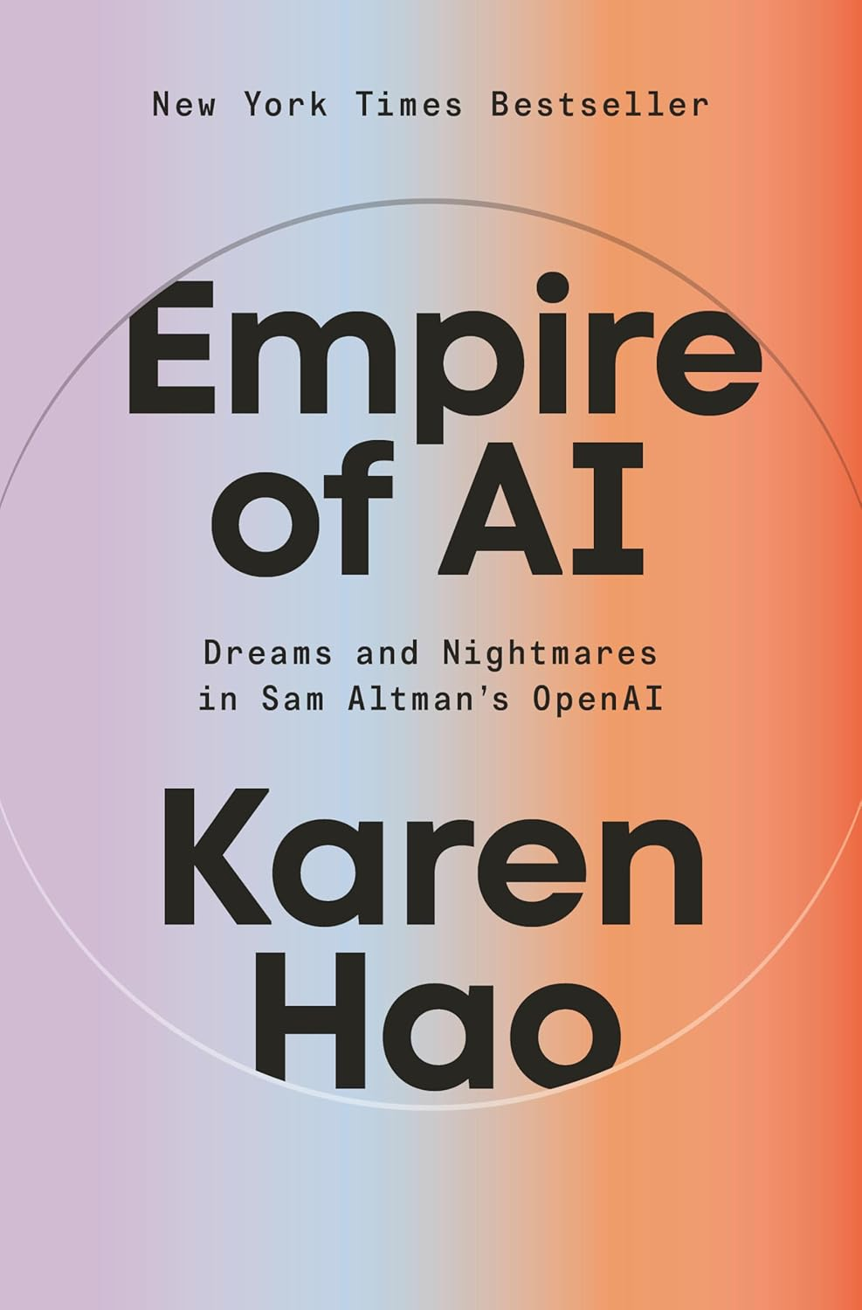
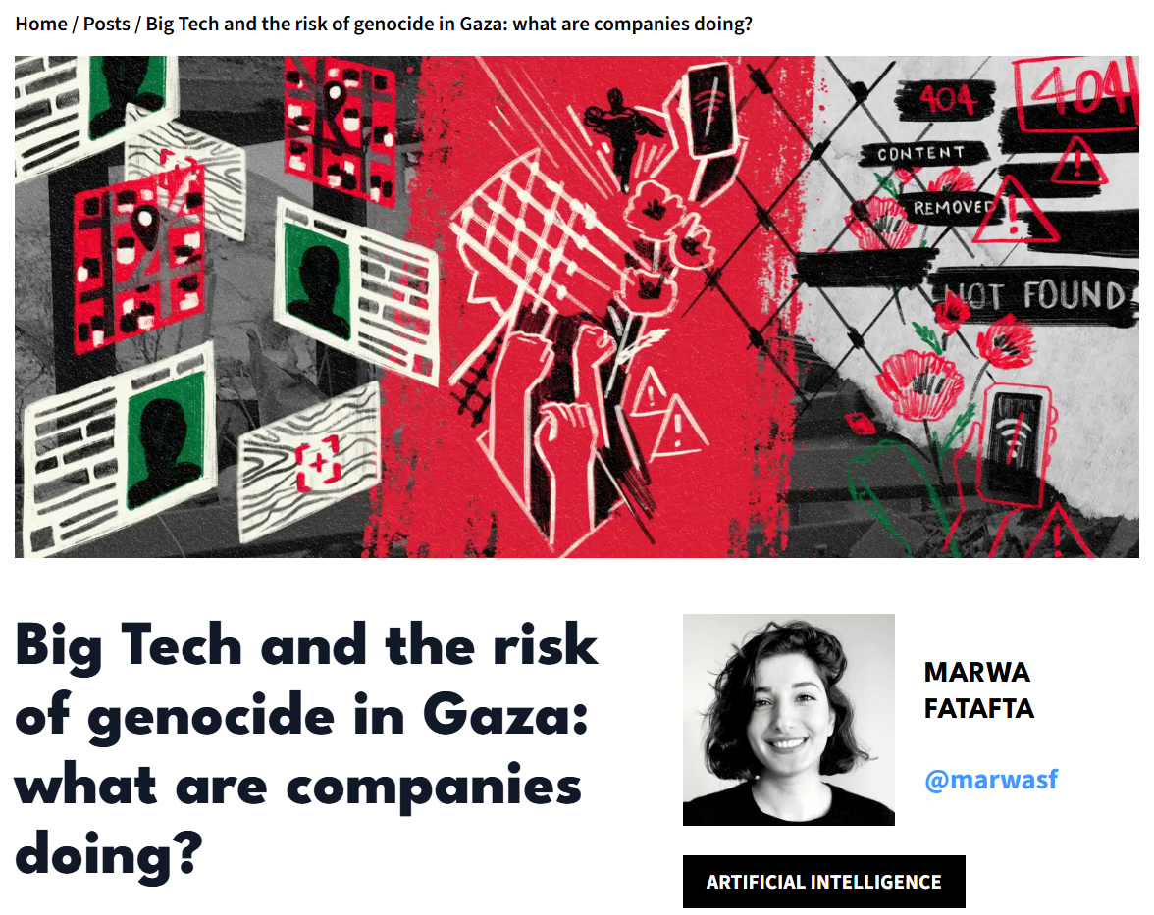
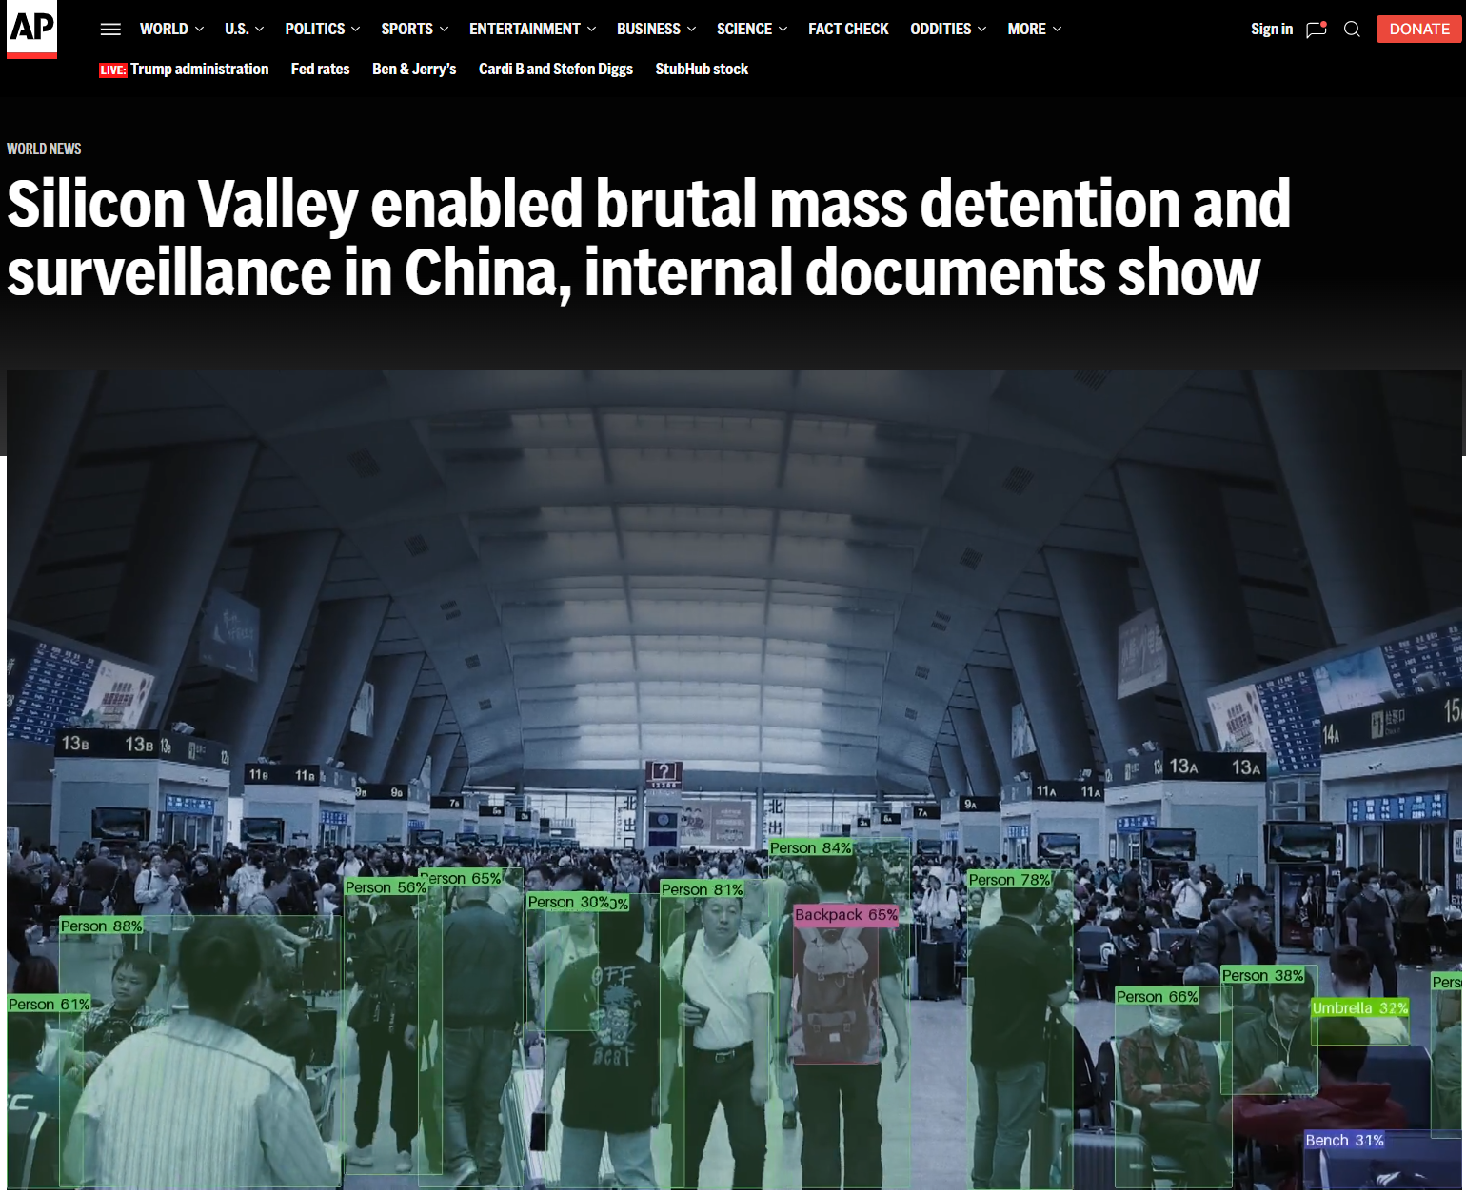
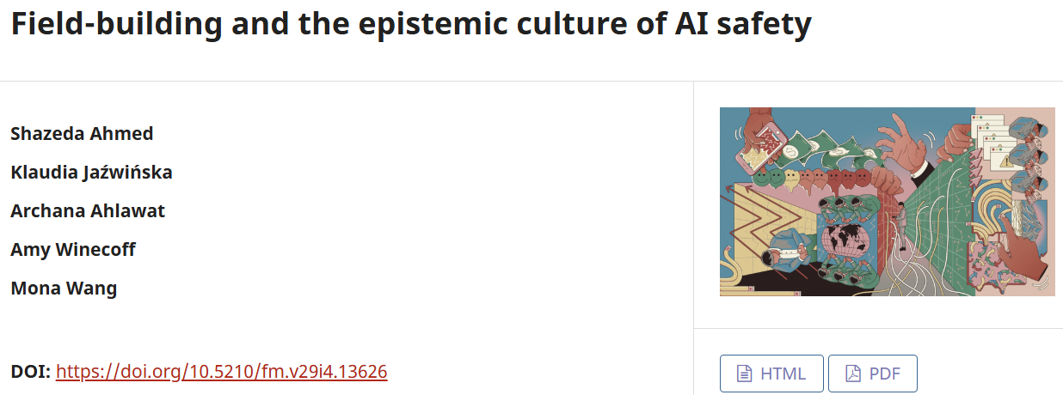
The Authoritarian tendencies of Big Tech & Silicon Valley
⚠️Beware of the pseudo-scientific community on x-risk / AI Safety; and the harmful TESCREAL bundle of ideologies
For more details, please read Gebru and Torres (2024) and Ahmed et al. (2024)

Slide 27
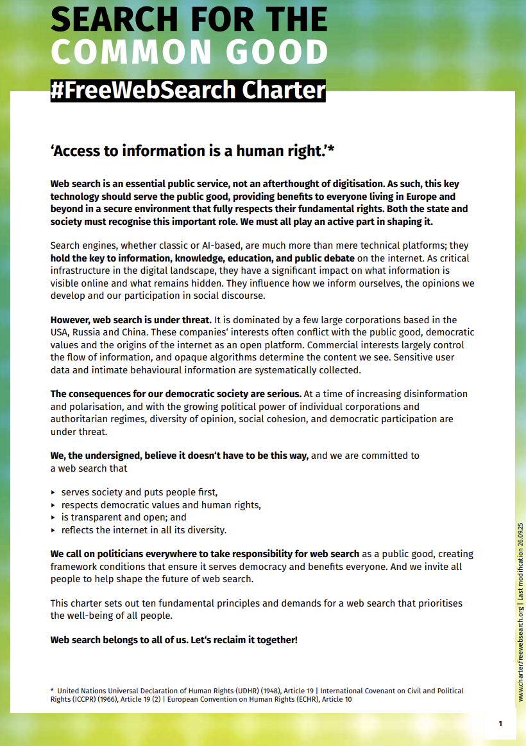
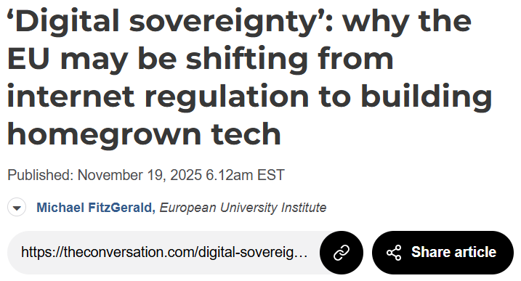

Calls for public platforms and digital sovereignty
However, Eurocentrism is not a meaningful antidote to American Exceptionalism
No search engine is truly open nor reflects the internet in all its diversity if it systemically erases the voices of the global south
Emancipatory IA seeks epistemic justice for the global south and marginalized populations within powerful nation-states
Mitra, Neophytou, and Gururaja. Information Access of the Oppressed: A Problem-Posing Framework for Envisioning Emancipatory Information Access Platforms ✊🏽✊🏾✊🏼. Preprint, 2026.

Slide 28
Open, to what end?
E.g., code, data, models, tooling, compute, labor, and governance
Commodities
Computing has a long tradition of pursuing openness to challenge tech oligopolies (e.g., open source, open AI models)
Within these movements, there is tension of values (e.g., free software vs. open source), and issues of co-option and open-washing by corporations defending their dominance
Openness should not be appraised w.r.t. what is being made open; but rather w.r.t. what capabilities and functionings it affords to those the system is being opened to
Formalized using Amartya Sen’s Capability-Theory from welfare economics
Depends on both the commodities being made open and actor-specific circumstances
Capabilities
(to function)
Functionings
E.g., critique, copy, and co-opt and co-construct
E.g., digital sovereignty, localization, market competition, open science, social justice, emancipation, and democracy
Well-beings
Sen. Commodities and Capabilities. Oxford university press, 1999.
Neophytou, Mitra, and Gururaja. Open, to What End? A Capability-Theoretic Perspective on Open Search. Preprint forthcoming, 2026.

Slide 29


Problem-posing framework for emancipatory IR
Beyond participatory design, challenging the technologists-as-liberator frame by structurally exposing spaces for community members to co-opt and co-construct the technology in aid of their emancipatory struggles
No user involvement
Implicit user feedback
User consultation
Participatory design
Co-option and co-construction
More user agency
Mitra, Neophytou, and Gururaja. Information Access of the Oppressed: A Problem-Posing Framework for Envisioning Emancipatory Information Access Platforms ✊🏽✊🏾✊🏼. Preprint, 2026.

Slide 30

Organizing and raising sociopolitical consciousness of our IR community (Cross-disciplinary workshops, book clubs, popular education, arts and zines, …)
https://bhaskar-mitra.github.io/reading/ →

Slide 31
Organizing and raising sociopolitical consciousness of our IR community (Cross-disciplinary workshops, book clubs, popular education, arts and zines, …)
https://bhaskar-mitra.github.io/reading/ →

Slide 32

“The exercise of imagination is dangerous to those who profit from the way things are because it has the power to show that the way things are is not permanent, not universal, not necessary.”
– Ursula K. Le Guin
bhaskar-mitra.github.io
@bmitra.bsky.social
bhaskar.mitra@acm.org
Notes:
Thank you.

